Slide 1
Robert’s Rules of Order January 21, 2017
Gary Minadeo
Parliamentarian
happy2help@att.net
440-840-6164

Slide 2
The Plan
Introductions
Class Objective
References
The Meeting
Questions
Wrap Up

Slide 3
Introductions
Gary Minadeo
Current Department Parliamentarian
Current Dynamic Ninth District Finance Officer
Past Post 7, Lake County, and Ninth District Commander
Army, 1974-1999
Math/Engineering Teacher at Cleveland High School, 1999-Present
Your Turn
Name
Post and Position
Service
One Takeaway from this Class

Slide 4
Class Objectives
Understand the Origination of Robert’s Rules of Order
General Henry Robert in 1867
Wanted to codify good order in meetings to not waste time
Understand How Robert’s Rules of Order Newly Revised Affects Posts
The Underpinning of Your CBL
The Premiere Guide for How to Conduct Meetings and Get Decisions Promptly
Understand Key Parts of the Book
Twenty (20) Sections from the Simple to the Complex
Section II, “Conduct of Business in a Deliberate Assembly” is the One for All
Understand the Other Helps that are Available
The 2016 Officers Guide
Many One and Two Page Helps on the Web

Slide 5
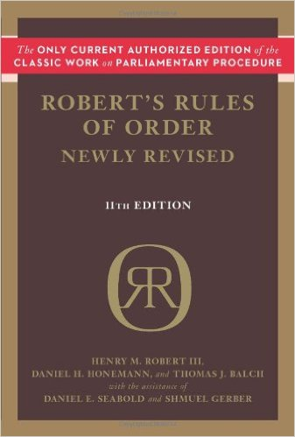
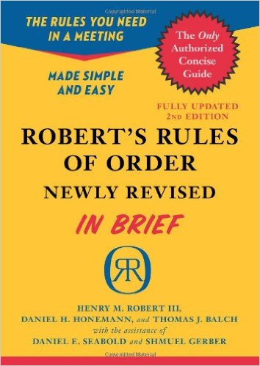
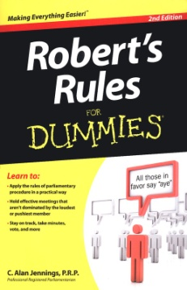
References
Robert’s Rules of Order Newly Revised, 11th Edition >>>>>>>
Robert’s Rules of Order Newly Revised –In Brief
Robert’s Rules for Dummies
2016 Officer Guide, Parliamentary Procedure, pages 122-128
Ohio Legion News, Just a Bit of Order, by the Parliamentarian

Slide 6
The Meeting
2016 Officer’s Guide (www.ohiolegion.com) Commander (Presiding Officer) Runs the Meeting According to CBL and Parliamentary Procedure
Prime Mission is to Allow for All to Participate in the Post Business
New Business is for Motions/Resolutions to be Voted Upon
Keep the General Announcements to Reports and Good of the Legion
To Table Keeps Motion Alive but Brings Another in Front
To Postpone Moves a Motion to Future Meeting
One Member Speaks at a Time and to the Chair – NOT OTHER MEMBERS
Have a Written Meeting Agenda, Publish It, and Stick to It

Slide 7
Wrap Up
General Henry Robert in 1867
Bring Order to Meetings
Applies to Posts as the Underpinning of CBL and Default Guide
Twenty (20) Sections of which Section II, “Conduct of Business in a Deliberate Assembly” Applies to All of Our Posts
Many On Line Helps, but Officers Guide is the Base Tool
Find Someone who likes Parliamentary Procedures
WHAT ARE YOUR QUESTIONS?

Slide 8
Have a Great Conference and 2017: Be Quota!
Gary Minadeo
happy2help@att.net
440-840-6164

