Slide 1
myLegion.org
Updated January 19, 2018
Notes:
Welcome to the myLegion training session. Introduction of presenter.

Slide 2
2018 Membership Drive
New Traditional
2018
Membership
Dept of Ohio
Goal = 94,000
Nation Renewal Campaigns
****
Direct Mail
Jul, Oct, Dec
Mar, May
Email
2/Month

Slide 3
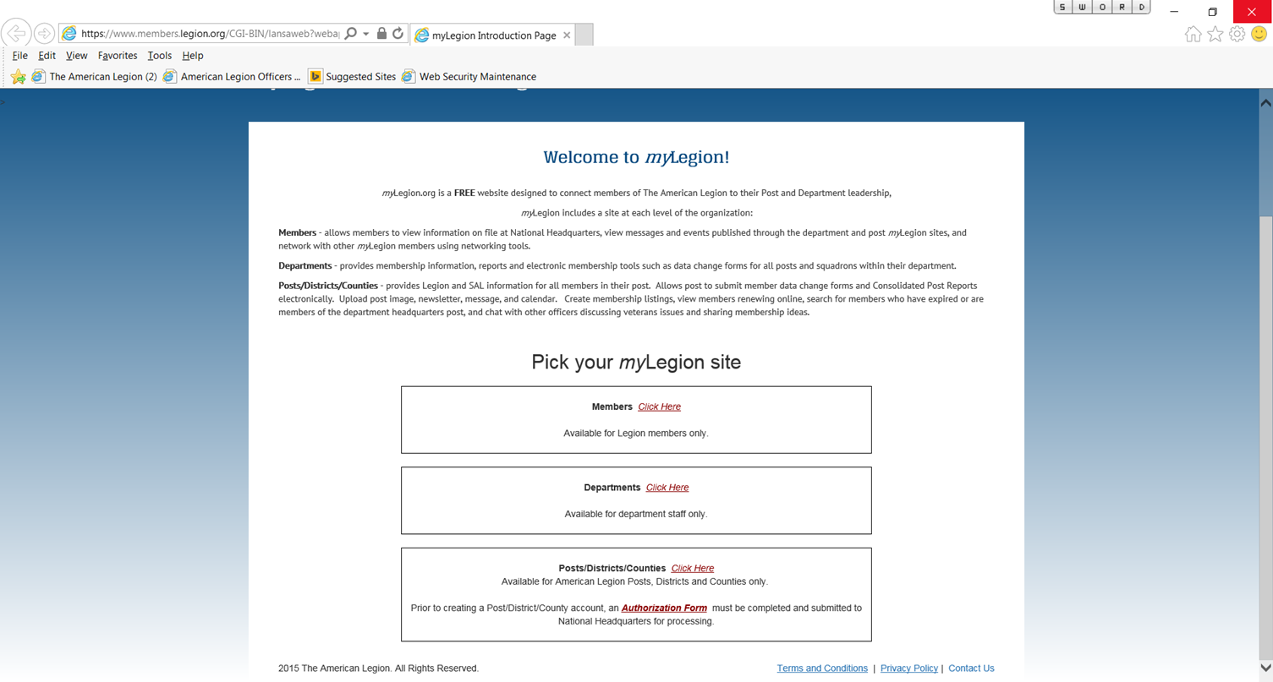
HOME PAGE
Notes:
By clicking on the myLegion.org link you are now on the myLegion Home page.

Slide 4
Available myLegion Sites
Member = Individual member only
Post = Post and Squadron membership
Administrator – Post Adjutant
County = All Posts within County (View only)
Administrator – County Commander
District = All Posts within District (View only)
Administrator – District Commander
Department = All Legion and SAL
Administrator – Department Adjutant / Commander
Notes:
Currently there are 5 available myLegion sites. Member, Post, County, District and Department. The amount of data accessible varies upon each level. The member will only see their member information. Post access will provide Legion and SAL data for all members of the post/squadron. District and County contains data for all posts within their area and Departments have access to all Post and Squadron membership.
Only post and department levels have Edit capability. Members can update their own information.

Slide 5
Administrators
Member = Individual member
Post = Post Adjutant
County = County Commander
District = District Commander
Department = Department Adjutant
LOST OR FORGOTTEN CUSTOMER NAMES AND/OR PASSWORDS
Once the site is created, if the customer name and/or password is forgotten, the site administrator must call National HQ to reset.
Notes:
Each site is assigned an administrator. Once the site is created, if the customer name and/or password is forgotten, the site administrator must call national headquarters to reset the log in credentials.
FAQ: Why only one administrator per site? My Post Adjutant doesn’t work membership.
Answer: Because myLegion is a secure site that includes personal membership information such as address, Date of Birth, email address, etc., it is important to maintain once source of control. The Post Adjutant’s manual states that “The adjutant keeps membership records and minutes of meetings, checks up on and assists the work of other officers and committees, and publishes official orders, announcements and instructions.” (ref. Page 3, 2014 Adjutant’s Manual) Therefore, the adjutant is the administrator at the post level.
At the District / County levels, Commanders have the responsibility for providing the link between individuals, posts and department. (ref. Page 3, 2014 District/County Commander’s Manual) Commanders are responsible for assigning responsibilities to other officers. However, National only records Commanders at the District/County level.

Slide 6
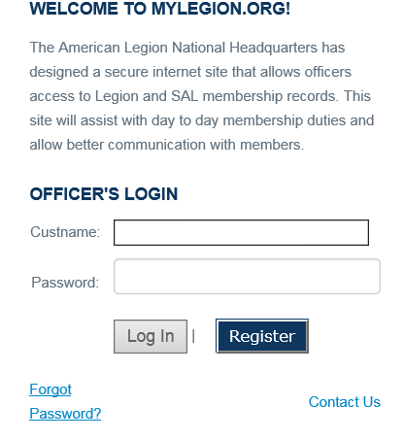
POST/DIST/CTY/DEPT
LOG IN PAGE
Notes:
This is the log in page for Posts, Districts, Counties, and Departments. Once the request is processed by National staff an email is sent to the contact to register the site. During the registration process a user name is assigned and a password is created by the user.
After the myLegion site has been registered you will enter the user name and password and click on the Log In button. Once you register you will not have to re-register. As new officers are assigned the site will transfer from the old officer to the new officer upon logging in.
FAQ: The previous administrator doesn’t know the user name and password / the previous administrator left and cannot be reached, how do we get the user name and password?
Answer: Call National’s customer service toll free number and ask for myLegion assistance. NOTE: The user name and password will only be provided to the site administrator. The administrator must make the call even if he/she is not the actual person who will be using the site.

Slide 7
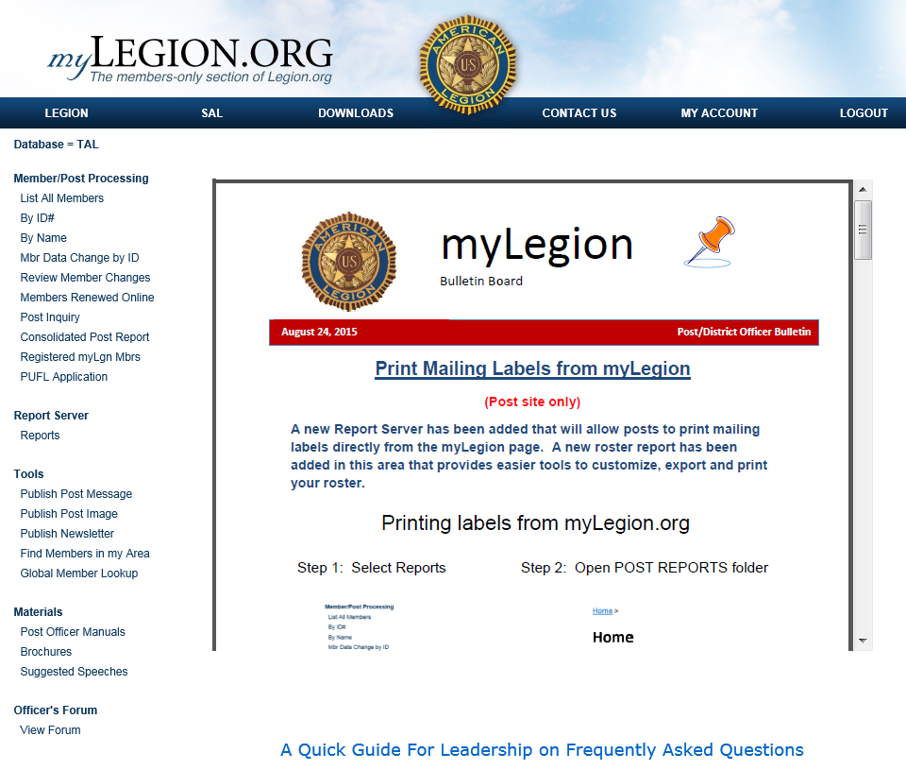
Notes:
Welcome to myLegion.org’s Home page for post officers!
***The bulletin board allows National to post information on the site such as frequently asked questions, new features, maintenance alerts, etc. This bulletin board will be updated periodically. This provides national staff the opportunity to display any maintenance alerts, new features, etc.
***Notice the top tool bars Legion, SAL, Downloads, Contact Us, My Account and Log Out. Clicking on one of these options takes you to a different area of the site. Example: the download area provides reports.
***The Home page opens on the Legion database options. The left hand column provides the general tools available.
This screen shot is from the Post site. District and County sites vary slightly. Now let’s look at the available tools from the Legion area.

Slide 8
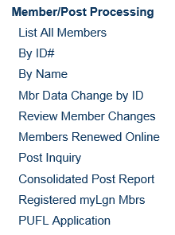
Member / Post Processing
Member Search
Notes:
In the Members/Post Processing section you can:
1.) look up members and access all membership information including payment history.
2.) Submit the data change form electronically such as address and email updates. However you cannot transfer, add or renew members through myLegion. These transactions must be submitted through the department headquarters.
3.) View and print reports for members who have renewed online.
4.) Post inquiry provides information on file for the post.
5.) Submit their Consolidated Post report electronically. And 6.) view members of your post who have created a myLegion member page.
6.) Quick link to Paid Up For Life (PUFL) application. Not available on the District/County level.
The member/post processing section is where you will search and edit member information, produce online renewal reports, look up post information, link to CPR report and view other myLegion users.
*** When searching for members there are 3 options. Selecting List All Members will display an alphabetical listing for all members. You can also search members by ID# and Name.

Slide 9
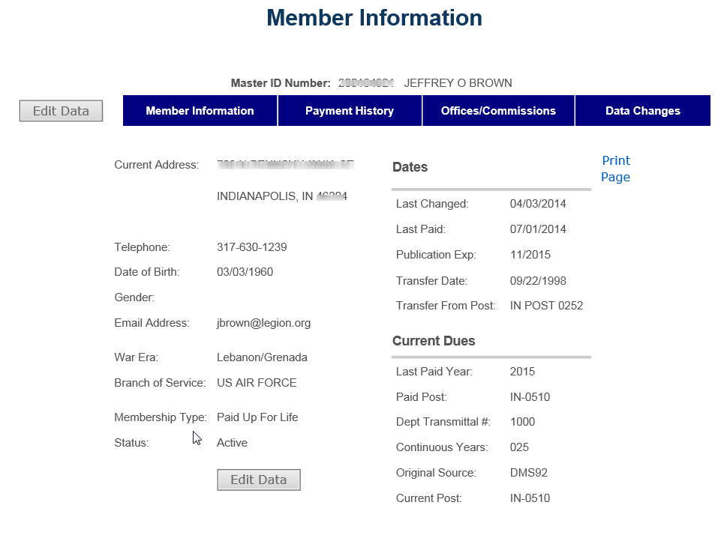
Notes:
There are four sections to Member Information. The Member information section displays standard data national maintains in their membership system.

Slide 10
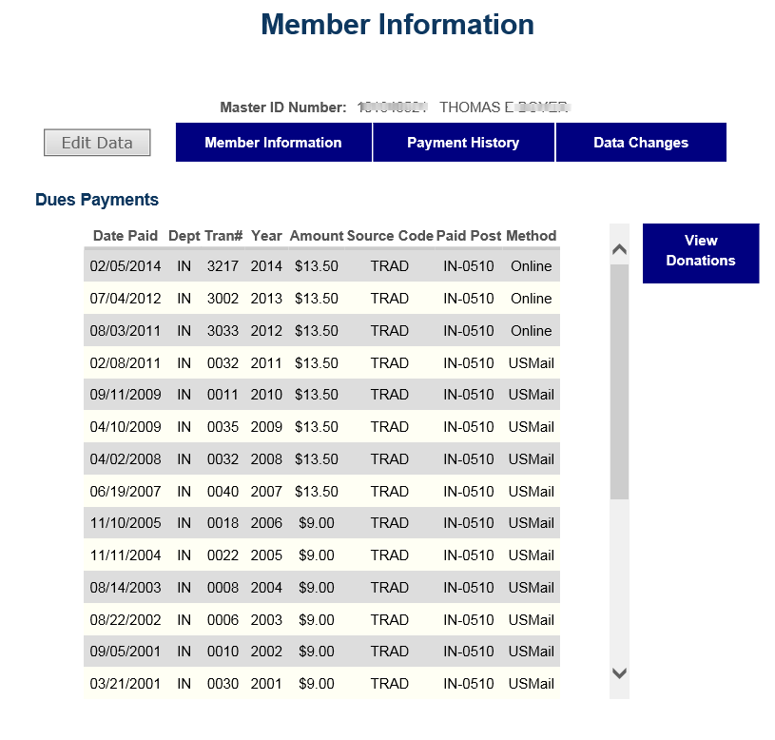
Notes:
Selecting Payment History displays payment history back to 1991 when National’s membership system was converted. Payment history includes any donations as well. This can be useful if you are researching continuous years.

Slide 11
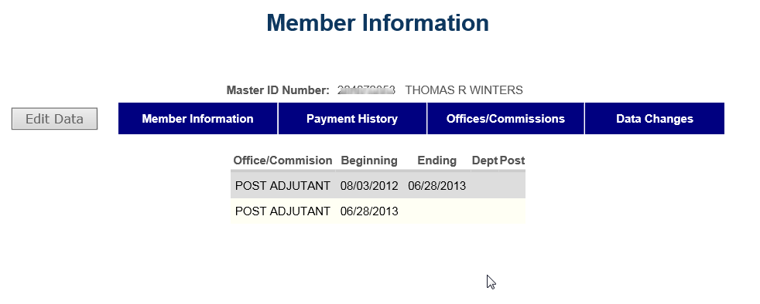
Notes:
Offices/Commissions displays any offices held on file at National Headquarters. Please note that National does not record all officers at the Post/District and County levels.
FAQ: What officers does national track?
Answer: Post Adjutants and Commanders. District Commanders. County Commanders. Department Adjutant, Commander. All National Officers, Commission and Committee members.
FAQ: What if the officer on file is incorrect?
Answer: All officer updates must be submitted through the department.

Slide 12
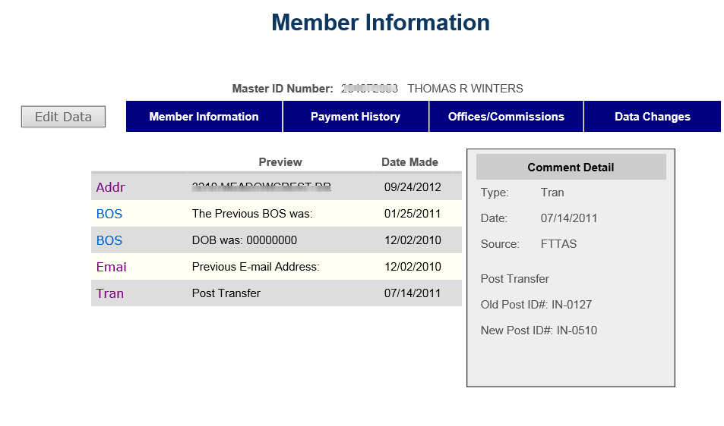
Notes:
The Data Changes section lists any changes applied to the record. Select Stat in the left column to display comment detail. This comment detail will provide the date and source the change was made.

Slide 13
DATA CHANGES ARE AVAILABLE FOR POST AND DEPARTMENT LEVELS ONLY.
DISTRICT/COUNTY SITES HAVE
VIEW ONLY ACCESS.
Notes:
Data changes are only available at the Post and Department levels. Districts and Counties cannot edit member’s records.

Slide 14
Notes:
The next tool is Members Renewed Online. This tool allows you to view all members who have processed their renewals online rather than through the post. Post Officers can keep a record of online renewals to send members their current membership card in a timely manner. This tool is also available on the District and County sites.

Slide 15
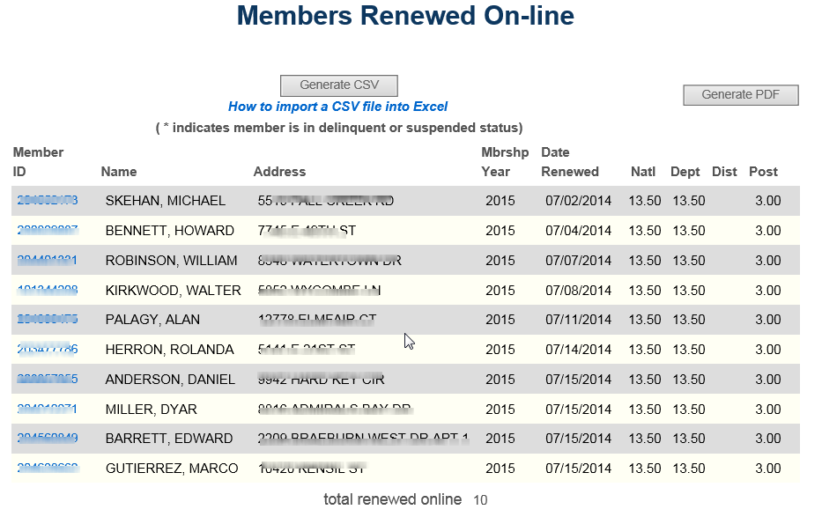
Notes:
A list of members who have renewed online will appear. This list provides the renewal date as well as dues allotment a the National, Department, District and Post level. Posts will be receiving their dues directly from the department via credit or check. It is determined by the department how to distribute post dues.
***You can then generate reports in either PDF or CSV formats.

Slide 16
Report Options
PDF – Portable Document Format
Print only.
CSV – Comma Separated Value
Allows report to be opened in other
applications such as Microsoft Excel and
Access so you can work with the data in
the file.
Notes:
myLegion provides reports in the following 2 formats. 1.) PDF. This is a Adobe format that only allows you to save and print the report. This format is valuable if you are wanting to send it to someone via email. 2.) CSV. The comma separated format can be opened in database programs so you can actually work with the data to produce custom letters and labels. If you need help with using the CSV format you can click on the help tool How to Import a CSV file into Excel.

Slide 17
Notes:
The next tool is the Consolidated Post Report or CPR.

Slide 18
Consolidated Post Report (CPR)
Available late fall through *July 1.
Complete in sections.
Departments Receive Copy.
Displayed on Member myLegion page.
Districts/Counties can view and print all reports submitted by their posts.
Notes:
Submit your Consolidated Post Report on-line. This option is available sometime in the late fall through July 1. National enters CPRs until all mailed forms are entered. The electronic form will be available until all entries are completed. However you will want to check with your department for their reporting cutoff dates.
The electronic CPR can be completed in sections.
National emails all submitted CPRs to the appropriate department.
The CPR is also linked to the myLegion members page thus allowing them to see what activities the post supports.
Districts and Counties can view and print submitted reports from their sites.
FAQ: Why isn’t the CPR available the beginning of the membership year?
Answer: Each year the CPR is modified by National’s Membership Division. Once the modified form is submitted to IT, it will be posted to the site and made available.

Slide 19
Notes:
Any questions regarding the Member/Post Processing area?

Slide 20
Online Membership Processing
The “Process Membership” feature in myLegion allows American Legion Post Officers to:
Renew Existing Members
Add new members and transfer-in existing members from other Posts. (NOTE: Posts can only transfer-in members that dues are being paid for.)
This feature utilizes electronic payment methods via myLegion, and eliminates the need for Post Officers to send the National/Department portion of the (3-part) membership cards and paper-checks to the Department Headquarters office
Electronic check (Echeck) is the only payment method available when using this feature. The account must be a valid business checking or savings account held with a US Bank.

Slide 21
Online Membership Processing
ELECTRONIC CHECK (Echeck) PROCESSING GUIDELINES
The processing time for Echecks is up to 7-business days.
Will decrease to 5 by the end of July
The Post will be charged all penalty fees levied by the ACH (Automated Clearing House) processor for declined Echecks.

Slide 22
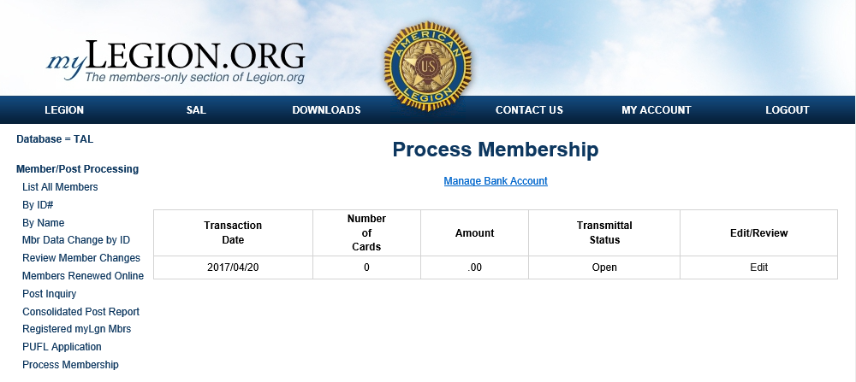
Online Membership Processing
From the left-menu, choose “Process Membership”

Slide 23
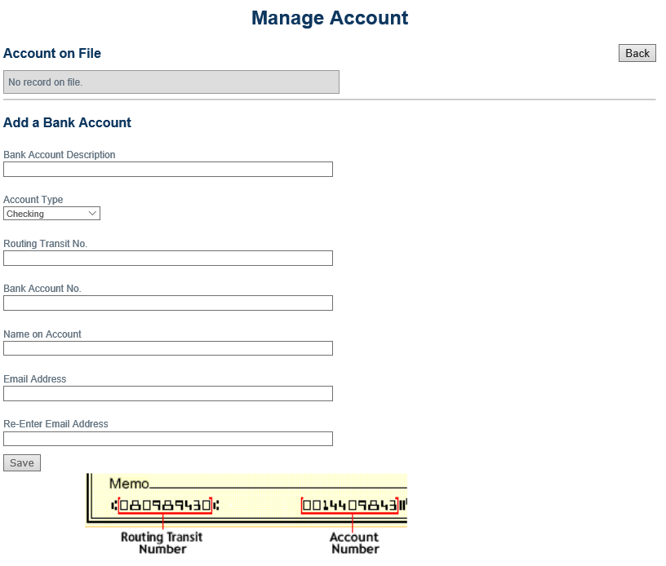
Online Membership Processing
STEP 1: Click “Manage Bank Account” to enter your Post’s Bank Information.

Slide 24
Online Membership Processing
STEP 2: ADD RENEWALS AND/OR NEW MEMBERS TO AN “Open” BATCH.
Only one “Open” Membership batch is available for processing. The Open batch must be completed and submitted before a new batch becomes available. In addition a $10,000 maximum limit is in effect for each batch.

Slide 25
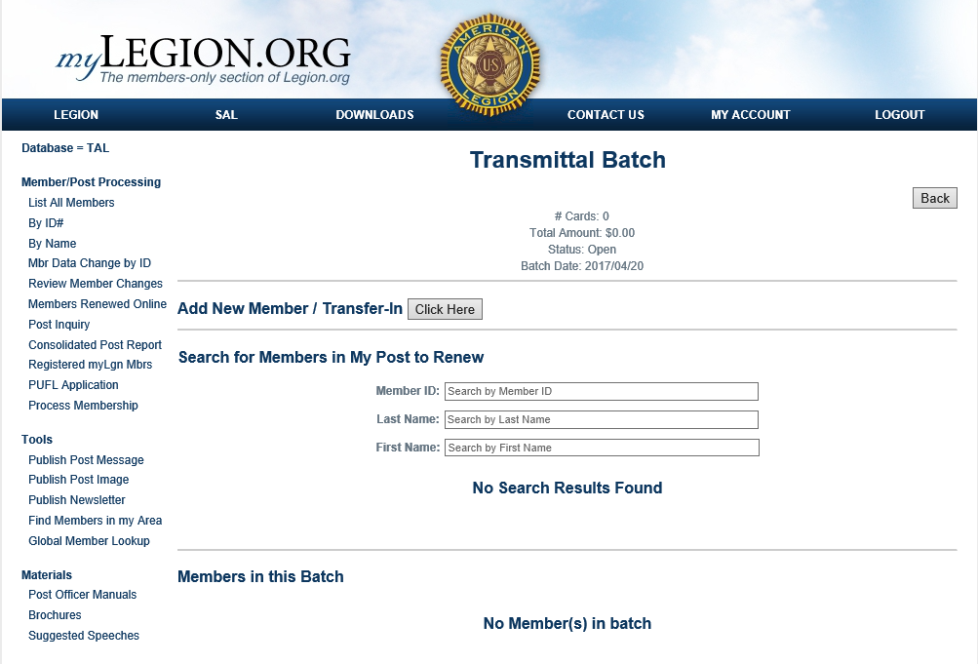
Online Membership Processing
The “Transmittal Batch” form allows you to Add New Members, Transfer-in and pay for a member from a different Post..as-well-as select from a list of members that currently reside in your Post for renewal.

Slide 26
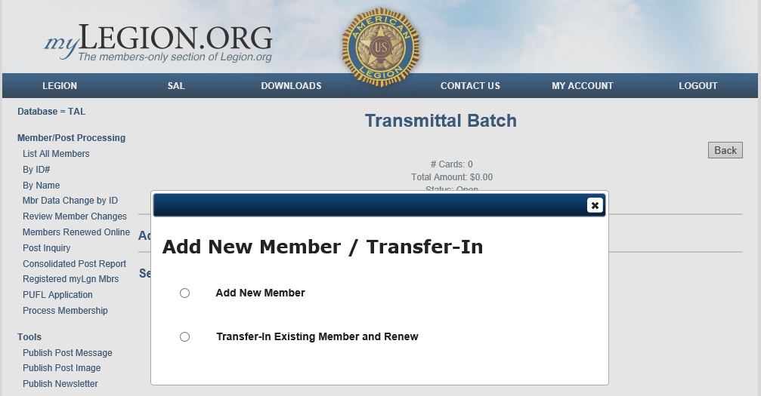
Online Membership Processing
ADD NEW MEMBER/Transfer-in
Choose whether you are adding a new member (never-before-Legionnaire), or transferring-in an existing member from a different Post.

Slide 27
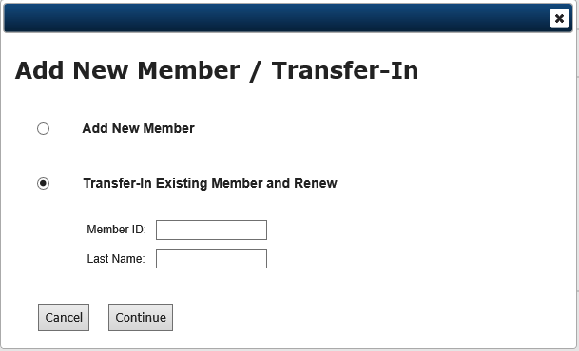
Online Membership Processing
Member ID# and name are required to transfer-in a member from another Post.

Slide 28
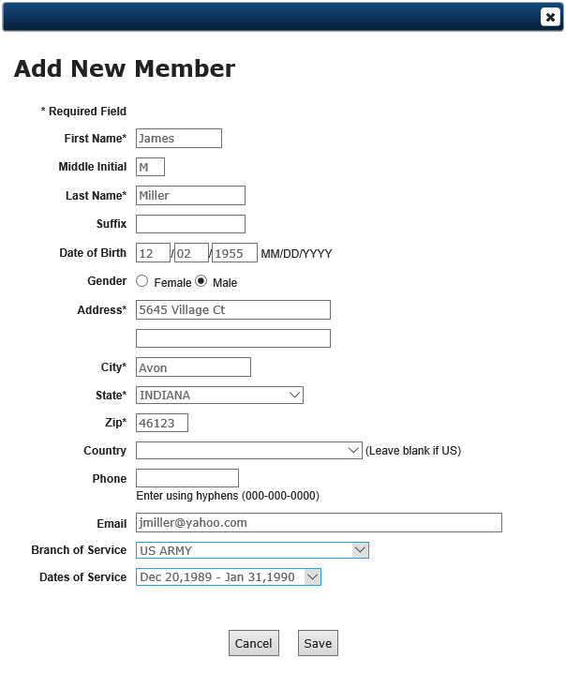
Online Membership Processing
Complete the “ADD NEW MEMBER” form and click “Save”

Slide 29
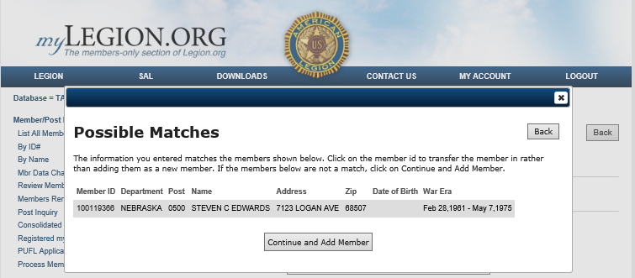
Online Membership Processing
If you chose “Add Member” (never-before-Legionnaire), this feature sweeps the entire database looking for potential matches.

Slide 30
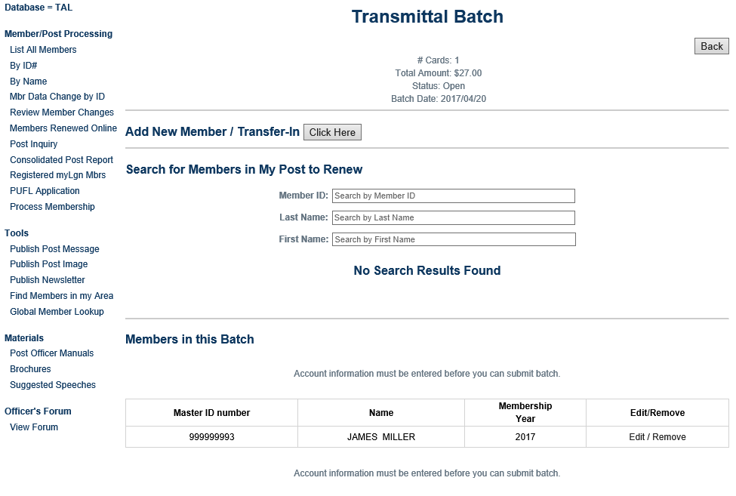
Online Membership Processing
After “Save”, notice the member shows up under “Members in this Batch”. Click “Edit” to change demographic information, or “Remove” to delete this member from the batch.

Slide 31
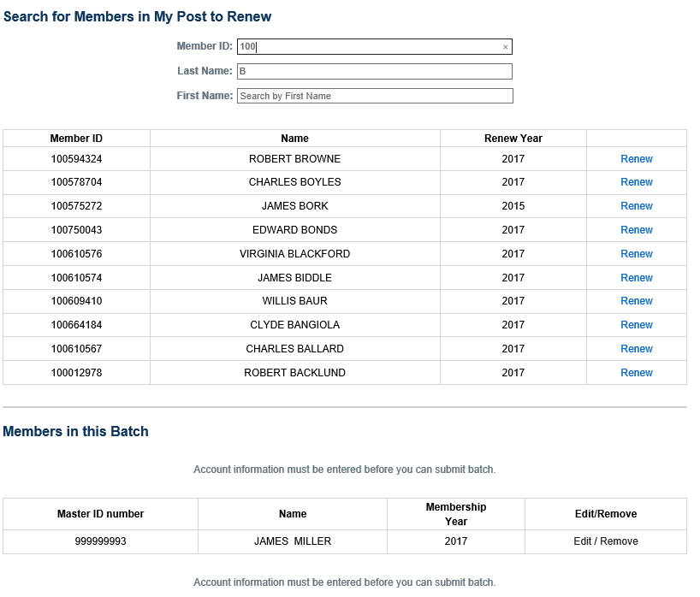
Online Membership Processing
Use the Search feature to find the member in your Post that you want to renew. Notice that the search feature follows along with you as you type. The example above shows “100” entered for “Member ID:” , and “b” for last name. The form then finds all members in your Post where Member ID begins with “100” and Last Name starts with “b”. Select the member by clicking “Renew”.

Slide 32
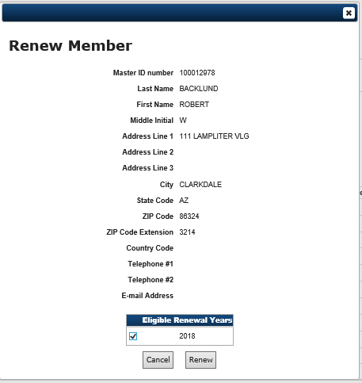
Online Membership Processing
Select the Renewal Year(s) and click “Renew”

Slide 33
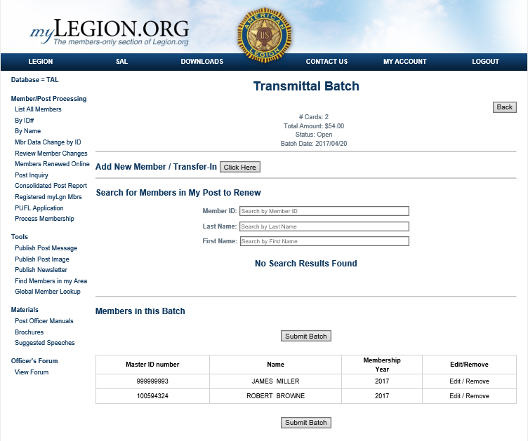
Online Membership Processing
STEP 3 : SUBMIT BATCH FOR PROCESSING
When your batch is complete, click “Submit Batch” to initiate payment.

Slide 34
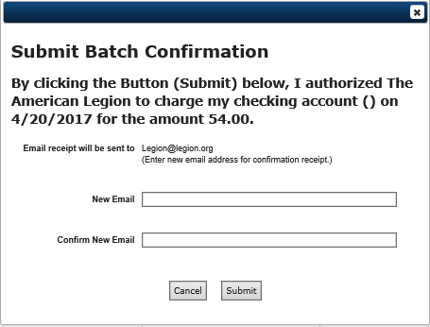
Online Membership Processing
A confirmation screen will appear with the email address where the transaction receipt will be sent. This screen also allows you to change where the email receipt will be sent.
Click “Submit” to initiate payment for the batch.

Slide 35
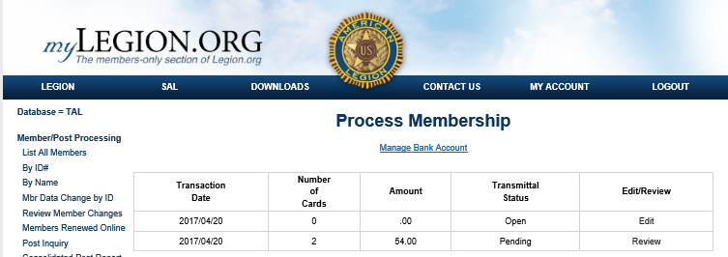
Online Membership Processing
After submitting the batch for processing, the “Process Membership” form will show the batch in a pending status. Once the transaction has completed processing in the ACH network, the Transmittal Status will change to “Applied”. Allow up to 7-business days for the transaction to clear through the ACH network.

Slide 36
Report Server
Report Server
Reports/Labels
Print mailing labels and reports from the new Report Server.
Notes:
Report Server now allows easy label printing options and reports that can be exported to other applications.

Slide 37
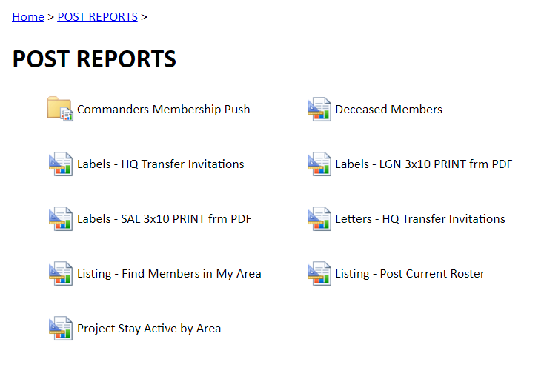
Post Reports
District and County sites do not include mailing label options
or Commanders Membership Push folder.
Notes:
In the Report Server you will open the POST REPORTS folder to view available reports. ** The District Report Server does not include mailing label options or Commanders membership push folder.

Slide 38
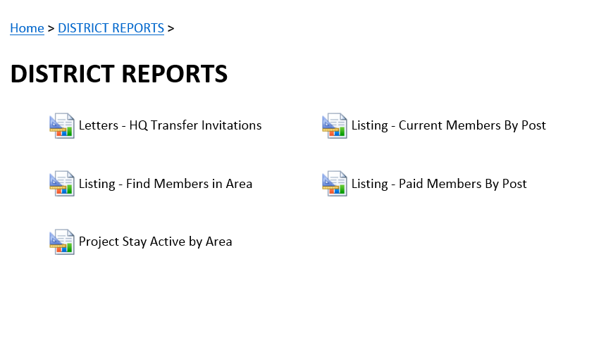
District Reports
Notes:
The District Report Server does not include mailing label option.

Slide 39
Commander’s Membership Push
Notes:
At various times, the National Commander will cerate a membership incentive.
National headquarters have planned direct mail campaigns for January, March and May. Additional email campaigns will be launched twice a month for 2017 through the end of the membership year.
Commander Schmidt would like to encourage local efforts to contact un-renewed members using tools through myLegion.

Slide 40
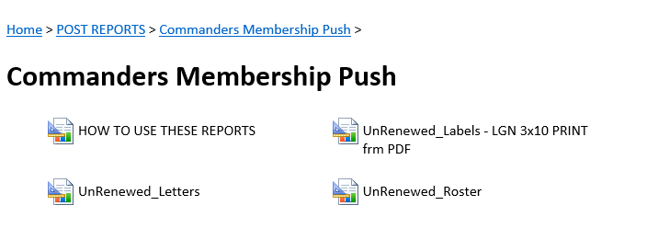
Produces results for all members of the post that have not renewed for the 2017 membership year.
Notes:
This folder provides a expired roster for the post, a pre-written personalized renewal letter, and labels.

Slide 41
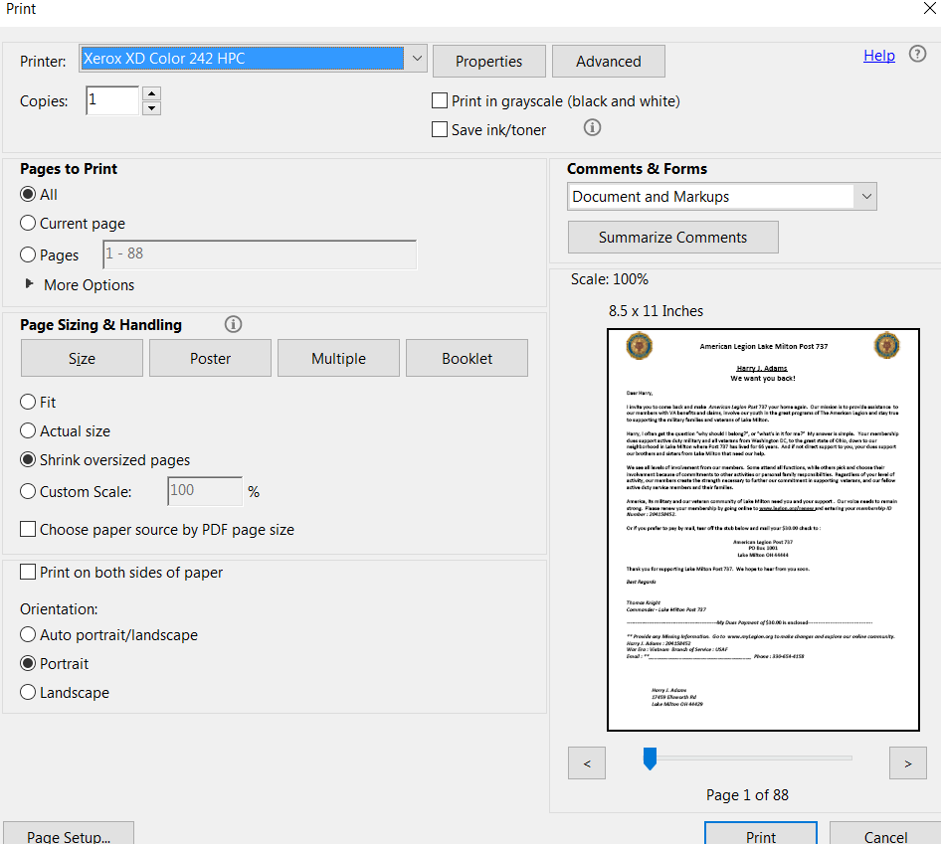
Notes:
When printing letters made sure your set your Adobe Reader to print to “Fit” page or “Shrink Oversized Page. It should be under a feature like “Page Sizing & Handling”. With a tri-fold and a stand #10 window envelope, your mailing should be simple.
If you want a set of 3X10 labels to match your letters, make sure you choose the same Address Type and Sort options on your labels as you set on the letter.

Slide 42
Produces results for all members of the post that have not renewed for the 2017 membership year.
Notes:
This folder provides a expired roster for the post, a pre-written personalized renewal letter, and labels.

Slide 43
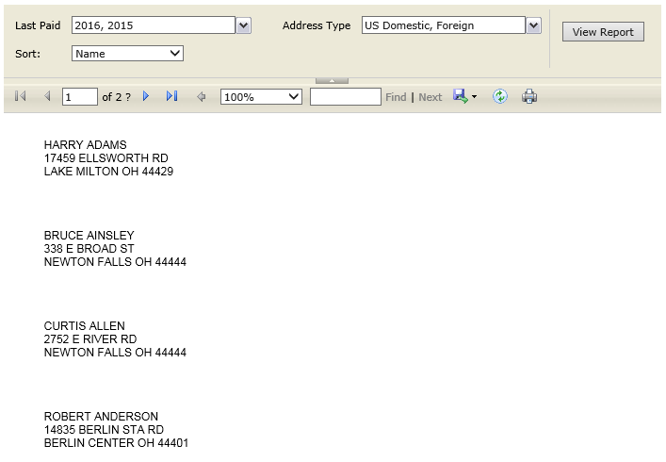
Commander’s Membership Push UnRenewed_Labels
Select options and View Report
Export to PDF
Print labels
PRINT ACTUAL
SIZE
Report renders one-column but will print 3-across 30/sheet.
Notes:
To create mailing labels, set the last paid year, address type, and sort information. Click View Report.
The names and addresses will display in your browser as a single column. When exported to a PDF they will appear 3 rows across and 10 rows down. You can use any standard 30/sheet label.

Slide 44
Produces results for all members of the post that have not renewed for the 2017 membership year.
Notes:
This folder provides a expired roster for the post, a pre-written personalized renewal letter, and labels.

Slide 45
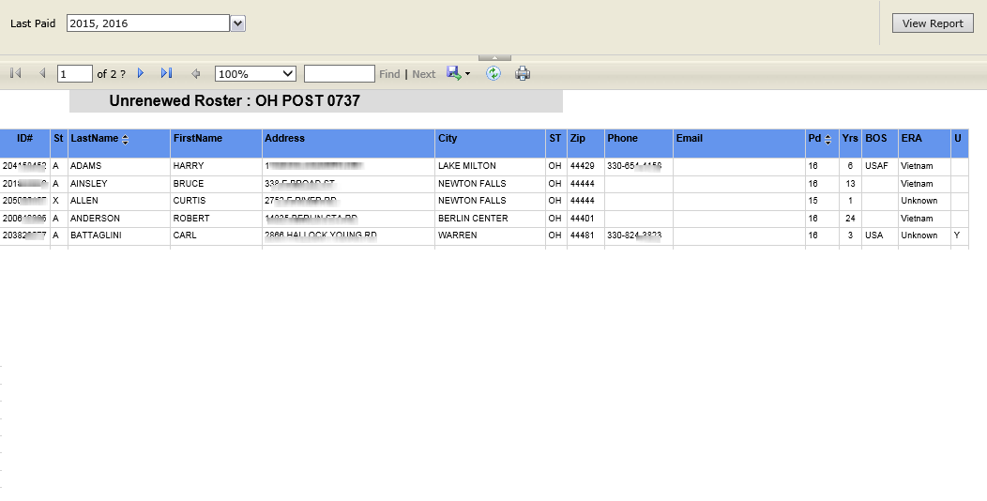
Commander’s Membership Push UnRenewed_Roster
Notes:
The un-renewed roster includes members with the last paid date of 2015 and 2016. Select either last paid year or “select all” for both and View Report. Export the roster to desired application.

Slide 46
Creating Labels from myLegion
Post sites only
Select Labels for either Legion or SAL members. Labels must be created separately.
Notes:
To create mailing labels select Legion or SAL. Labels must be created separately.

Slide 47
Creating Labels from myLegion
Post sites only
Select Labels for either Legion or SAL members. Labels must be created separately.
Notes:
You will notice also a label option for Headquarters’ Transfer Invitation Letters. When using these tools, make sure you are entering the same search criteria.

Slide 48
Creating Labels from myLegion
Designate last paid year.
Notes:
Select the desired criteria. You can designate labels based on last paid year.

Slide 49
Creating Labels from myLegion
Designate address type. This allows you to exclude foreign addresses.
Notes:
Once you have selected the last paid year, select address type. The address type will be either US Domestic or Foreign. To exclude foreign address labels to be created, uncheck the Foreign option.

Slide 50
Creating Labels from myLegion
Designate sort by requirements. Click on View Report.
Notes:
You can sort the labels by last name or zip code.
** Once you have selected your criteria, click on the View Report button.

Slide 51
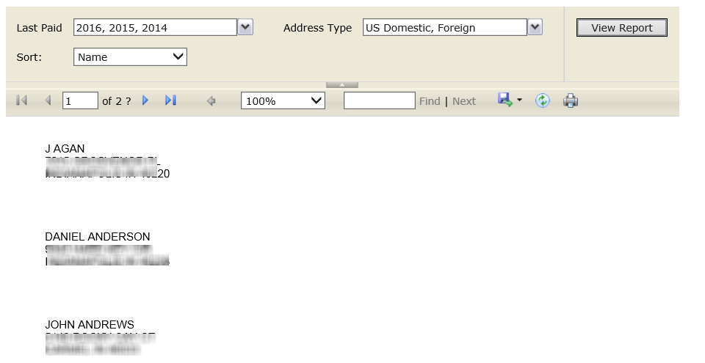
Creating Labels from myLegion
Report renders one-column but will print 3-across 30/sheet.
Notes:
The report will render one-column when viewed. It will export to a PDF 3-across, 30/per sheet labels which is the most commonly used label.

Slide 52
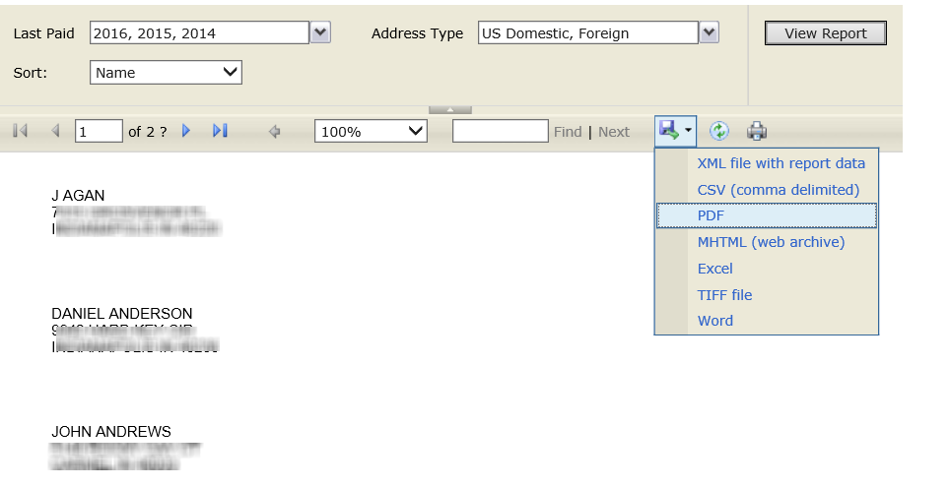
Creating Labels from myLegion
Use the Export icon to and select PDF to create labels. You can also export the file to other formats.
Notes:
Use the export icon and select PDF to open labels as a PDF document for easy printing. You can also export the mailing data to other applications such as Excel and Word.

Slide 53
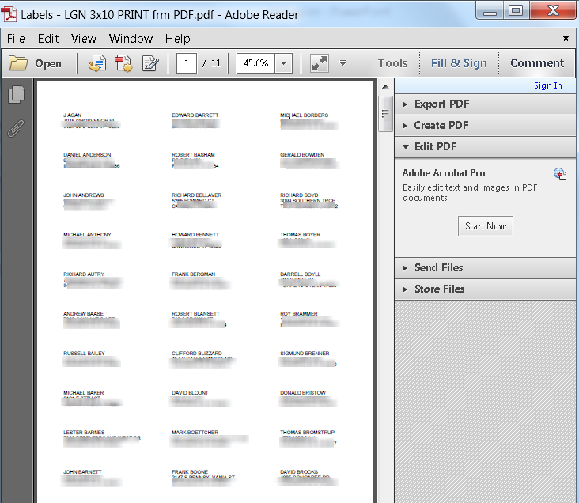
Creating Labels from myLegion
Print PDF file on labels.
Notes:
When opened as a PDF document, the view will look like this. Place blank label sheets in your printer and print.

Slide 54
Creating Reports Letters – HQ Transfer Invitations
Notes:
HQ Transfer Invitations -- A pre-written letter is available inviting members currently assigned to your state headquarters post to transfer into your post.

Slide 55
Creating Reports Letters – HQ Transfer Invitations
Use this pre-written letter to assist with contacting members to transfer into your post.
Select zip code(s) – all state zip codes available
Target Transfer Post – designated post to transfer into
Target Post Information – editable information for letter
Other Legion Family at Target Post – select what other American Legion family your post sponsors.
Results for current members only.
Export to PDF or Word document
Notes:
Select the search area criteria and use custom fields to add personalization to your letter. This report pulls current members belonging to the state headquarters post.
Search for members: Select the zip code(s) to search for members in the headquarters post.
Target Transfer Post : Post contacting the member to transfer
Personalize letter:
Post Address – Displays top of page
Post Rep – Signature block on letter
Title – Displays above signature block
Other Legion Family: Add to letter other Legion Family affiliated with your post.
No labels needed! The letter will include the mailing name and address at the bottom of the letter so it folds to fit inside standard #10 window envelopes.
Export letter to a PDF file and print using the Export icon.

Slide 56
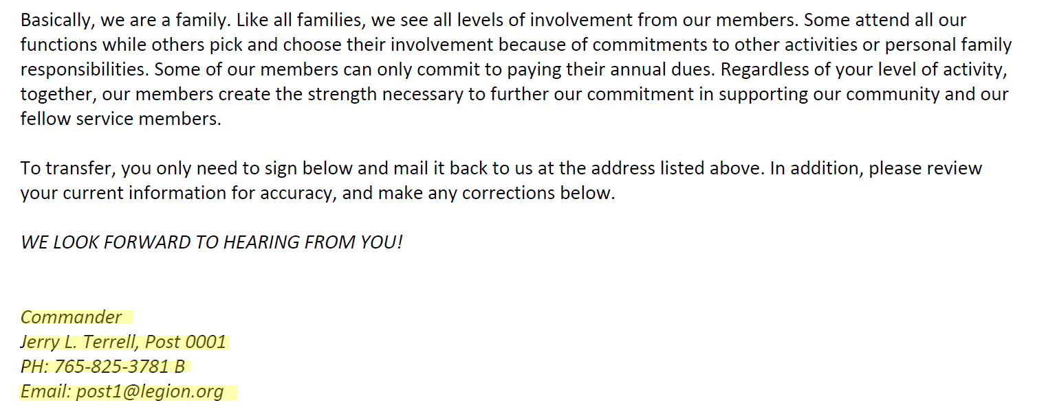
Notes:
The letter will include information selected. **Notice the 3rd paragraph. This paragraph includes the organizations your post supports. If None is selected, the first sentence of this paragraph will be excluded.

Slide 57
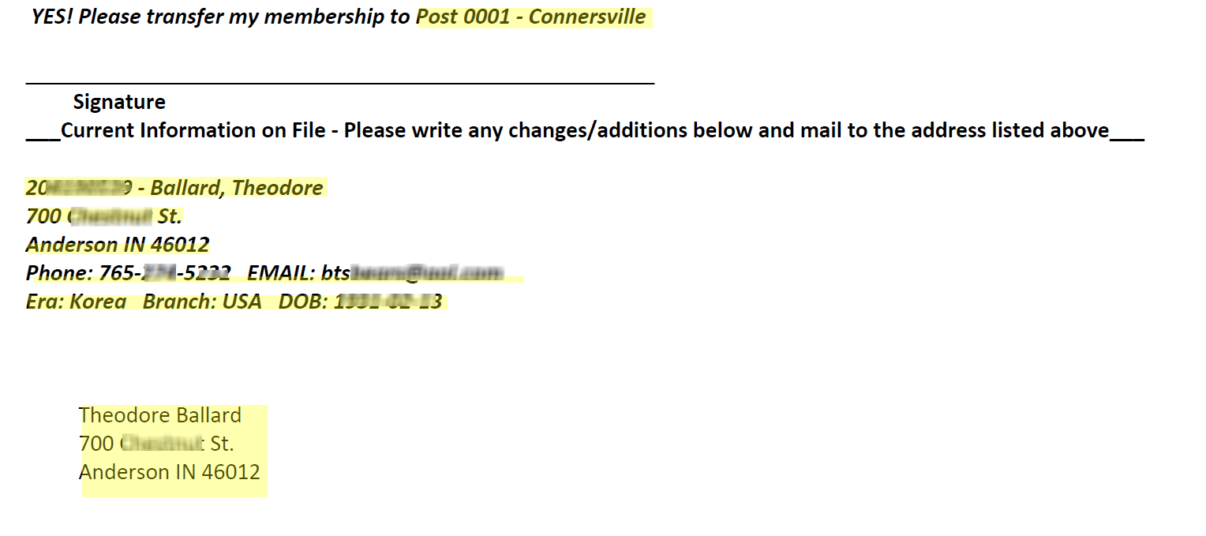
Bottom of letter includes personal member information. If not on file, a line will appear for member to enter.
Notes:
The bottom of the letter includes a signature block requesting transfer into the target post. NOTE: This letter does not replace the Data Change Form currently used to transfer members. Continue to complete the form, write “per member’s request” on the form and attach a copy of the letter. Transfers continue to go through the state headquarters.
The letter also includes information currently on file at National Headquarters. This allows the member to correct any information needed. It also includes

Slide 58
Address to use standard window #10 envelope.
Notes:
Each letter has an address block at the bottom of the page. This allows you to use standard #10 window envelopes. No need to print labels.

Slide 59
Creating Reports Listing – Find Members in My Area
Notes:
The Find Members in my Area is also available in the Tools section. This listing allows you another way to select members who are currently in expired status or belong to the state headquarters post base on the criteria entered.

Slide 60
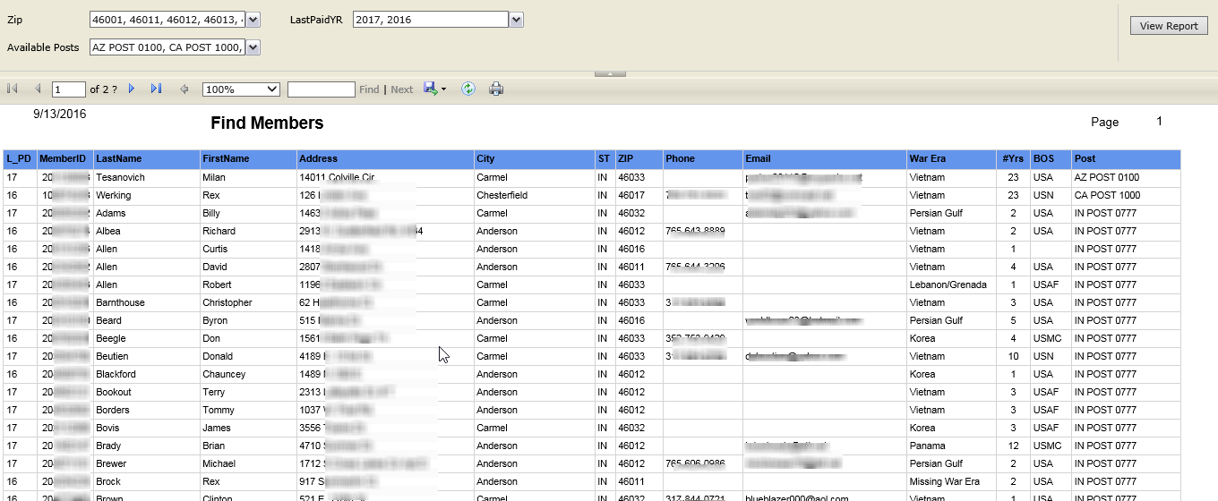
Creating Reports Listing – Find Members in My Area
Notes:
Using the sort options you can select one or multiple zip codes and last paid year. The available posts search allows you to select only people in the headquarters post.

Slide 61
Creating Reports Current Post Roster
Notes:
The report works similar to mailing labels. Select the report. Note that this report is also available in the downloads area.

Slide 62
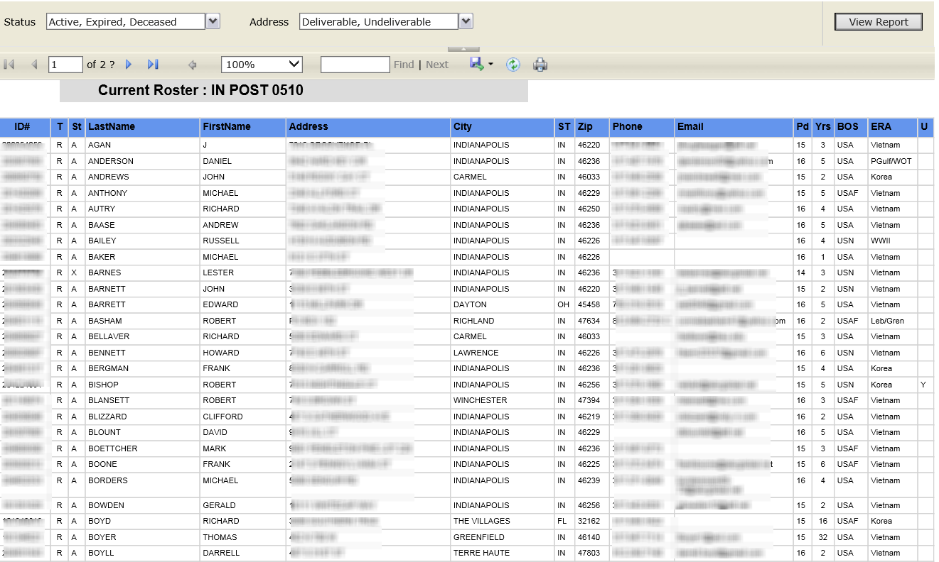
Current Post Roster
Export Icon
Notes:
The first step is to set the criteria. Using the pull down menu, select desired status. This report allows you include or suppress undeliverable addresses. Select View Report button.

Slide 63
Current Post Roster
Export Icon
Notes:
The roster report will look like this. Using the Export icon, select the file type.

Slide 64
Creating Reports Project Stay Active by Area
Notes:
Americans are on the move, and Legionnaires are no exception. National Headquarters’ Project Stay Active helps local posts maintain contact with members who move into your area. When moving into your area, the post should contact and welcome the member to the area. This is an ideal time to offer assistance and to invite the member to visit your post.
In many cases, the Legionnaire may wish to transfer membership to a post in the community. As may be expected, some of these Legionnaires are involved in temporary moves, some may have a life membership “back home,” and others may have sentimental feelings toward their hometown post. However, many of them will be receptive to an offer to transfer to your post when asked.

Slide 65
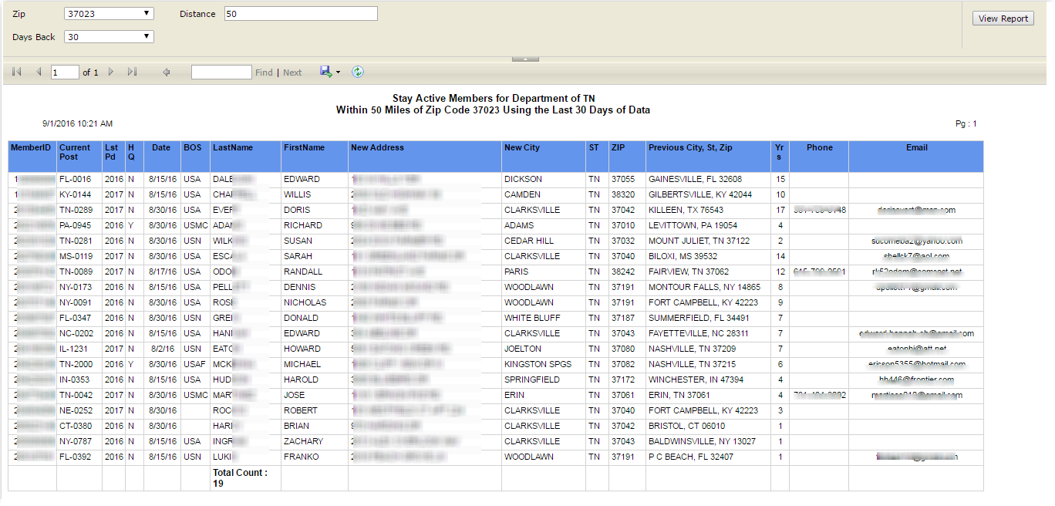
Creating Reports Project Stay Active by Area
This report is designed to allow you to identify members that have moved into your area. Select the zip code, distance, and # of days from the date the address change was entered.
Notes:
Select the zip code, distance and days back of the reported move. This report allows you to go 45 days back.

Slide 66
Tools
Tools
Publish Post Message
Publish Post Image
Publish Newsletter
Find Members in my Area
Global Member Lookup
*
*
* Post and Dept Only
Notes:
The tools section includes publishing tools to post a message, upload an image or picture that will appear as their page profile in the chat forums, and create and upload a newsletter. The Find Members in my Area helps identify potential members by retrieving lists of Expired and DMS members eligible for transfer. The Global Membership lookup allows you search any member using their ID# or name and post to assist with member transfers and SAL and Aux eligibility.
The District and County site has the same tools with the exception of publishing message and newsletter.
The next section to cover is Tools. It includes Publish Post Message, Image, Newsletter, Find Members in my Area, and Global Member Lookup.
*** Publish Message and Newsletter is only available at the post level.

Slide 67
Where will published items be displayed?
Message (Post only)
Member myLegion site
Find a Post (www.legion.org)
Image (Post / County / District)
Member myLegion site
Forum
Find a Post (www.legion.org)
Newsletter (Post only)
Member’s myLegion site
Find a Post (www.legion.org)
Notes:
Where will these images be displayed?
***Messages will be seen on the members myLegion page and Find a Post tool through www.legion.org.
***Uploaded images such as The American Legion Emblem or picture of Post/District/County Commander is displayed in the officer’s forum and with the post message.
***Posts can uploaded Newsletters where members who have registered myLegion members sites can see them. The newsletter is also linked to the post information from www.legion.org’s post locator tool.

Slide 68
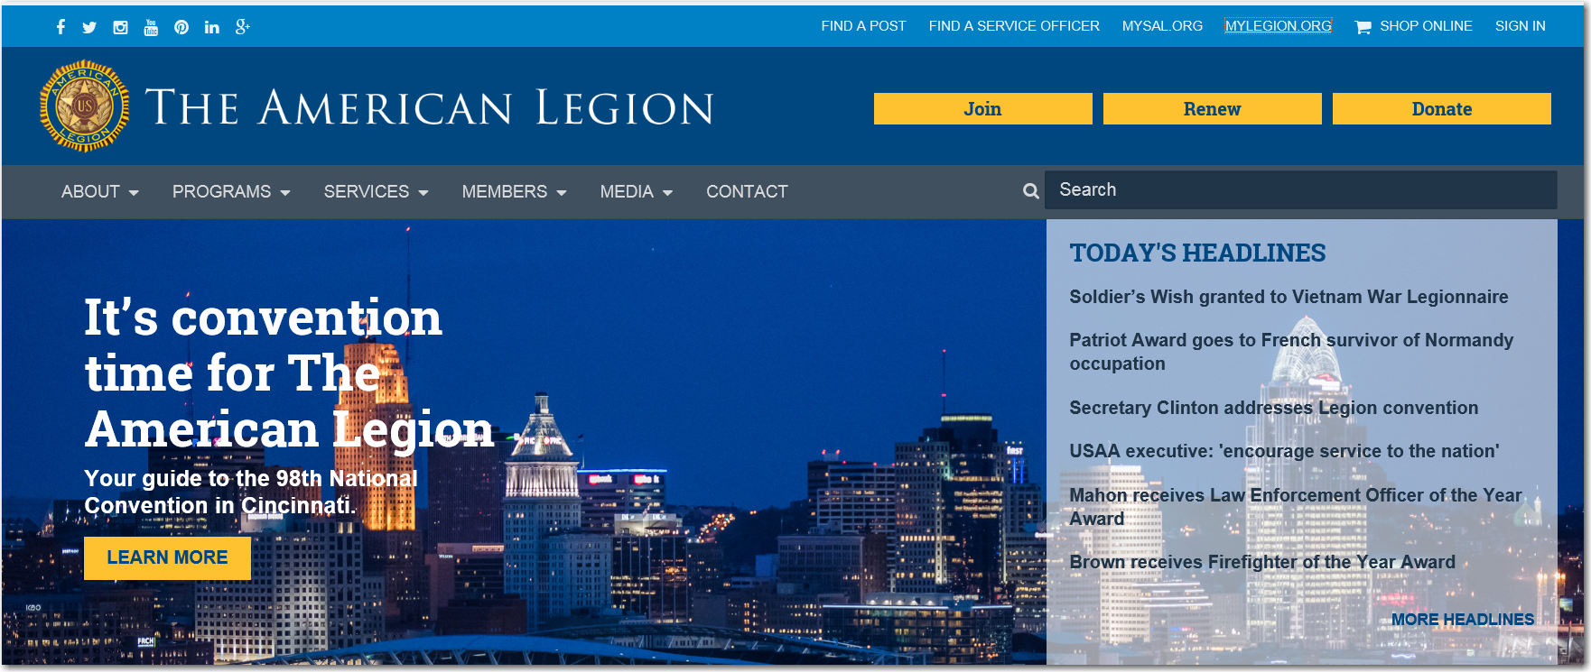
Notes:
Publishing tools from the post myLegion site can also be seen on National’s site www.legion.org. In the upper right hand corner this search tool allows anyone to search for a post by city, state, or zip code. ***Once they find your post they can view your newsletter or click on the link for more information. To view the published image and message from the post site select the More Info link.

Slide 69
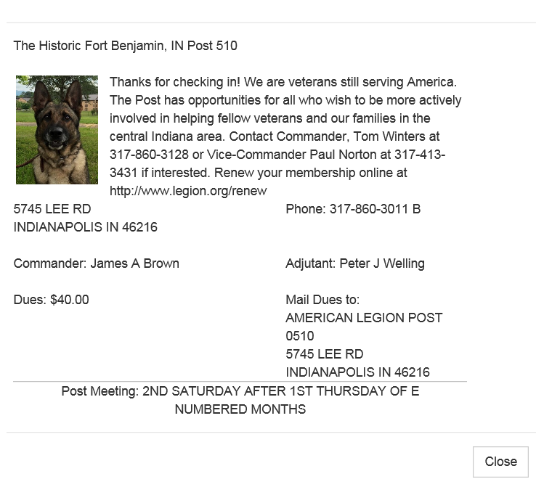
Notes:
Here is where the published image and message are displayed. Also displayed is post information including post officers, dues and dues remittance address. Please note it is important to have post information correct as it is published on a public webpage.

Slide 70
Tools
Tools
Publish Post Message
Publish Post Image
Publish Newsletter
Find Members in my Area
Global Member Lookup
Notes:
Any questions for the Tools area?

Slide 71
Materials / Officer’s Forum
Materials
Post Officer Manuals
Brochures
Suggested Speeches
Officer’s Forum
View Forum
Notes:
myLegion also provides quick access to materials such as the Post Officer Guide, Adjutant’s Manual, and program brochures.
The Officer’s Forum provides a chat forum to share and discuss membership ideas and concerns with other officers.
Materials essential for officers are available in the materials section. In this area you will find PDF documents for Officer manuals, brochures and speeches. There is also an officer’s forum that allows discussion between users.

Slide 72
Manuals
Post Officer’s Guide and Manual of Ceremonies
Post Adjutant’s Manual
Post Operations Manual
Post Membership Team Training Guide
Post Training Guide
New Member Application
Why Belong
Flag Code
Available in PDF format only.
Notes:
In the Post Officers manuals section you will find resources for post operations and officer’s guides.

Slide 73
Brochures
National Family Week
Temporary Financial Assistance
Make Halloween a Fun and Safe Night
April is Children & Youth Month
Gateway Drugs
Children’s Miracle Network
Family Support Network
Child Welfare Foundation
Operation: Military Kids
Play It Safe
Warning Signs
Available in PDF format only.
Notes:
The most widely used brochures can also be downloaded. These brochures can be used to disburse and educate about the many Legion programs offered.

Slide 74
Speeches
Pearl Harbor Day
Veteran’s Day
American Legion Birthday
Flag Day
Memorial Day
Available in PDF format only.
Printed versions are also available through your Department Headquarters.
Notes:
Suggested speeches for annual events. *** Printed versions of all publications are available from your department. All these materials can be printed, and copied without National approval.

Slide 75
mySAL.org
www.mySAL.org
Provides separate site for Squadron Officers with their own user name and password.
Notes:
mySAL was introduced at the October meetings in 2013. This site was created to allow Squadron Adjutant’s their own site to view and edit membership. It is similar to myLegion with less features.

Slide 76
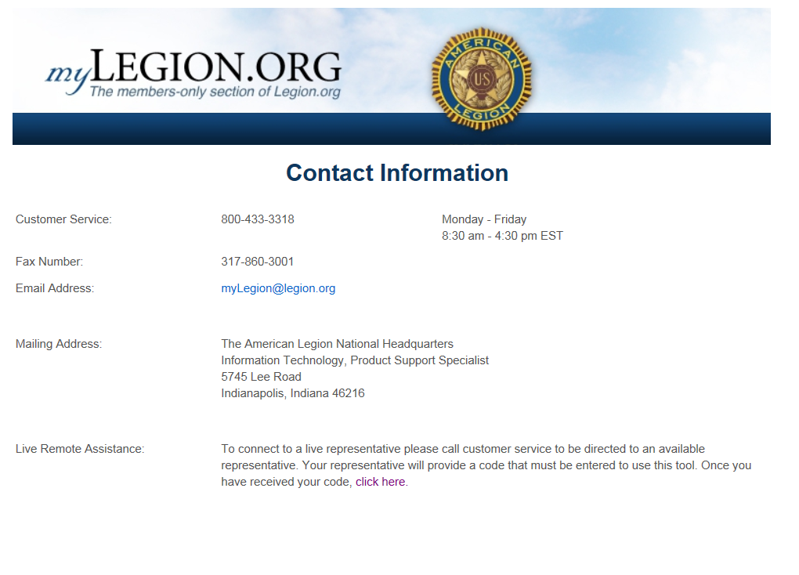
Notes:
Customer support is available through our Customer Service via email, or calling the toll free number. *** Using the Remote Assistance, National Staff can proxy into your PC to better troubleshoot.

Slide 77
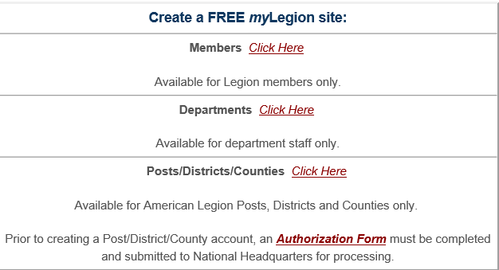
Notes:
Prior to setting up a Post/District or County site, an authorization from must be submitted for officer verification and department approval.

Slide 78
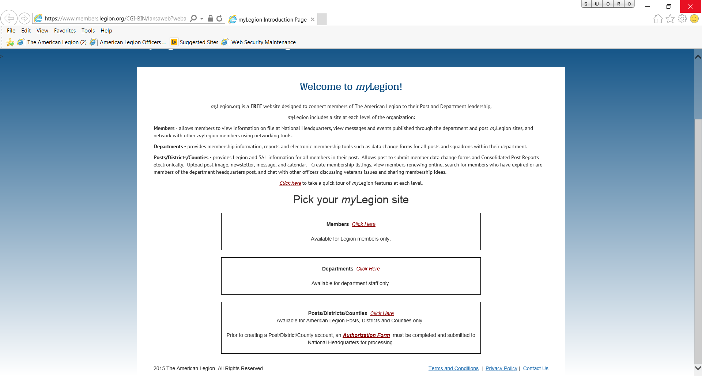
Notes:
To proceed to the members area, select the link for Members.

Slide 79
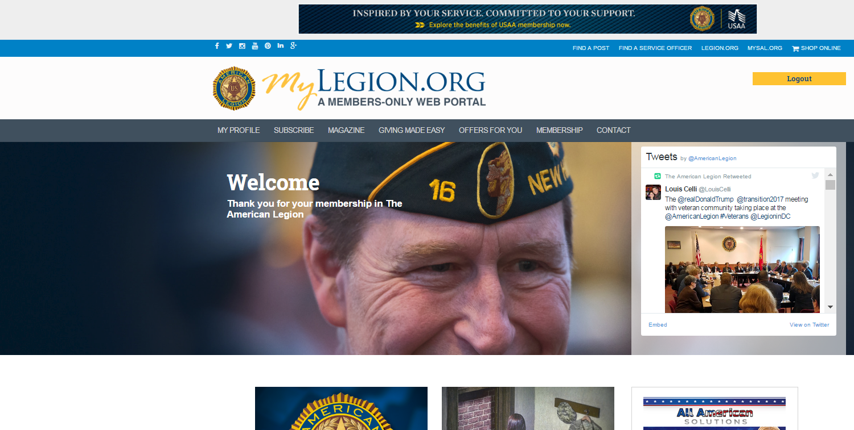
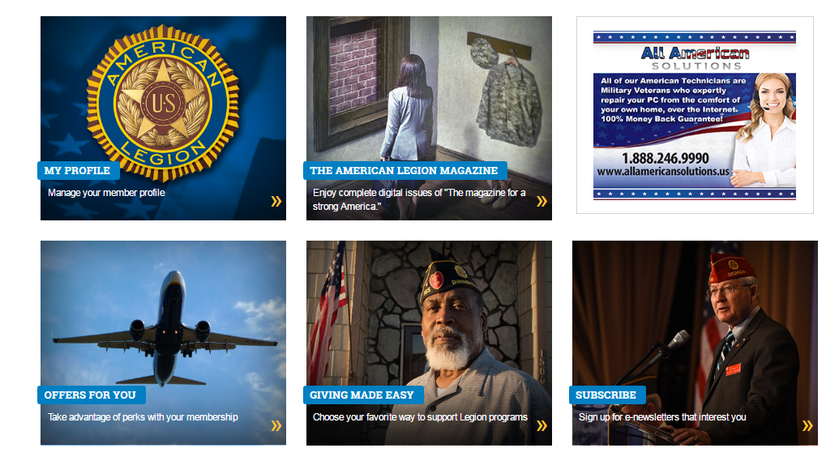
MEMBER PAGE
Notes:
The members home page provides quick access to the membership information, The American Legion Magazine, newsletters, charities, and member discounts.
If the member is set for renewal, they will be able to renew and print their current membership card through this page.
The member can also update information from this page in the My Profile area. Updates on this site will be posted on National’s database.

Slide 80
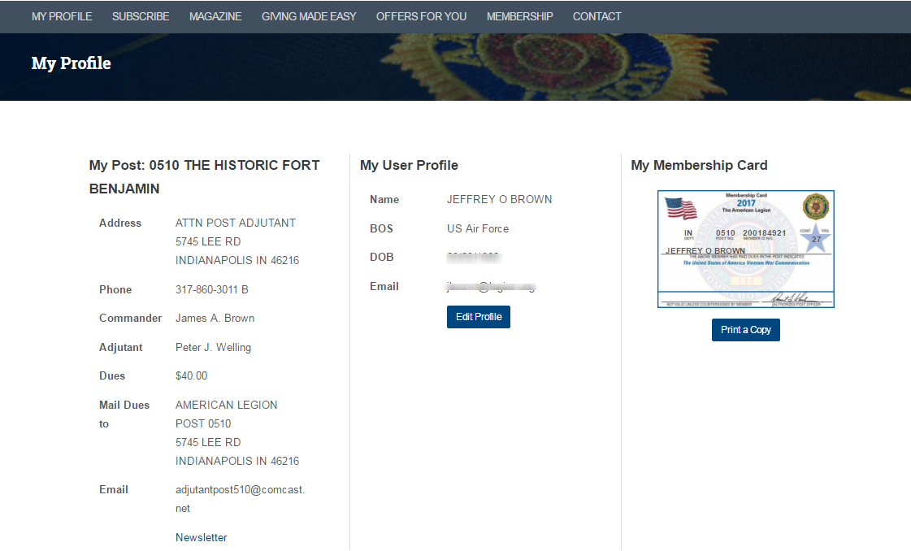
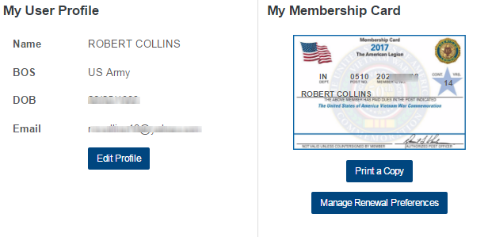
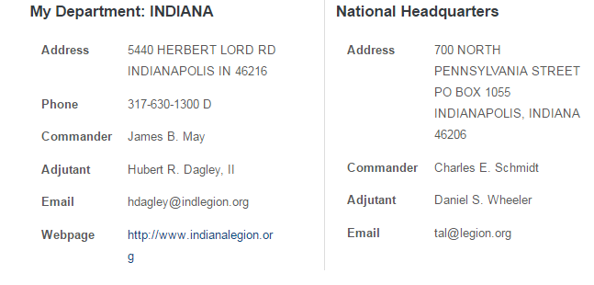
Notes:
The My Profile section provides contact information for the member’s post, department and national.
Using Edit Profile the member can update personal information. Name, Branch of Service, War Era, Gender, Date of Birth, Email, Phone and Mailing Address.
Member’s can also print their membership card and set up renewal options using Manage Renewal Preferences.
NOTE: Paid Up For Life members will not have the Manage Renewal Preferences option.

Slide 81
myLegion Customer Support Staff
Post/District/County
Libby Vickers, Product Support Specialist
Pam Johnson, Computer Operations Specialist
Eileen Sipe, Computer Operations Specialist
Andrea Noufer, Computer Operations Specialist
Department
Justin McKay, Software Support Specialist
Call 1-800-433-3318 and ask for myLegion support to be transferred to the next available representative.
Notes:
National provides dedicated customer support staff for myLegion. To contact staff call the toll free customer service number and ask for myLegion assistance to be transferred to the next available representative.

