Slide 1
Membership Retention
Mid-Winter Conference Training 2017

Slide 2
Presenters
Christie “Don’t Call Me An Assistant I Don’t Fetch Your Coffee” White
Jason “Do As I Say Not As I Do” Graven

Slide 3
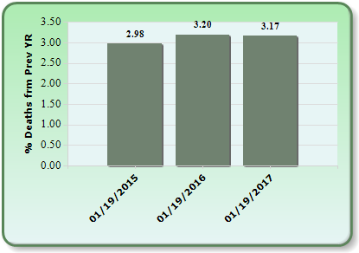
Current Numbers
79.24% renewal rate. Annual Average is just around 88% representing a little over 10,000 members lost per year.
Only about 3,500 members not renewed is due to Post Everlasting

Slide 4
So where aren’t they renewing?
Financial
Post Issues
Moving
Lack of perceived value

Slide 5
Best Practices-Financial
If a member is having financial troubles assist them if possible. We are here for each other and even a small token of help such as paying their dues for one year is normally appreciated.
Direct them to the Department Temporary Financial Assistance Office (Suzette Price-Director)
Hold a Post fundraiser or place out a tip jar at the canteen.
If you don’t ask they probably wont tell you, they will just discontinue to pay their dues and you will never hear from them again.

Slide 6
Best Practices-Post Issues
Don’t have them, but if you must, work together to find a satisfactory resolution
Having arguments in Post meetings deters people from participating, wastes time
Post’s whose elected leadership does not report to the membership at the meetings deters people from participating, make your members feel as though they are a part of the decision making process BECAUSE THEY ARE
No one wants to pay to have a BAD time

Slide 7
Best Practices-Moving
If you know they are moving beforehand, speak to them about retaining their membership with your Post instead of transferring
If a member moves to your area, transfer them
Keep them on your newsletter email or mailing list so they still feel as a part of the Post
Post 808 uses videoconferencing for their meetings so that members that cannot attend the meeting in person can still participate
Honor them so that they feel their time as a member of the Post wont be forgotten when they leave

Slide 8
Best Practices-Perceived Value
Members must feel as though the money they spend is of tangible value
We celebrate and honor 50-60-70 continuous years, what about 2-3? The earliest years are the most important
Promotional goods such as commemorative products they can receive for renewing
Most times, all it takes is someone from the Post asking them to renew. Show them you care

Slide 9
Best Practices-Perceived Value
Positional Good- a product that gains its value based on desirability; a product that symbolizes a higher social status.
Perceiving affluence is more important than actually being affluent.
The perception of value in a product or service is what drives the desirability to possess the product or service.
They should WANT to spend the money, if you have to chase after it then this signals something is wrong

Slide 10
What’s The Difference?
Both videos put out by their organizations national headquarters

Slide 11
Floor Discussion
How did your Post make quota this year?
What does your Post do to retain its members?
What about your Post creates value to a new member’s membership in your Post that would make them want to renew?
What is your Post’s product or service?

Slide 12
Conclusion
Clever marketing gets them in the door, your Post decides if they stay
Don’t just talk about Comradery, be about comradery
People watch Days of Our Lives, they don’t want to experience it
A distant member doesn’t have to be a forgotten member

