Slide 1
American Legion Department of Ohio Legislative
Suzette M. Heller, Past Department Adjutant, Legislative, VA&R, and National Security Director
District 12, 2nd Vice Commander, Post 0001 1st Vice Commander
734-358-4404 zheller1105@gmail.com

Slide 2
Learning Objectives
Be knowledgeable of Ohio Legislature website to access Legislators, Bills, and Resolutions.
Be knowledgeable of Congress.gov website to access Members of Congress, Bills, and Resolutions.
Be knowledgeable of the purpose of the American Legion Legislative and VA&R Division Office in Washington, D.C.
Be knowledgeable of interacting with State and Federal Elected Officials
Notes:
The learning objective for this lesson are….

Slide 3
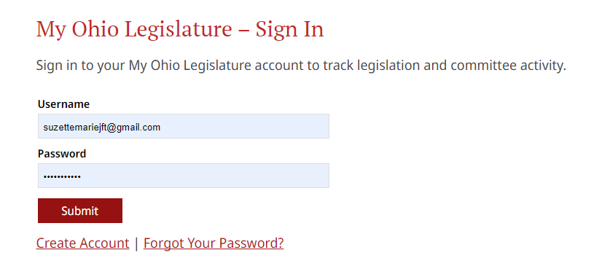
OHIO LEGISLATURE
https://www.legislature.ohio.gov/
“My Ohio Legislature”
Create Account
Notes:
Notes…

Slide 4
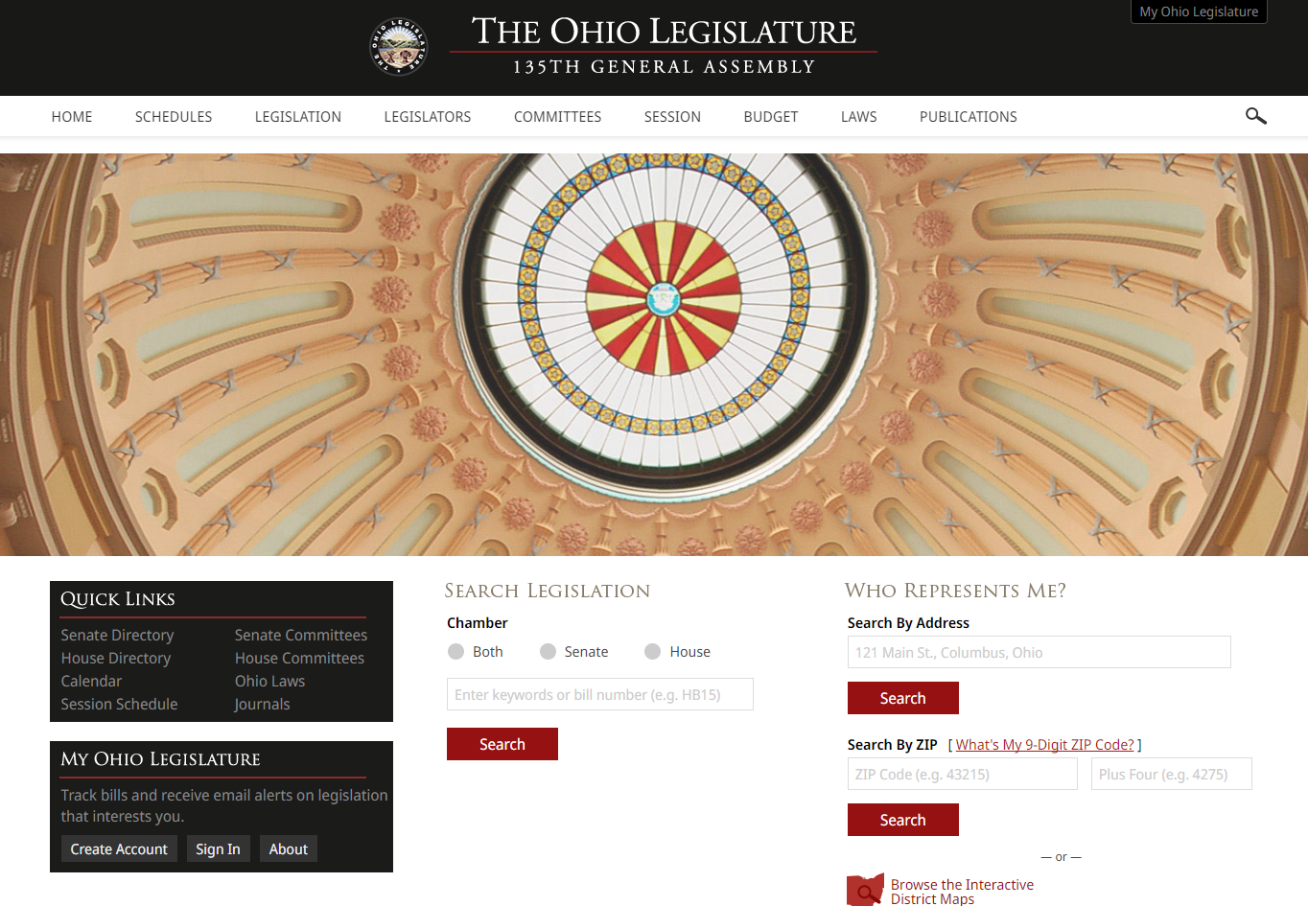
OHIO LEGISLATURE
Notes:
Notes
.

Slide 5
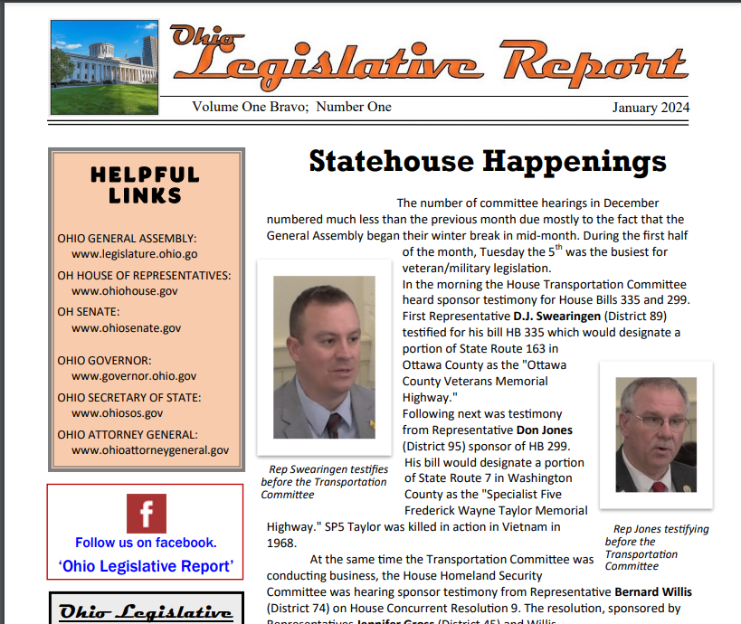
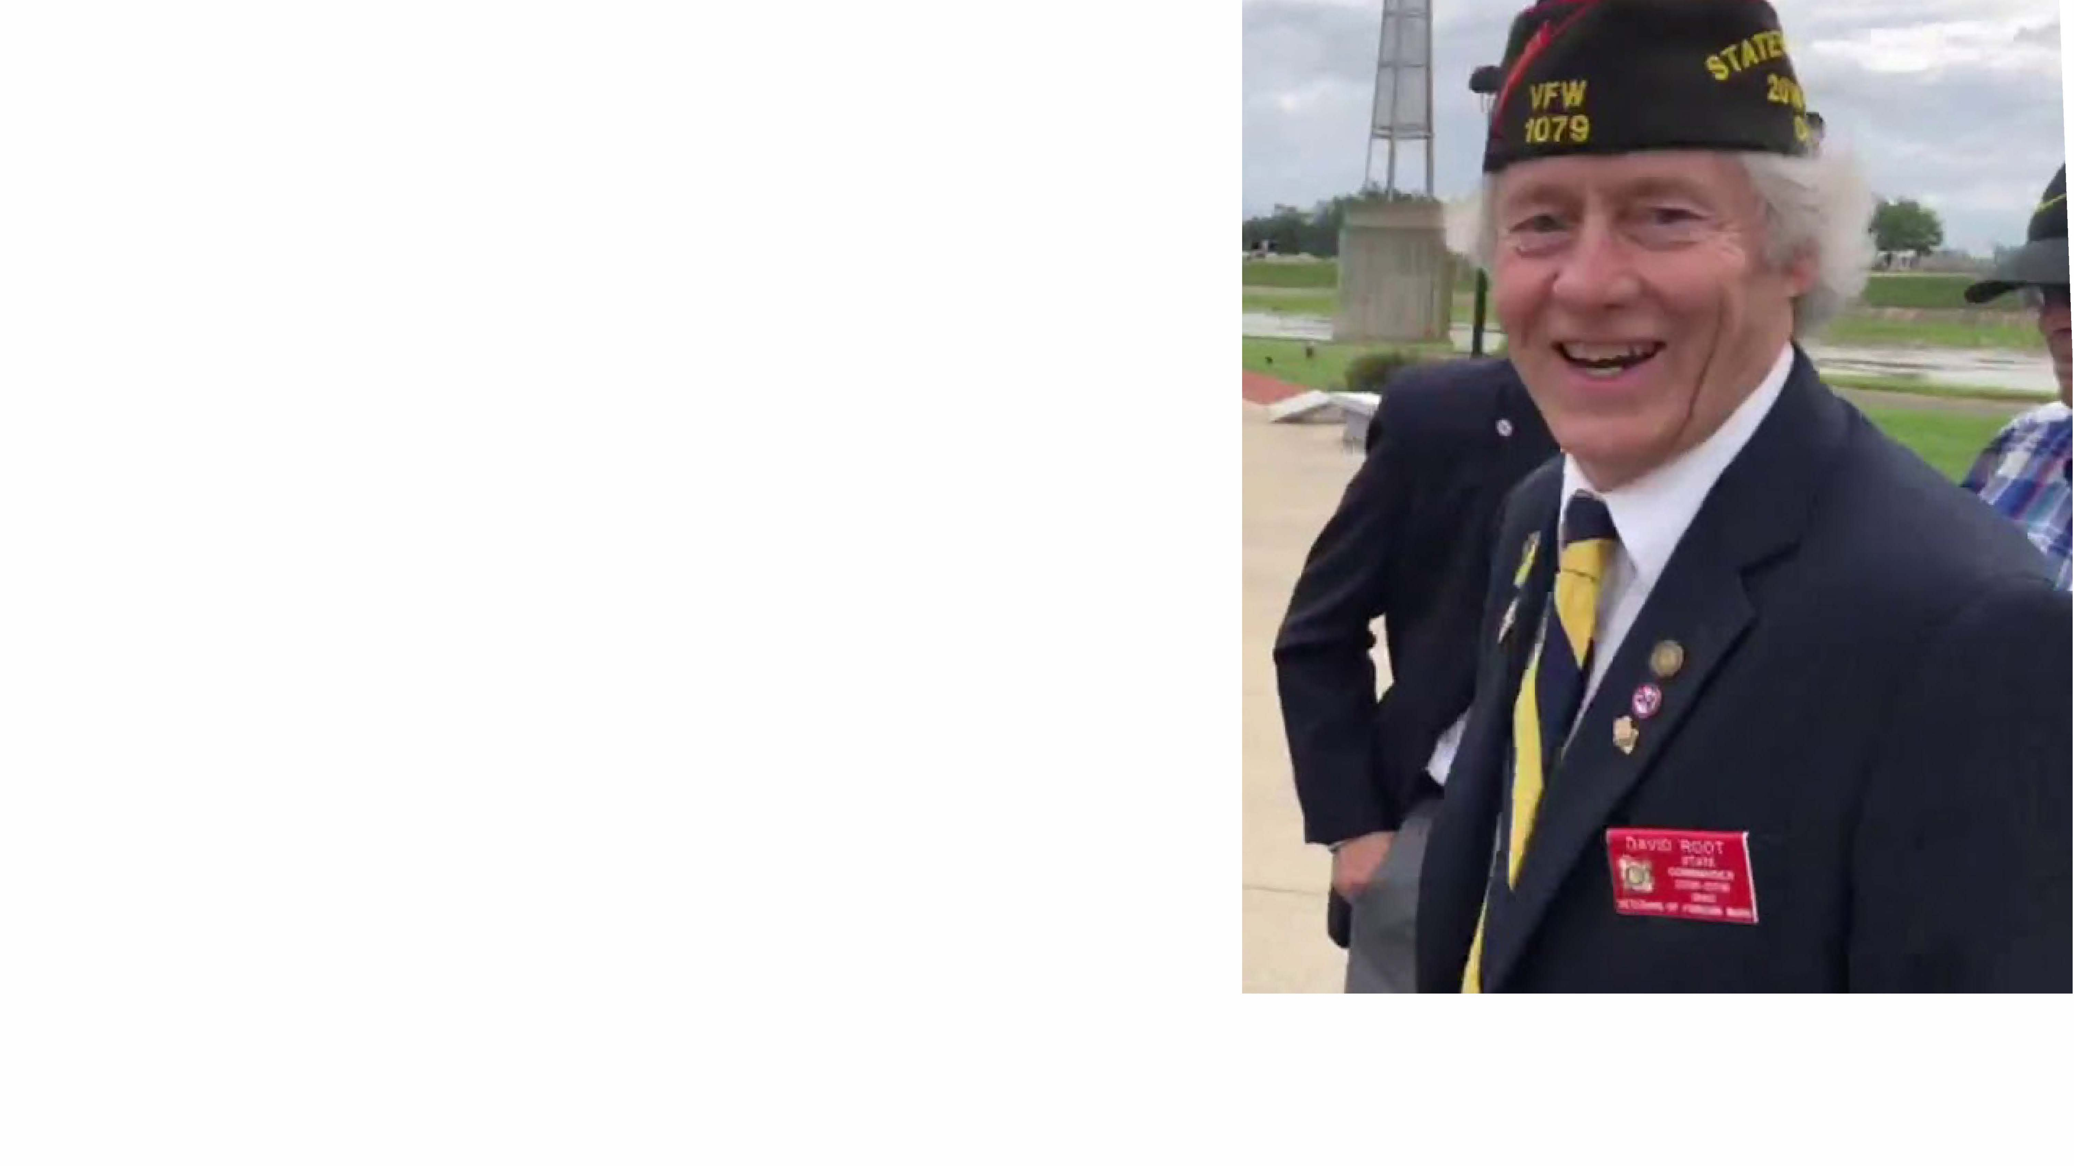
OHIO LEGISLATIVE REPORT
David K. Root, Member
Email: oh.leg.report@gmail.com
Notes:
Notes

Slide 6
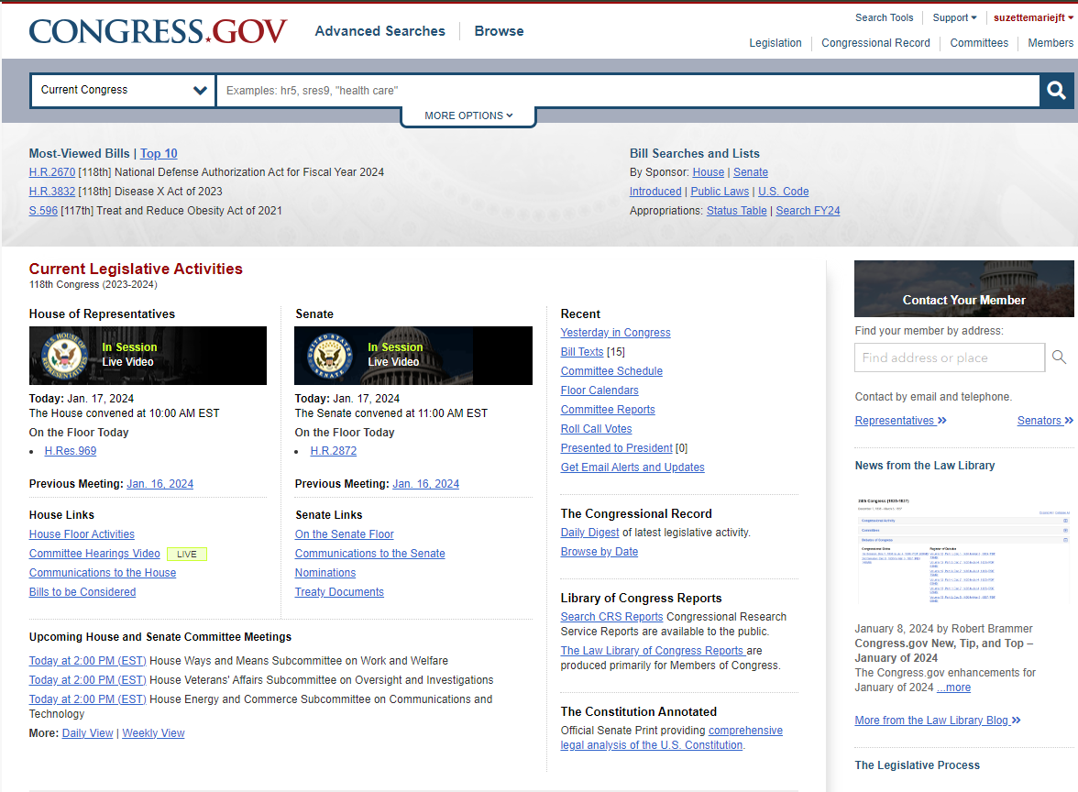
FEDERAL CONGRESSIONAL LEGISLATION
https://www.congress.gov/
Notes:
Notes

Slide 7
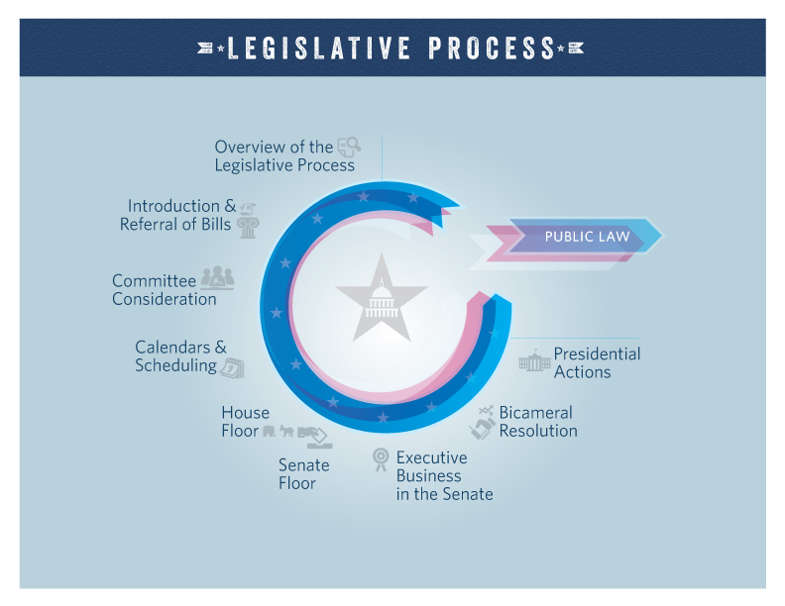
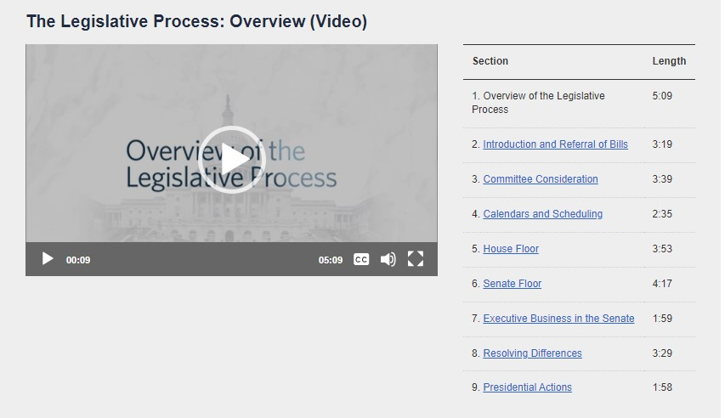
FEDERAL CONGRESSIONAL LEGISLATION
https://www.congress.gov/legislative-process
Notes:
Notes

Slide 8
AMERICAN LEGION NATIONAL LEGISLATIVE DIVISION (NLD) WASHINGTON D.C.
Grassroots Action Updates
Katherine Ryan
grassroots@legion.org
Action of DC is Resolution Based
Washington DC Conference Annual - February
Notes:
Notes

Slide 9
INTERACTING WITH STATE LEGISLATORS AND MEMBERS OF CONGRESS
DO
RESEARCH YOUR LEGISLATOR
BE PREPARED
BE SPECIFIC – BE POSITIVE
ASK FOR ACTION - SOLUTION
KNOW THE ISSUE
USE TIME WISELY
BE CONSIDERATE OF THEIR TIME
PLAN OUT YOUR REMARKS
SOLICIT SUPPORT FROM YOUR LEGISLATOR
TELL THE TRUTH
BE RESPECTFUL
FOLLOW-UP: WRITE A THANK YOU NOTE
ADDRESS THEM PROPERLY
FORGE RELATIONSHIPS
VISIT LOCAL OFFICES AND WORK WITH STAFFERS
DON’T
BE DISRESPECTFUL
BE UNPREPARED
DISMISS STAFF
MONOPOLIZE THE MEETING
TALK LOUDLY OR UNPROFESSIONALLY
CONFUSE THE LEGISLATIVE ISSUE
LACK BREVITY
BE AFRAID TO SAY “I DON’T KNOW” “I’LL GET BACK WITH YOU”
BE CONFRONTATIONSL OR ARGUMENTATIVE
USE INAPPROPRIATE LANGUAGE
PROVIDE FALSE INFORMATION
FAIL TO FOLLOW UP

Slide 10
Summary
Access to state and federal legislation
Resources for state and federal Legislation
Knowledge of the National Legislative Division
Do’s and Don'ts of interacting with a State
Legislator or Member of Congress (MOC)

Slide 11
Questions
SUZETTE HELLER
EMAIL: zheller1105@gmail.com
734-358-4404
Notes:
Notes

