Slide 1
Department of Ohio American Legion National Security
Al Buxton – Department National Security Chairman

Slide 2
Learning Objectives
How The American Legion supports U.S. interests and security at home and abroad
Steps the Legion takes to care for the families of living and deceased service members and veterans
Actions you can take to help promote national security in your community
Notes:
The learning objective for this lesson are….

Slide 3
Overview - History
■ The American Legion's commitment to strong national security
dates back to the organization's founding
■ In August 1919, national headquarters began soliciting service
members and veterans "conversant on military affairs ... to
discuss the future military policy of the U.S.“
■ Commitment to this pillar interest of the organization began to
take clear shape in 1929 when two committees -Military Affairs
and Aeronautics - were consolidated into one National Security
Committee
Notes:
Notes…

Slide 4
"The story of American wars is one of gallant deeds and great personal courage on the part of the individual officers and soldiers, but lack of preparation and training has always let to undue loss of life and heavy financial burdens ... As to the Word War, I firmly believe that a substantial condition of preparedness of our land and naval forces, backed by an adequate merchant marine, would have kept us out of the war and would have placed us in a position to have brought it to an early termination."
-Gen. John 'Black Jack' Pershing, writing in 'The American Legion Weekly’ magazine, 1922
Notes:
Notes
.

Slide 5
Overview
Specific aspects of the national security pillar include:
A well-funded, well-equipped and well-trained military
Awareness and surveillance of rogue nations, terrorist groups and global threats to U.S. security around the world
Support for the Department of Homeland Security, and protection of U.S. borders, ports and other points of access
Comprehensive disaster preparedness
Notes:
Notes

Slide 6
Overview
National Security Division
National Security staff lobbyists
The work of the National Security Commission, its standing committees, the National Security Council, and division staff
Notes:
National Security Division staff work out of the American Legion's Washington office, where military-affairs experts have proximity to authorities in the Pentagon, Congress and the White House.
National Security staff lobbyists testify before Congress in support of American Legion resolutions and work closely with each branch of the U.S. Armed Forces in an effort to stay well informed about issues that affect personnel, military families and retirees
The work of the National Security Commission, its standing committees, the National Security Council, and division staff is mirrored at the local level by American Legion posts that conduct visits at military installations, adopt deployed units, provide support for military families and elevate public awareness about the honorable nature of military service

Slide 7
Homeland Security
Since the OHS' creation following 9/11, the American Legion has supported its intent, purpose and arrangement: to harmonize multiple agencies, offices, businesses, community groups and others with readiness plans and quick-response capabilities
The American Legion concurs with the DHS mission to coordinate domestic security, including effective customs operations, increased security of the border and aggressive drug interdiction
Notes:
Notes

Slide 8
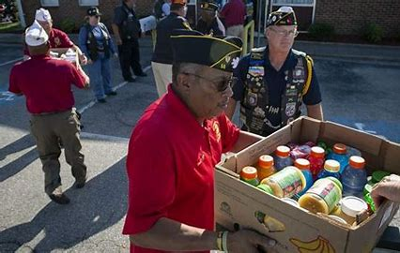
Homeland Security
At the local level, American Legion posts commonly serve as disaster shelters in times of crisis
Posts provide vital backup and assistance to local VA medical centers
Many posts take this opportunity to invite fire, police and emergency management officials to speak
Notes:
At the local level, American Legion posts commonly serve as disaster shelters in times of crisis, working closely with local and state emergency-management and homeland security authorities
Posts provide vital backup and assistance to local VA medical centers and play active roles in their emergency-services programs. Legion posts also build public awareness every September with events and activities that support National Disaster Preparedness Month
Many posts take this opportunity to invite fire, police and emergency management officials to speak and Provide information, as well as to build support for local Citizen Corps volunteerism

Slide 9
Quality of Life for Troops, Retirees, and Military Families
Those who have chosen to serve in uniform, and those who make careers of military service, deserve a decent quality of life while they are in service and after they retire. This core belief of The American Legion drives many of its national security positions
Adequate base housing, family support, pay, insurance and health care for members of U.S. military all fit into the Legion's quality-of-life interests. The Legion is also a strong supporter of earned benefits and quality care for military retirees

Slide 10
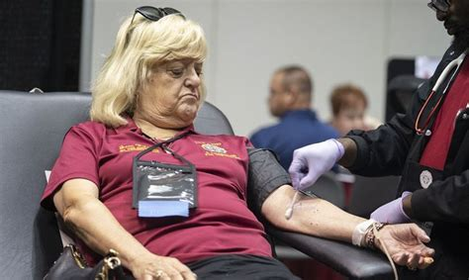
Blood Donor Program
Nationwide, nearly 501,000 veterans a year donate more than 80,000 pints of blood through the Legion's Blood Donor Program
The American Legion's Blood Donor Program has officially existed since 1942
While the Legion's Blood Donor Program has been a mainstay in communities nationwide since World War II
Notes:
Nationwide, nearly 501,000 veterans a year donate more than 80,000 pints of blood through the Legion's Blood Donor Program. The Legion works with Red Cross and community blood banks to ensure enough is available for ordinary use, military use, and in the event of a natural disaster
The American Legion's Blood Donor Program has officially existed since 1942, and each year, the national commander recognizes Legion departments that donate the most blood, based on five different membership size categories
While the Legion's Blood Donor Program has been a mainstay in communities nationwide since World War II, it became extremely important in the aftermath of 9/11 and continues to provide vital contributions during the war on terrorism

Slide 11
How do I fit in?
Legionnaires will be called upon to voice their opposition to military spending cuts that could threaten national security and to initiatives that could erode the value of military benefits and retirement
Legionnaires can help by writing, calling and emailing their elected officials and by making themselves available for media to share the Legion position on the need to maintain a strong national defense, including the protection of benefits for those who choose military careers
American Legion posts make positive impacts in the lives of military personnel and their families through firsthand connections. An important post relationship is with an installation's Family Readiness Group. It is vital for such relationships to start early, before deployment, and continue as they transition to civilian life

Slide 12
Couple of Questions
Disaster preparedness is not a responsibility or interest of The American Legion's national security program.
True
False
The American Legion questions the long-term value of the Department of Homeland Security.
True
False

Slide 13
Questions
Al Buxton
EMAIL: 4thdistcmdr@ohiolegion.com
asbuxton69@gmaill.com
Notes:
Notes

