Slide 1
How to Write a Resolution
Holly Lewis – District 10

Slide 2
Class
What is a resolution?
Why are resolutions important?
Who can submit a resolution?
How do you write a proper resolution?

Slide 3
What is a Resolution?
A resolution is a motion submitted in writing
A main motion is often offered as a resolution either because of its importance or because of its length or complexity
Resolutions are not applicable for minor decisions such as having a yearly fish fry
It is a means of resolving a particular problem by stating very specifically what action is to take place

Slide 4
Why are Resolutions Important?
Resolutions tell our leaders (at all levels) what is important to the members
Resolutions are the only way to make changes to American Legion programs, policies, and positions
Resolutions are in writing, making it easier for the voting body to review and can be easily distributed to a wide audience when adopted
Resolutions are a historical record of decisions

Slide 5
Who can submit a Resolution?
Any legionnaire can submit a resolution to their Post
Should be reviewed in advance and suggestions considered
If adopted, the Post submits resolution to County Council (if available), and then District and Department for adoption if applicable
Department Adjutant determines whether or not the Department Executive Committee can deal with it or if it has to be sent to the Department Convention
If adopted and appropriate the Department forwards to National.
National Adjutant sends to appropriate committee for review and action
National Committee sends to NEC or National Convention for vote

Slide 6
How do you write a Resolution?
Make sure that there isn’t already a resolution or position available (legion.org/resolutions for National Resolutions) and that the resolution is applicable to the mission of the American Legion
Start with the Resolve clause (the motion)
Ensure that it is covering only one subject

Slide 7
How do you write a Resolution?
Use the Preamble (the Whereas clauses) to provide background information that builds the case for the resolution
Be concise
Go from broad to specific
Use facts, not assumptions – do your research
Check your grammar/spelling and have it reviewed

Slide 8
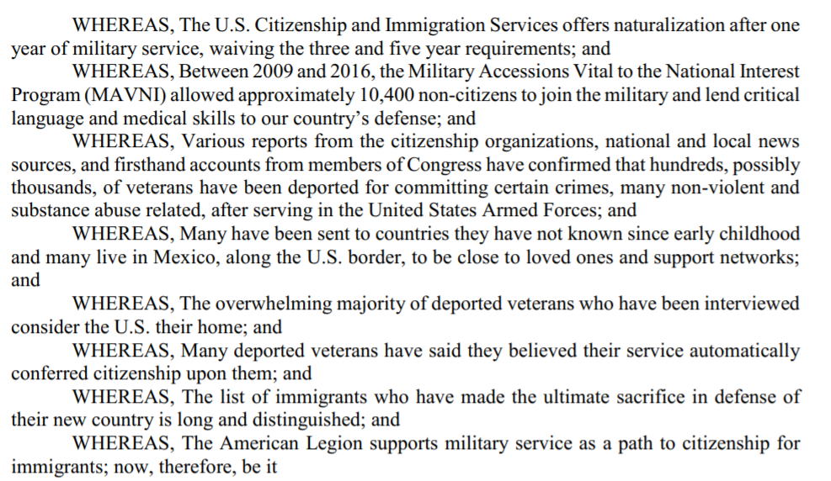

Slide 9
Additional Information
Download the resolution booklet at legion.org/resolutions
Review resolutions in the Digital Archive for ideas
Reach out to others who have written resolutions for advice and direction
Don’t be intimidated!

Slide 10
Questions
A resolution is necessary for every decision a Post makes
True
False
Only officers can write and submit a resolution
True
False

