Slide 1
American Legion Department of Ohio Americanism
Christie White- Department Americanism and Children & Youth Coordinator

Slide 2
Buckeye Boys State Mission Statement
The mission of The American Legion Buckeye Boys State is to provide an educational and leadership program that exposes young men to the rights and privileges, the duties and responsibilities, and the love for God and Country necessary to being self-governing citizens
Through a practical, objective, nonpartisan approach, participants in The American Legion Buckeye Boys State program are exposed to fundamental democratic principles in local, county, and state elections and government functions which prepare them for leadership roles as patriotic American citizens

Slide 3
Program Overview
Established in 1936
3rd chartered Boys State Program in the Nation
Single largest program in the Nation
Averages over 1200 delegates annually
Premier youth program in Ohio
#1 Boys State program in the Nation
Held at Miami University in Oxford
Program governed by 60 member board of trustees all of whom are members of The American Legion
Over 125 staff members at the program
Planning meetings are held in the spring and fall
Annual planning meetings held with Miami University and Ohio State Highway Patrol prior to the program

Slide 4
Buckeye Boys State is not a Camp!
Buckeye Boys State is a highly structured, intense, "hands on" workshop into Ohio Government
Candidates selected to Buckeye Boys State must be willing to give The American Legion and Buckeye Boys State an eight day commitment of their time and 100% willingness to learn and participate
Candidates are required to attend a Boys State Orientation program in their area. Details on the orientation program are provided to all candidates by the sponsoring Post/Squadron
THE FINAL SELECTION IS THE SOLE RESPONSIBILITY OF THE SPONSORING AMERICAN LEGION POST. A representative of the Post must meet with the candidate and certify him for acceptance. Young men not acceptable to a Post/Squadron will not be acceptable to the Boys State Board of Trustees

Slide 5
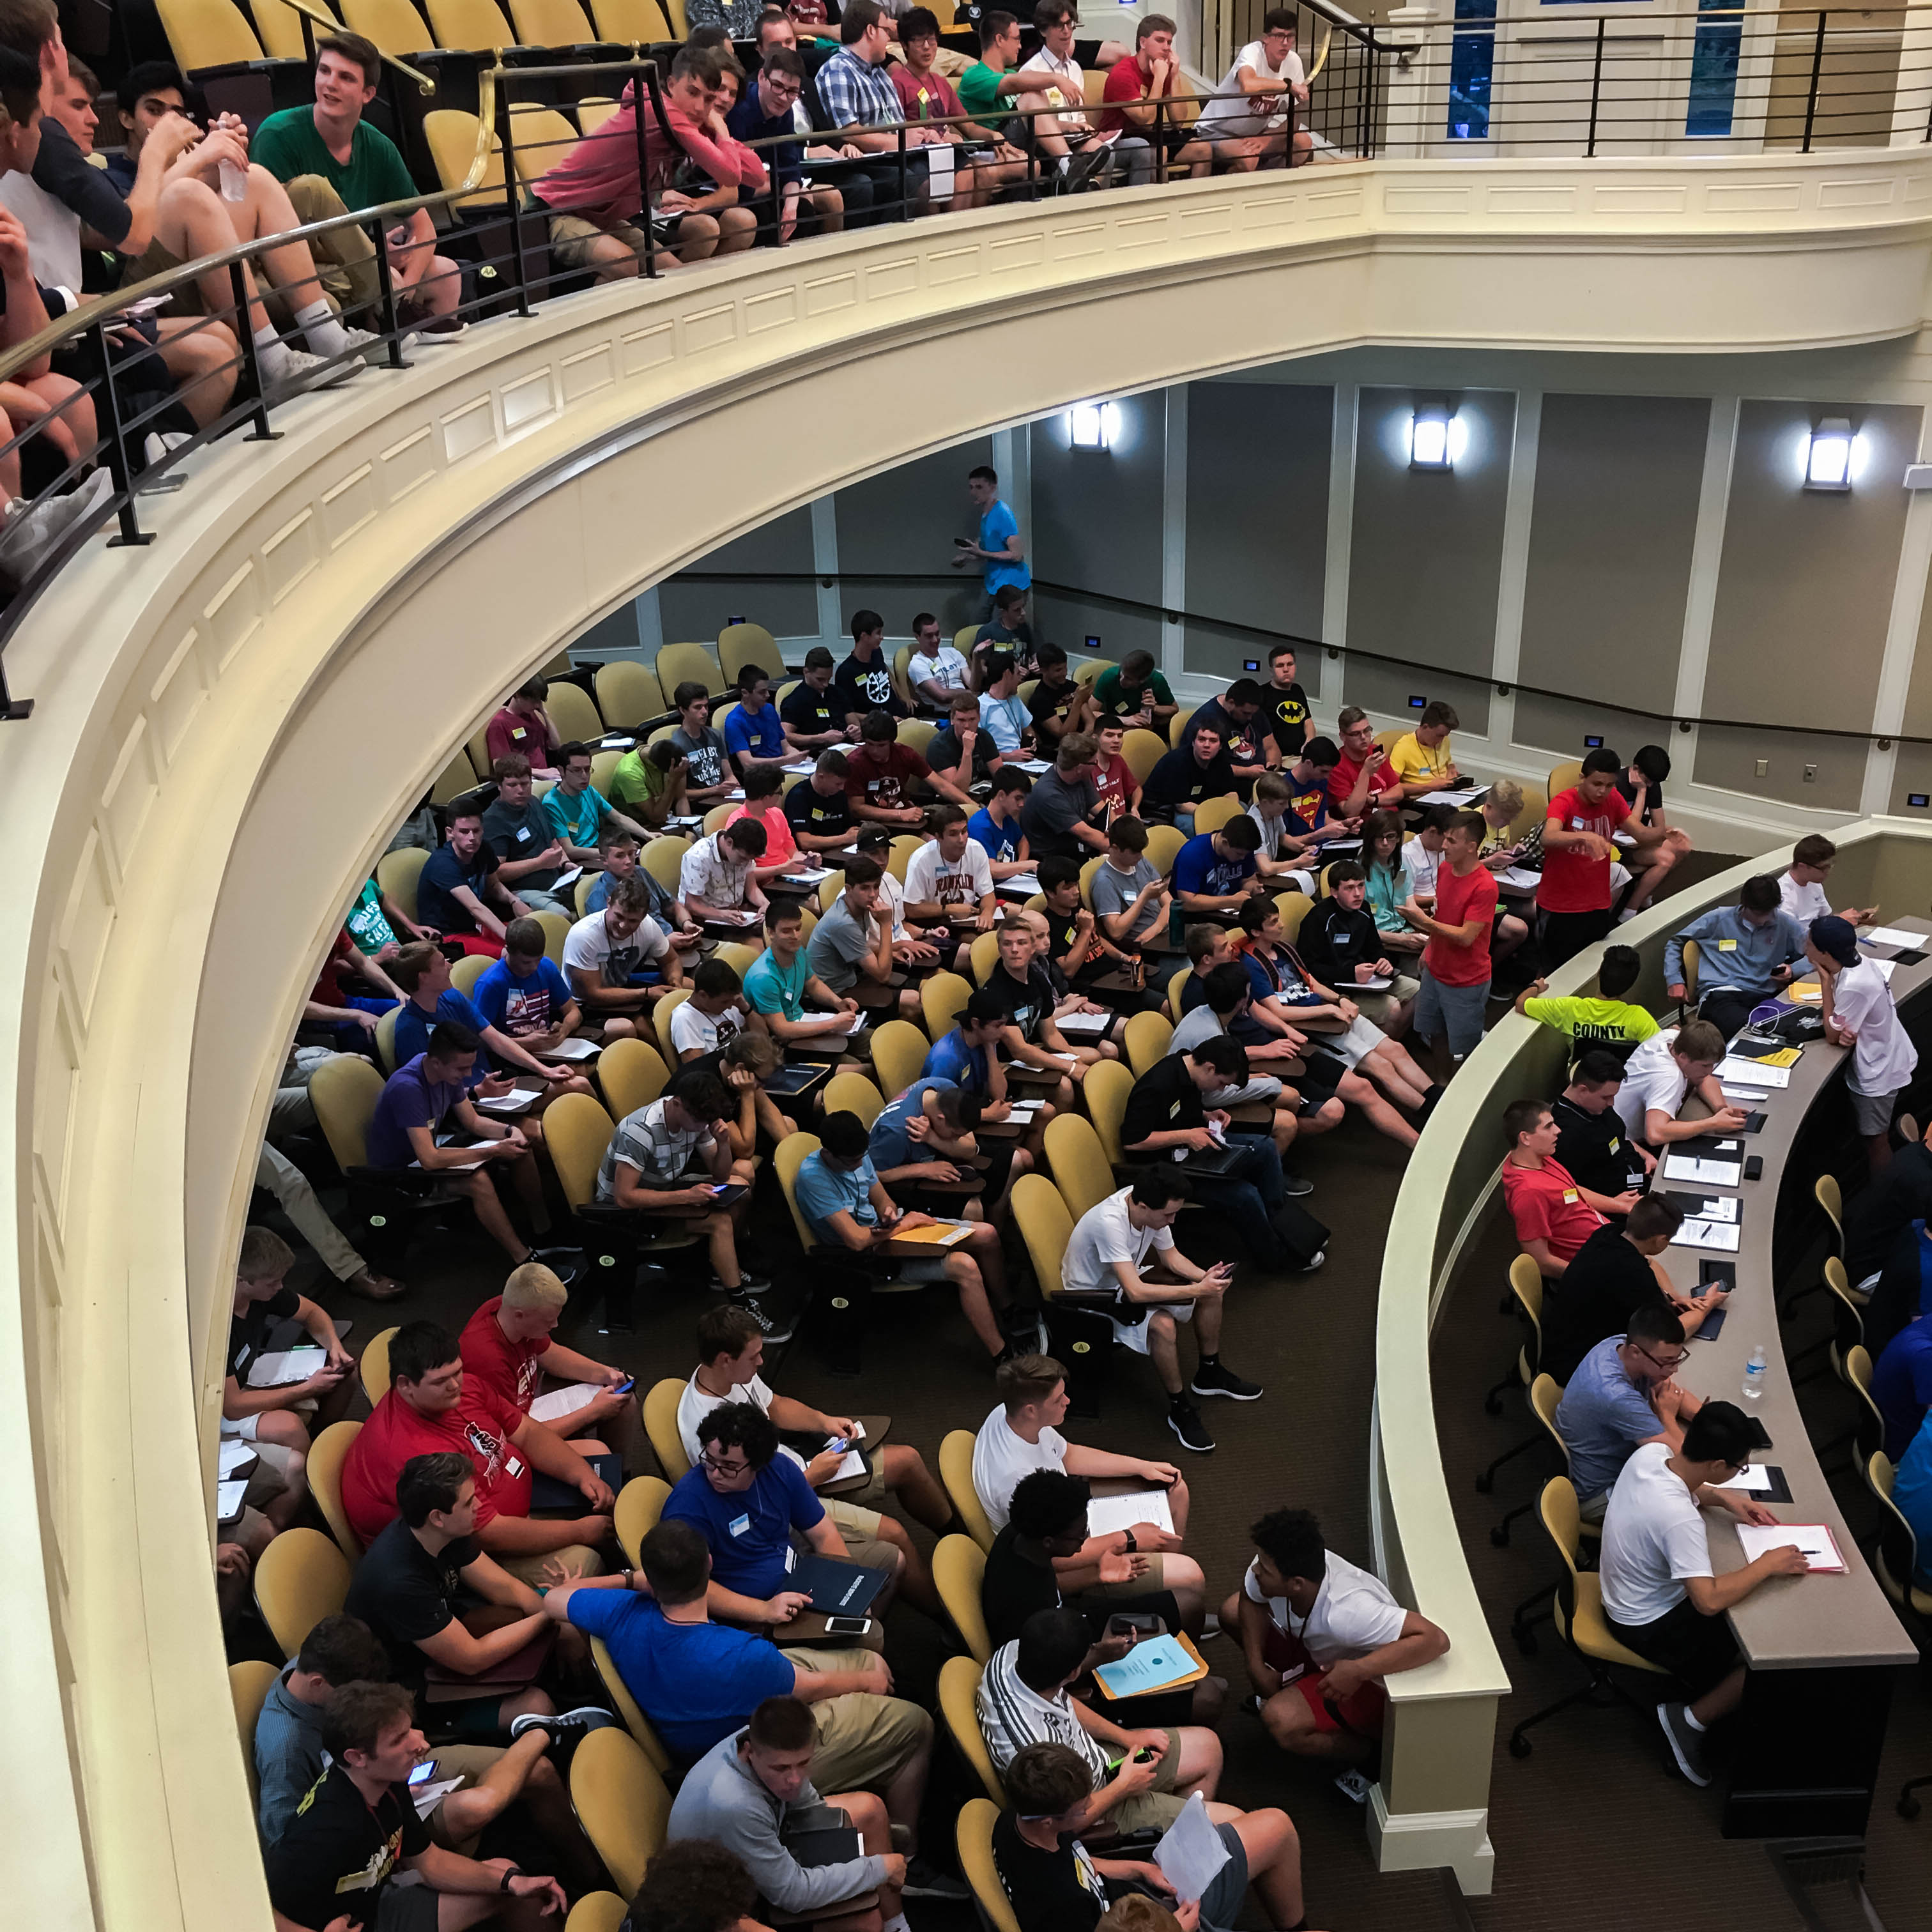
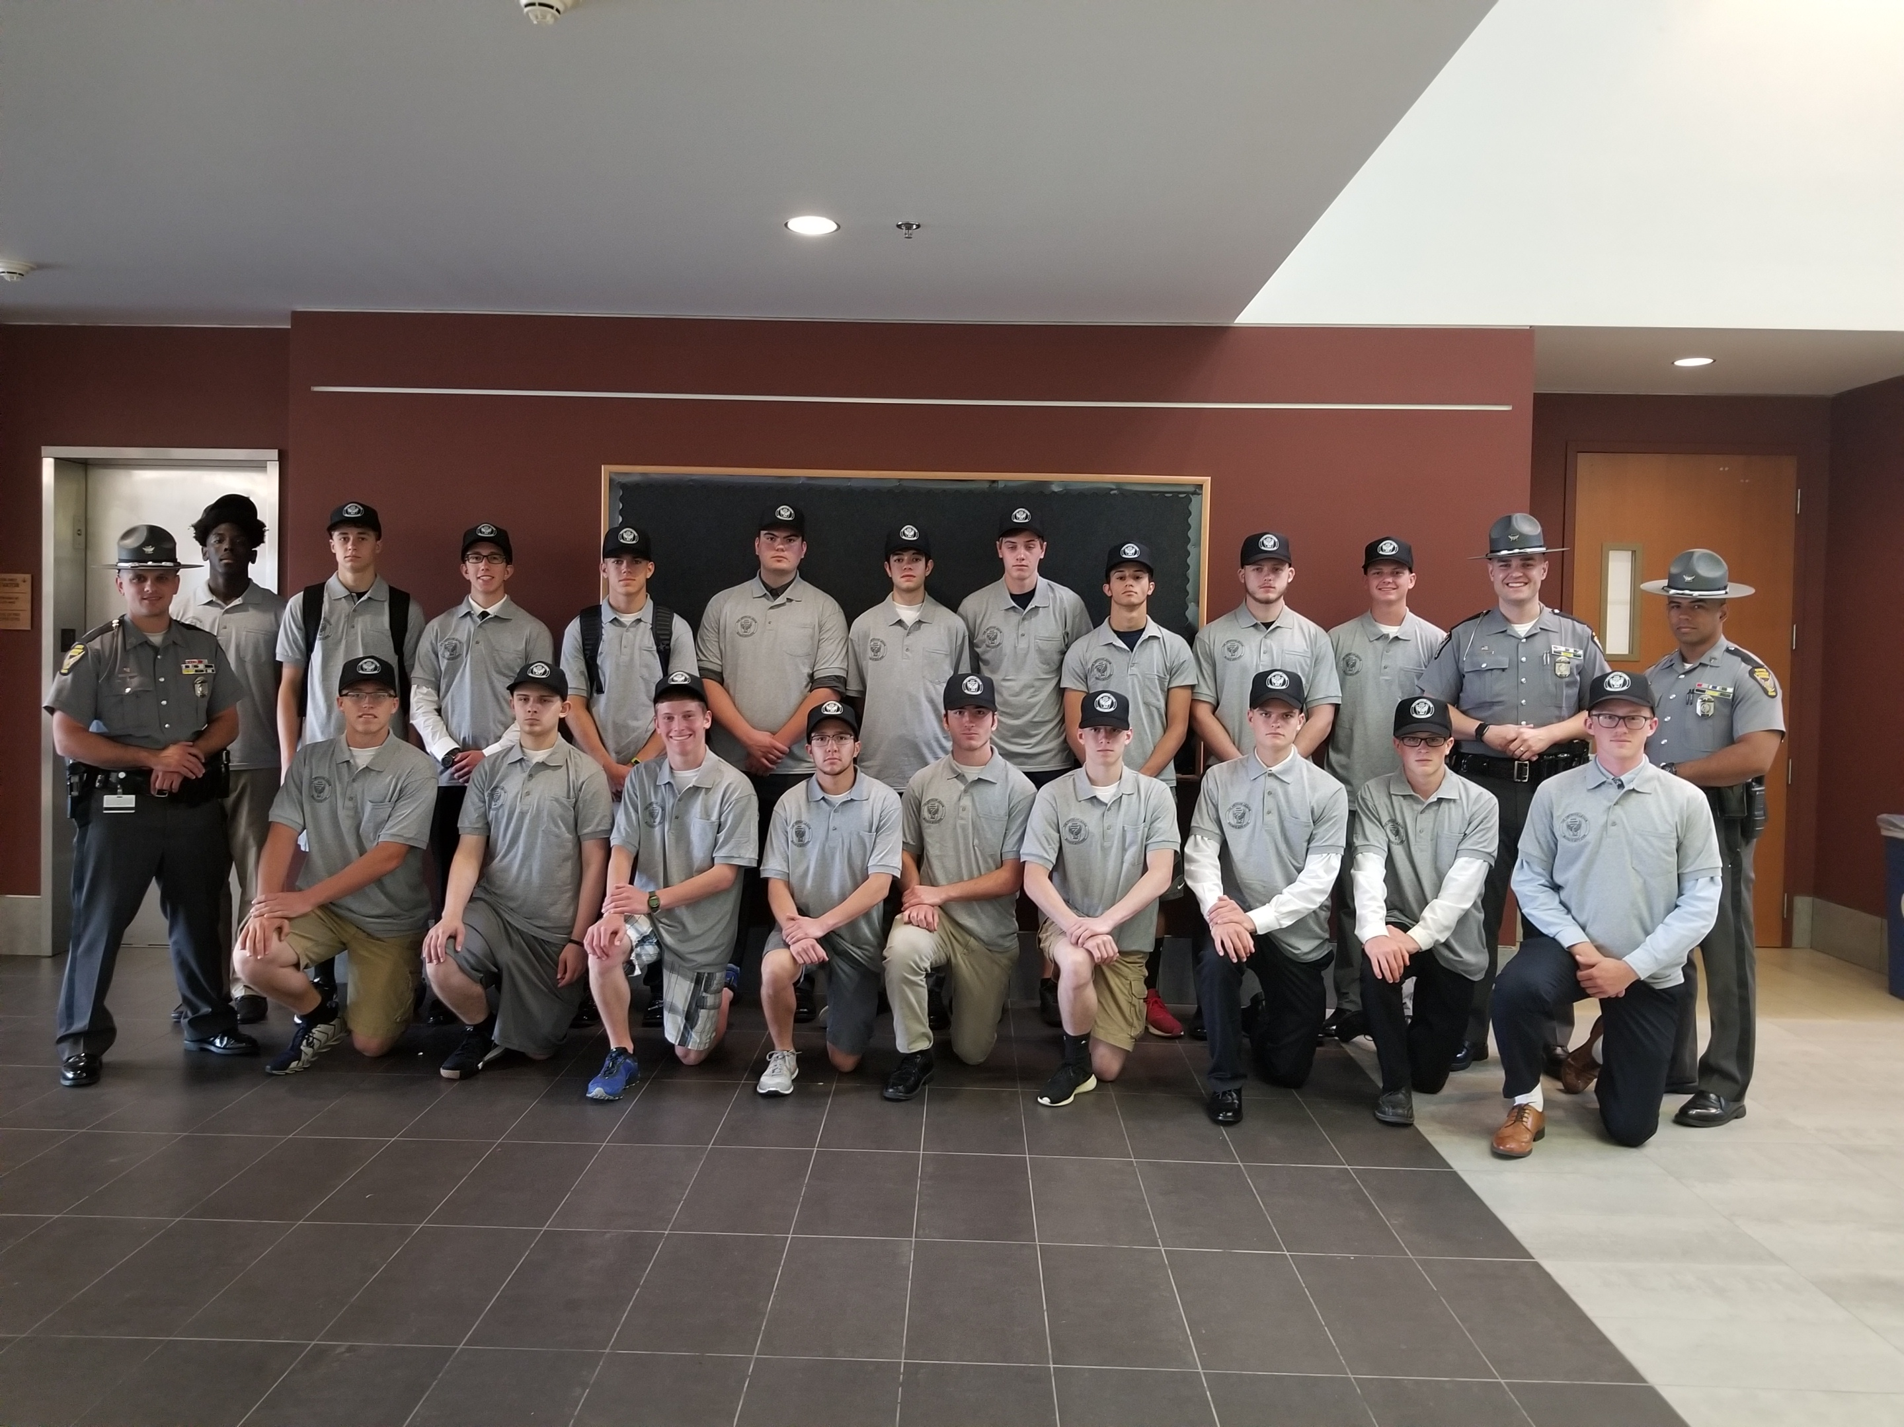
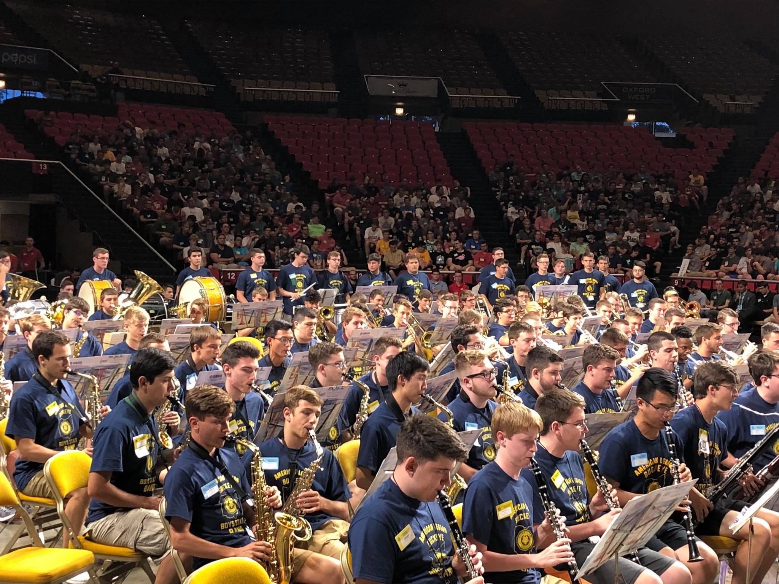
Organizational Sections
State Government
Elections
Ohio State Highway Patrol
Legislative
County Government
City Government
Courts
Banking and Realty
School Boards
Utilities
Band

Slide 6
Scholarships
Government Excellence Awards (six $500.00 awards)
Samsung Scholarship (ten National finalists, $20,000.00 each)
United States Senate Youth Program ($5,000.00 scholarship)
Boys Nation
College Fair

Slide 7
Why should my Post support Boys State?
Program introduces high school students to the American Legion and it’s principles and values
Promotes sense of patriotism, respect for flag and country, and respect for veterans
Increases Post involvement and visibility in the community
Boys State and Girls State are a major component of the Americanism Pillar of the American Legion
Support is an investment in the future of our nation
Attendees learn more about our form of government than 70% of the general population

Slide 8
How can my Post and/or I support BBS?
Get involved with your local schools to identify and send students to the program, if your post is not already doing so
Partner with local service clubs to raise the funds to send students if you don’t have enough money to sponsor a student
Make a direct donation to the program through Department of Ohio if you can’t send students
Partner with other Posts in your area to send students or raise funds
Volunteer to serve on the staff of Buckeye Boys State (we’ll teach you what you need to know if you don’t have a government background)

Slide 9
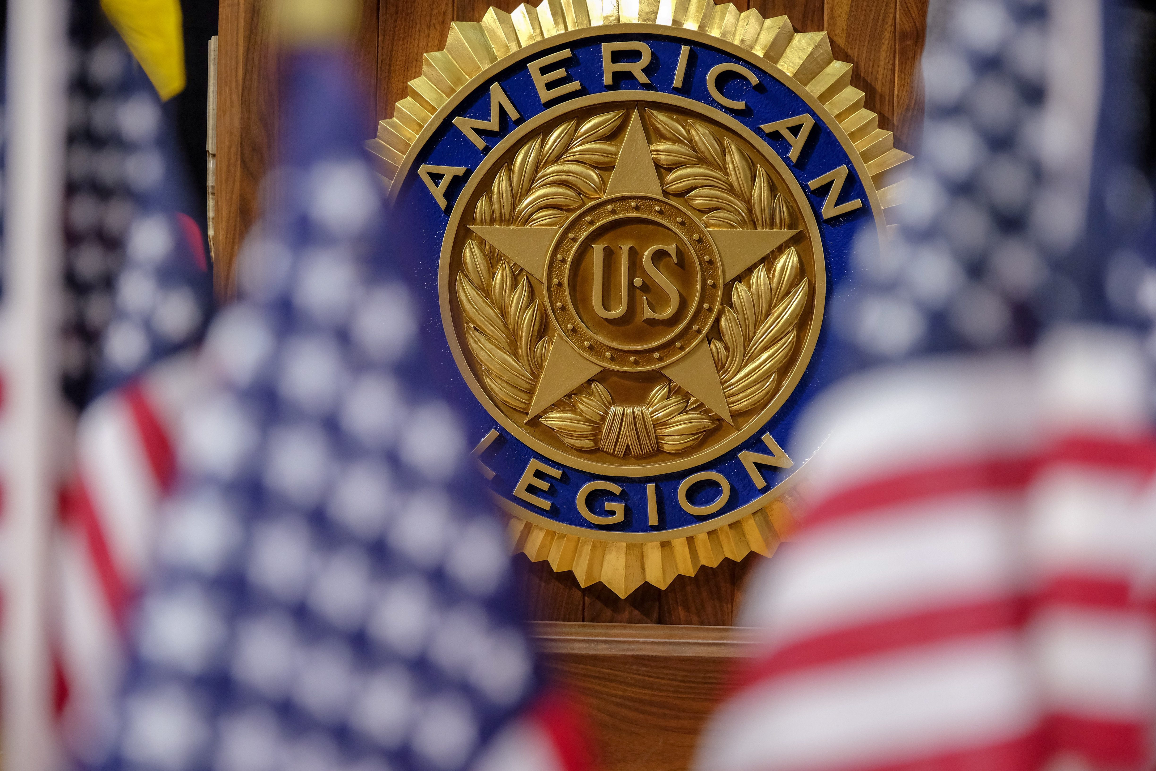
Important Information
Buckeye Boys State will be held at Miami University June 9th – June 16th 2024
Enrollment fee is $300.00 per delegate
Website- www.ohiobuckeyeboysstate.com
Facebook- www.facebook.com/BuckeyeBoysState
Instagram- www.Instagram.com/ohiobbs

Slide 10
Oratorical
The Oratorical Program is a constitutional speech contest for high school students, and it offers scholarships upwards of $25,000. The contest has a prepared oration and an assigned topic which is assigned the day of the contest.

Slide 11
The Prepared Oration (8-10 Minutes)
The oration must be on some aspect of the Constitution, with emphasis on a citizen’s duties and obligations to our government. The same subject and oration used in the department contest must be used in the national contest
Contestants may have a copy of their prepared oration while waiting in the first holding room. They may consult the copy until they exit to begin the contest. The copy will then be surrendered to the contest official monitoring the first holding room.
Quotations must always be indicated as such. Where quotations are more than 10 words in length, the author’s name must be given in the manuscript and cited orally.
It is acceptable to utilize or incorporate short phrases in a foreign language to develop the argument, establish a point, etc. It should be understood that the vast majority of the prepared oration and/or assigned topic must still be delivered in English. Singing is not permitted and will result in immediate disqualification. The contestant may, however, quote a verse(s) of a song(s) provided proper attribution is made

Slide 12
The Assigned Topic (3-5 Minutes)
The purpose of the assigned topic discourse is to test the speaker's knowledge of the subject, the extent of his or her research, and the ability to discuss the topic as related to the basic principles of government under the Constitution
The assigned topic shall be drawn by the contest official in full view of the audience immediately before the last speaker begins delivery of his or her prepared oration and will be made known to the audience and each contestant approximately five (5) minutes prior to the time of delivery
The topic will be on some phase of the U.S. Constitution, selected from Articles and Sections as listed under assigned topics for the current year's contest.
2024 Assigned topics
Amendment II
Amendment XXIII
Amendment XXV, Section 3
Amendment V

Slide 13
Important Dates
State contest March 17, 2024. Contest will be held at the Department Headquarters, 60 Big Run Road, Delaware, Ohio 43015. Contest begins at 10:00 AM, contestants and volunteers need to be there by 9:00 AM
National Contest May 17-19, 2024. Contest will be held in Hillsdale Michigan at Hillsdale College.

Slide 14
Americanism & Government
The Americanism and Government Test and Trip program of the Ohio American Legion was created by Legionnaires of Ohio in 1936.
The Americanism and Government Test program is open to students in grades 10, 11, and 12. Students in grade 9 may take the test for practice only.
The Americanism and Government Test is a fifty (50) question test comprised of True/False and multiple-choice question.
A three hundred (300) word essay is also part of the Americanism and Government Test and every student taking the test writes on the same essay topic.

Slide 15
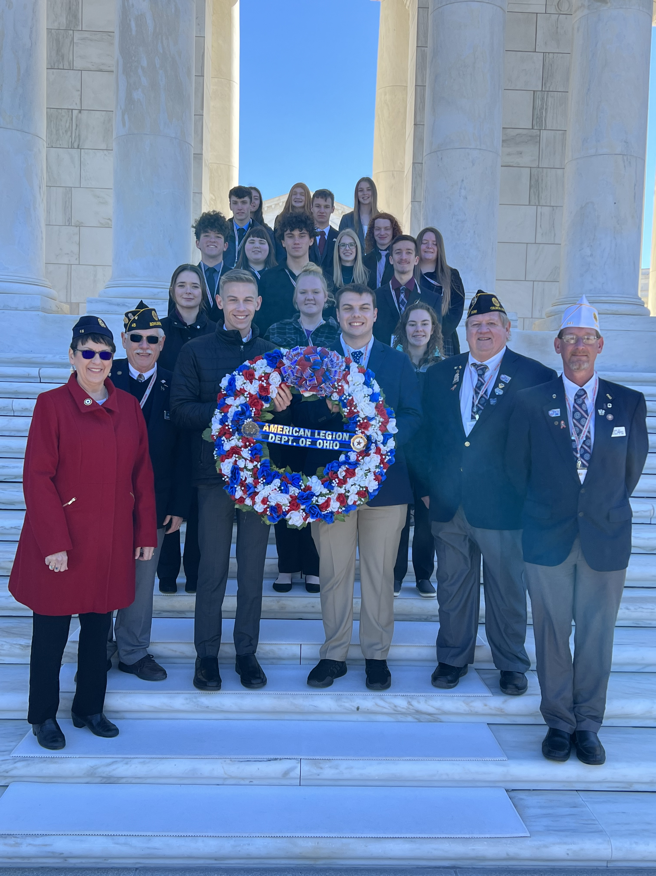
What’s on the test?
The United States Flag
The Declaration of Independence
The United States Constitution
State government in Ohio
County government in Ohio
City government in Ohio
Township government in Ohio
Village government in
Ohio School District government in Ohio
On average, over 65,000 students participate in the Test program annually.

Slide 16
Selections
Through several judging levels to select Post, County, and District winners, the initial field of 65,000 students is narrowed to 84 district winners, whose winning test papers are submitted to a State Judging Committee for this program. From the field of 84 District winners, the State Judging Committee typically selects 18 winners in the following categories:
Grade 12 (Seniors): Six (6) State winners/three (3) men and three (3) women
Grade 11 (Juniors): Six (6) State winners/three (3) men and three (3) women
Grade 10 (Sophomores): Six (6) State winners/three (3) men and three (3) women

Slide 17
Americanism & Government Test Winners
The State Award from the Ohio American Legion for the 18 State winners is a five (5) day, all expenses paid trip to Gettysburg, Pennsylvania and Washington D.C.
A highlight of the trip is a Wreath Laying at the Tomb of the Unknowns at Arlington National Cemetery.
The Ohio American Legion and Ohio American Legion Auxiliary have had the honor of laying a wreath at the Tomb of the Unknowns every year since 1936.
The Americanism and Government Test and Trip program is unique to the national America Legion organization as only two other states, Indiana and Wisconsin, have versions of the program, which both adopted/adapted from the Ohio American Legion, but neither program is the size or scope of the Ohio program.

Slide 18
Scouting
There are over 100 American Legion Chartered Scouting Units in the Department of Ohio with over 2,600 participants.
The Department presents the “Department Eagle Scout of the Year” award annually. The Department winner advances into the National American Legion competition and receives a $500.00 financial award from the estate of Mikeal and Frances Golato.
The American Legion annually honors the Eagle Scout of the Year at the national convention. The winner of the competition receives a $10,000 scholarship, and the three runners-up are each awarded $2,500 scholarships.
To start sponsoring a Unit, contact scouting@legion.org

Slide 19
United States Flag Etiquette
Since 1919, The American Legion as a national organization and the Ohio Department of The American Legion have been strong proponents for educating the general public, especially the students in the nation’s schools, on the proper care, display, protection, and disposal of the United States Flag.
The Posts of Ohio conduct many presentations throughout the state on the proper folding, care, and display of the United States Flag.
The Posts of Ohio also conduct proper flag retirement ceremonies for United States flags that are no longer flyable and conduct graveside flag ceremonies for the funerals of deceased veterans.

Slide 20
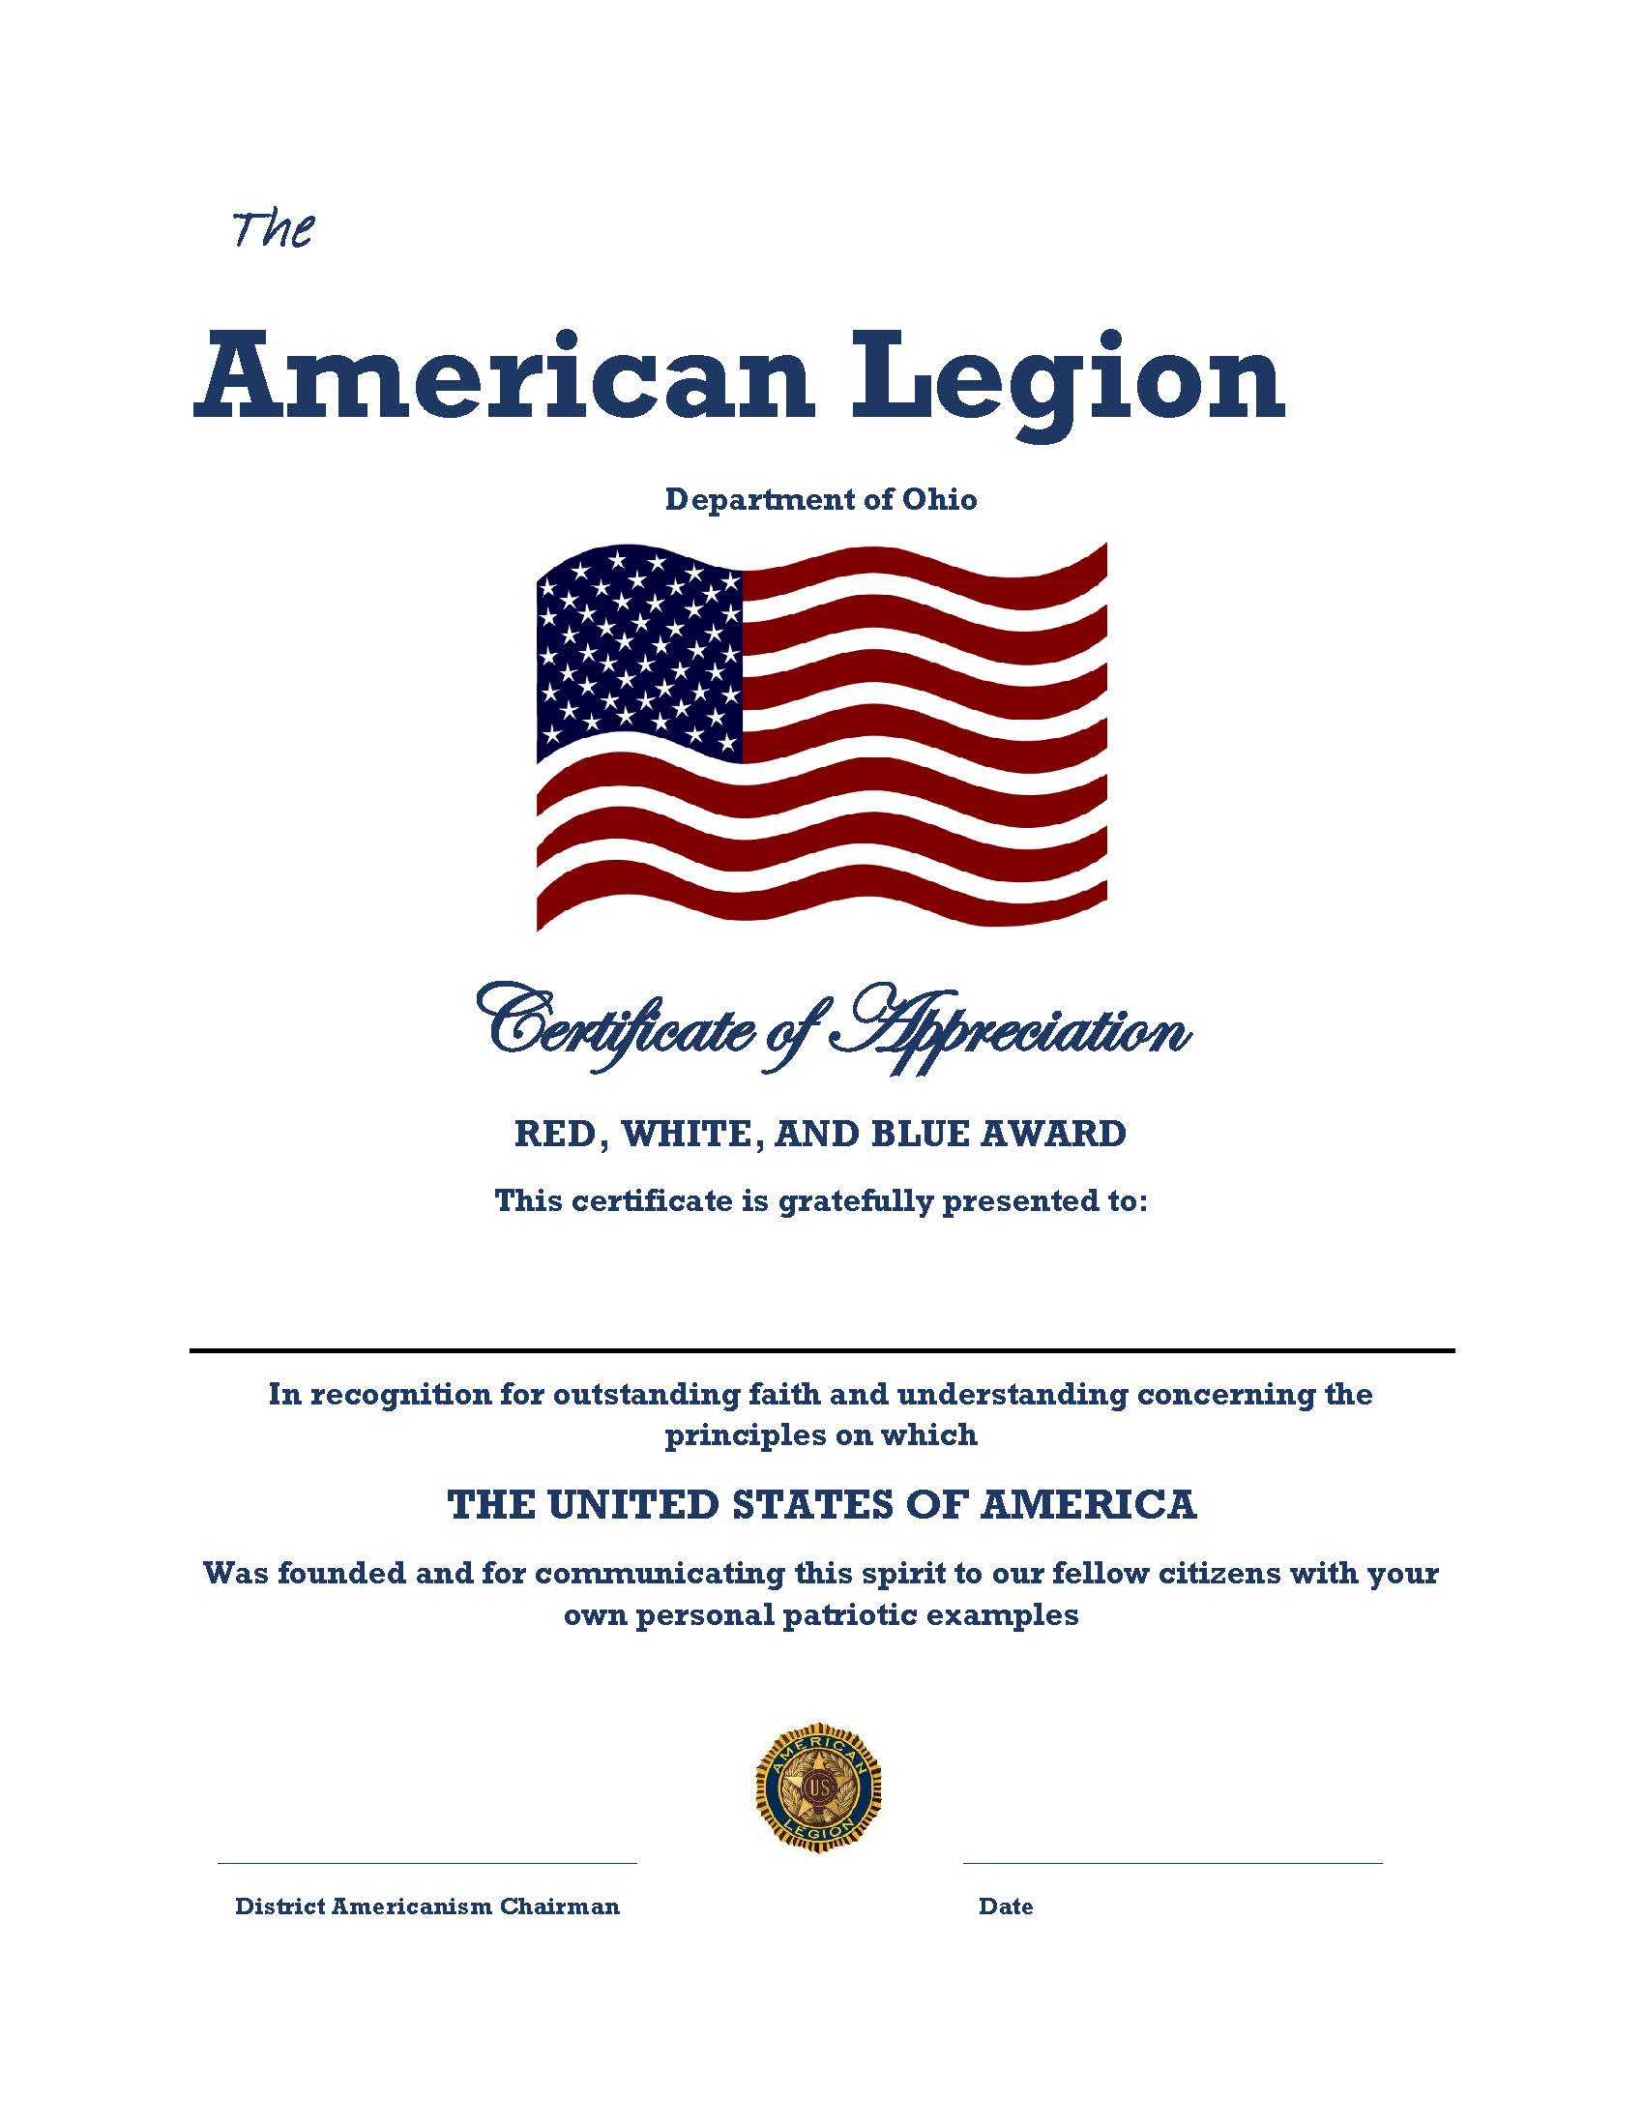
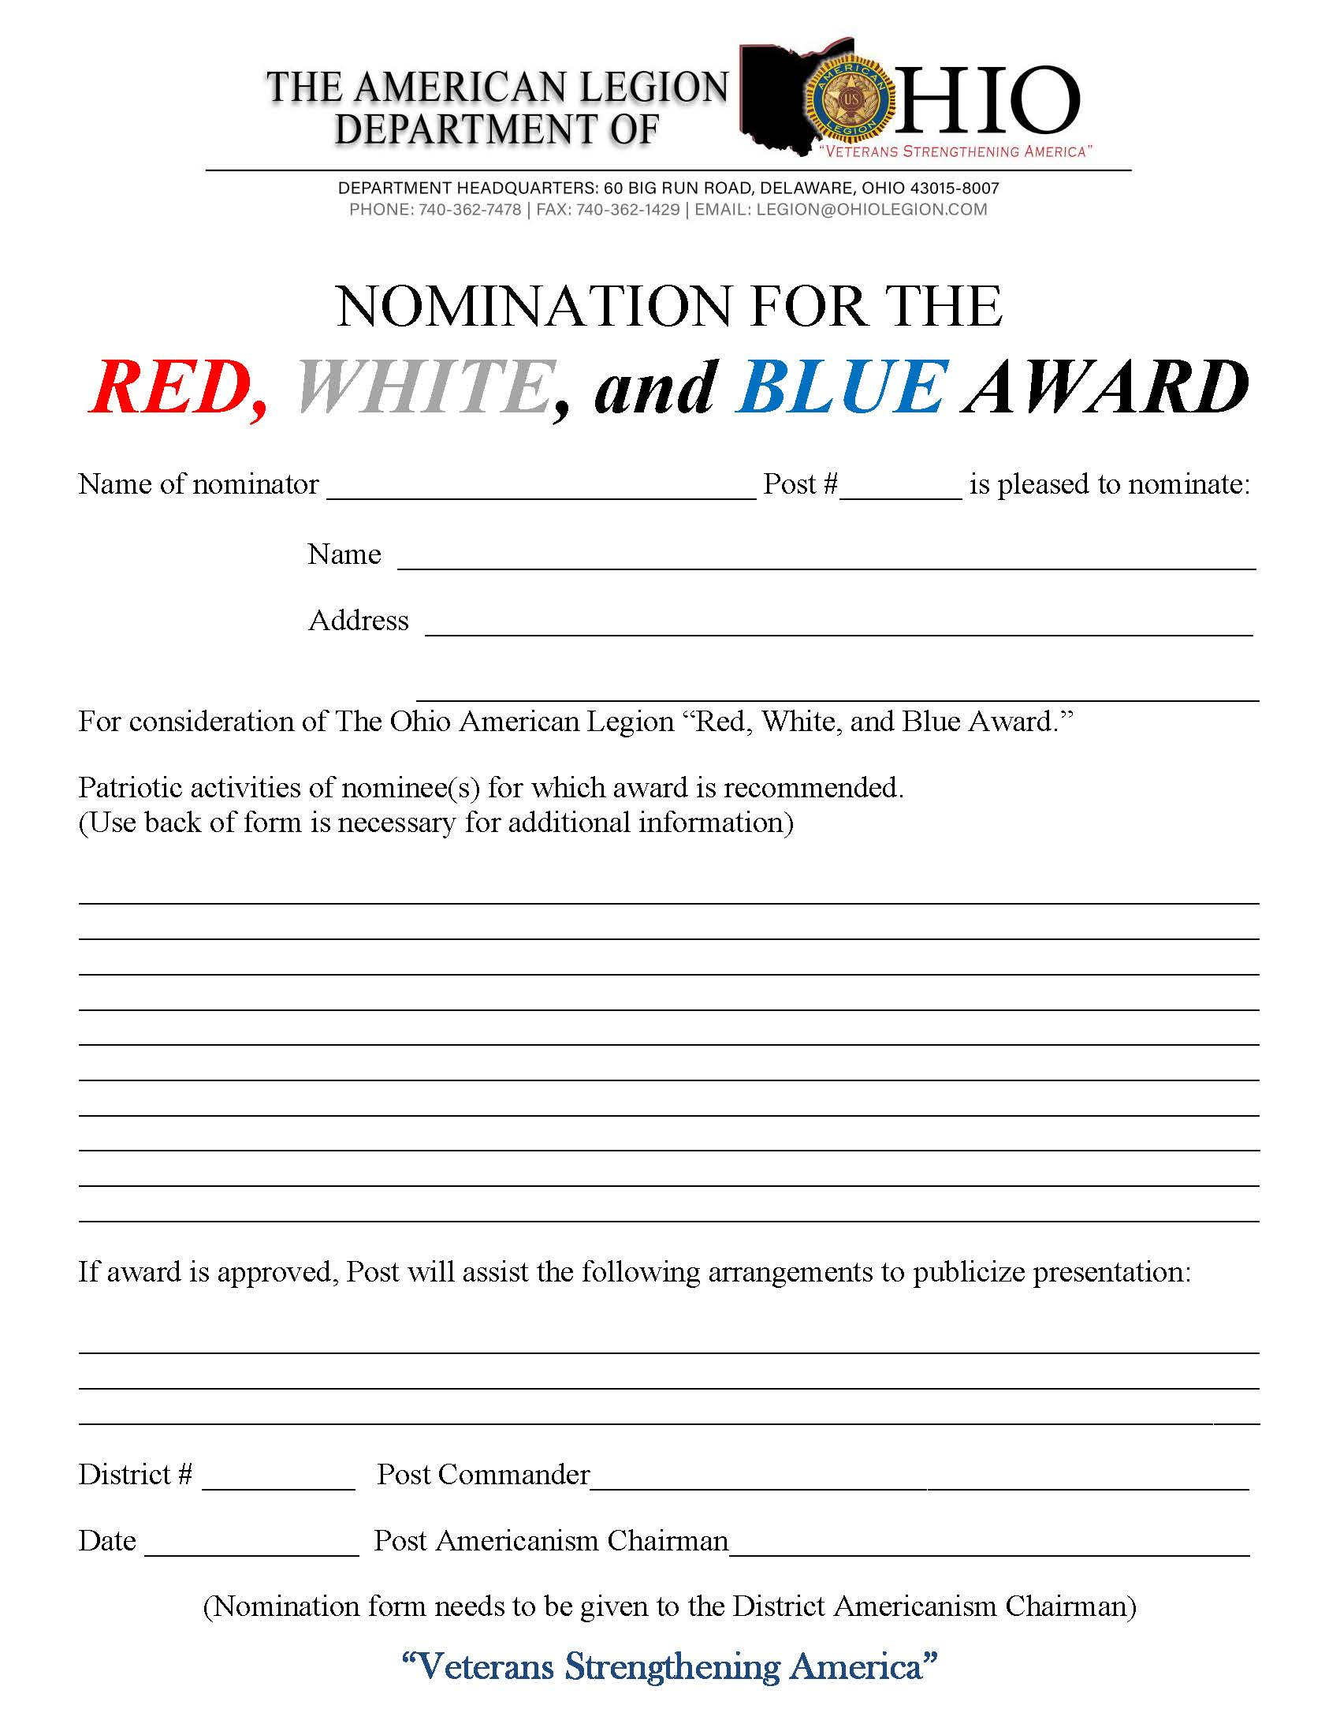
Red, White and Blue Award
The Department of Ohio Americanism Office promotes the Department “Red, White, and Blue Award” program to recognize people and organizations in local communities for flying the flag and positive contributions to their community.

