Slide 1
American Legion Baseball
Chris Emmons, Department of Ohio Baseball Chairman

Slide 2
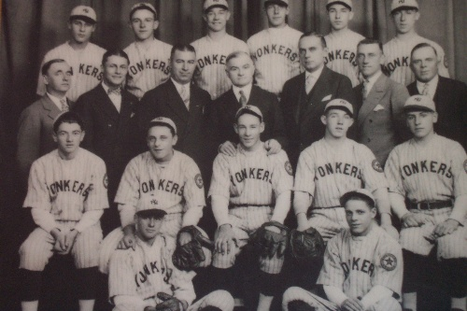
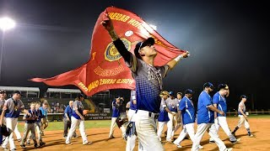
American Legion Baseball History
First AL World Series held in Philadelphia, Pennsylvania in 1926 at Yonkers Post 321
1927 was the only year not to have a World Series
2023 American Legion Baseball World Series Champion was Post 544 from League City , TX

Slide 3

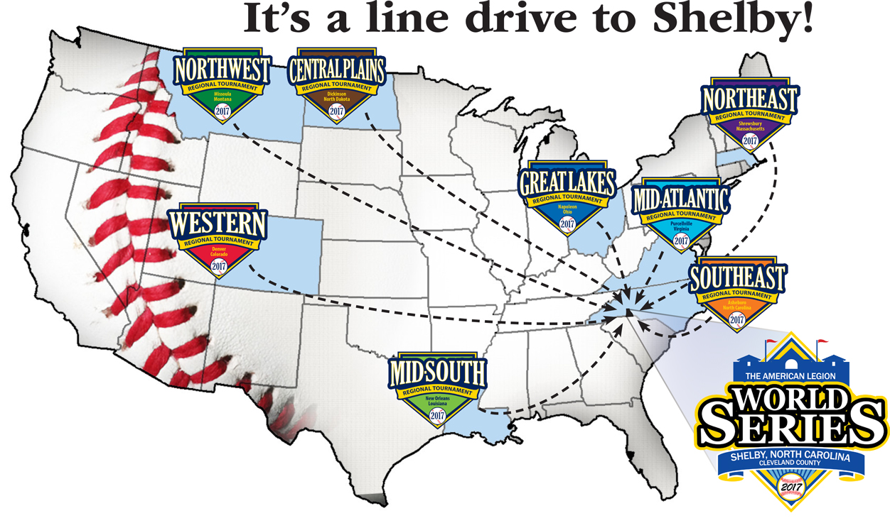
Shelby, North Carolina
Home of The American Legion World Series
Played in Keeter Stadium since 2011
Attendance the last (3) years have been over 120,000 fans

Slide 4
Ohio American Legion Baseball Resume
Hall of Fame
Ohio in the World Series
Major League Baseball Hall of Fame is full of American Legion Baseball players from Ohio- Jim Bunning of Cincinnati and Phil Niekro of Bridgeport
Full list of all American Legion Baseball Alumni that became professional baseball players can be found at legion.org/baseball/alumni
Ohio has won (7) American Legion Baseball World Series
#2 on the list of teams who are series winners
Ohio has (24) World Series appearances
Ohio also has players who won the American Legion World Series “slugger” Award

Slide 5
How to Start a Baseball Team
Cost
Age
Rulebook
Roughly $3500.00 for equipment, uniforms, umpires, and miscellaneous costs
Ask the community to sponsor
Senior Team entry fee is $600.00 which includes Department and National Insurance
Junior Team entry fee is $500.00 which includes Department and National Insurance
Insurance is mandatory
Senior Players age is18 to 19 for the 2024 season
Players born in 2005 and 2006 must play in the Senior Division
If a player turns 20 ANYTIME this calendar year, he CANNOT play. His eligibility has expired
Junior Players age is 13 to 17 for the 2024 season
Players born in 2007 to 2008 must play in the Junior Division
2024 Department of Ohio American Legion Baseball Rulebook Available February
2024 National American Legion Baseball Rulebook
Insurance website
Important team forms
All located on the Department website- ohiolegion.com/baseball

Slide 6

How to Start a Baseball Team
Registration
Safety
Paperwork
All Teams must register their teams on the National ALB site. Registration opens Jan 1
All teams must purchase insurance and pay fees through Nat’l Site- opens Feb 15th
All Coaches must be entered into roster along with all players
Once rosters, BG’s and Abuse Awareness training has completed their roster can be approved by Dept Chair
All coaches, managers and assistant coaches are required to do a background check and abuse awareness training through the National ALB site.
Each team must complete their Ohio Team Packet within the Packet must include
Team Picture
Official Team Roster from ALB Site
Form 2 – Each player must have signed by parents and notarized to play ALB.
Each player must have copy of driver's license or Birth cert for some Jr Players
No Patch / No Play

Slide 7
Ohio Tournament Dates
Ohio Junior Tournament
Ohio Senior Tournament
July 18th – July 21st , 2024
Beavers Field
1651 Granville Pike
Lancaster, OH 43130
July 26th - July 30th , 2024
Beavers Field
1651 Granville Pike
Lancaster, OH 43130
Ohio Senior Tournament winner advances to Mid-Atlantic Region Tournament

Slide 8

Region Tournament Dates
Mid-Atlantic Region; DE, MD, NJ, OH, PA, WV
Aug 6th -10th 2024
Morgantown, WVA

Slide 9
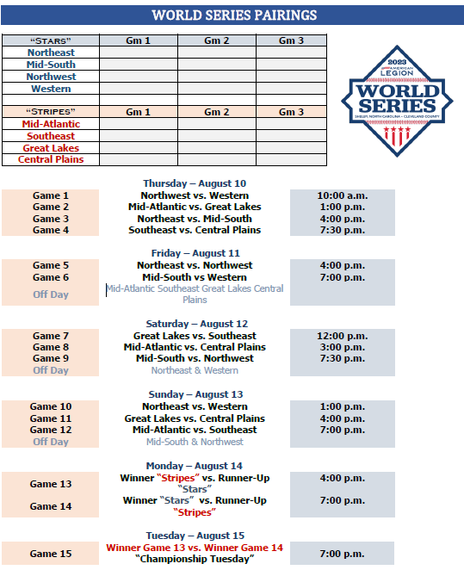
Region Tournament Dates
ALB World Series
Aug 15th -20th 2024
Shelby, NC

Slide 10
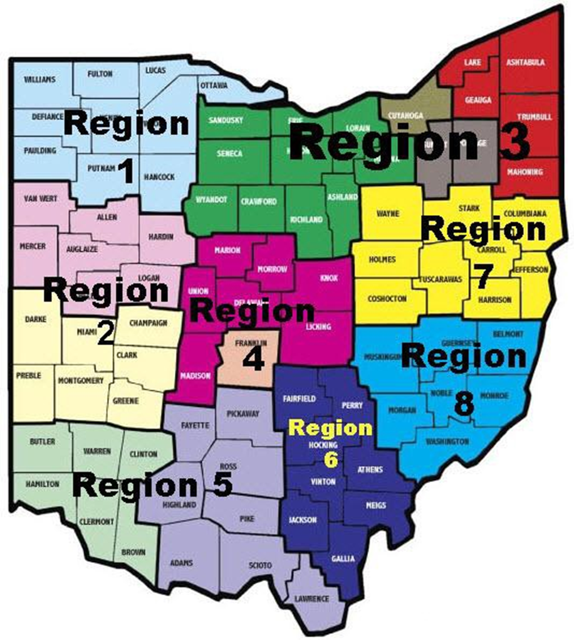
Department Commissioners
Region Contacts
Commissioners handle any issues and help coordinate the Regional Tournament
Also determine the (8) teams that come to the State Baseball Tournament
Region 1- Bryce Agner
Region 2- Chris Emmons
Region 3- Ted Sturzinger
Region 4- Jeff Vrabel Sr.
Region 5- Bret Mavis
Region 6- Phil Lightfoot
Region 7- BJ Long
Region 8- Vacant

Slide 11
Department Teams
2023 27 Senior Teams by Region
2023 19 Junior Teams by Region
The Largest Metro Areas in Ohio have the fewest teams!!! Come On 3 C’s!

Slide 12

Upcoming Baseball Meeting
Meeting for American Legion Baseball Coaches and Managers
Sunday February 4th, 2024 at 1:00PM.
Department Headquarters, 60 Big Run Rd. Delaware, OH 43015
Department Americanism and Children & Youth Coordinator- Christie White Programs@ohiolegion.com 740-362-7478
Department Baseball Chairman- Chris Emmons emmons0341@gmail.com 937-681-2080

