Slide 1
American Legion Baseball
Marv Shamhart, Department of Ohio Baseball Chairman

Slide 2
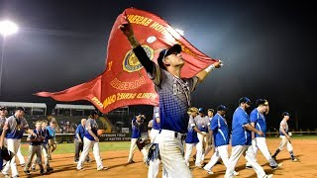
American Legion Baseball History
First AL World Series held in Philadelphia, Pennsylvania in 1926 at Yonkers Post 321
1927 was the only year not to have a World Series
2018 American Legion Baseball World Series Champion was Post 40 from Henderson, Nevada

Slide 3
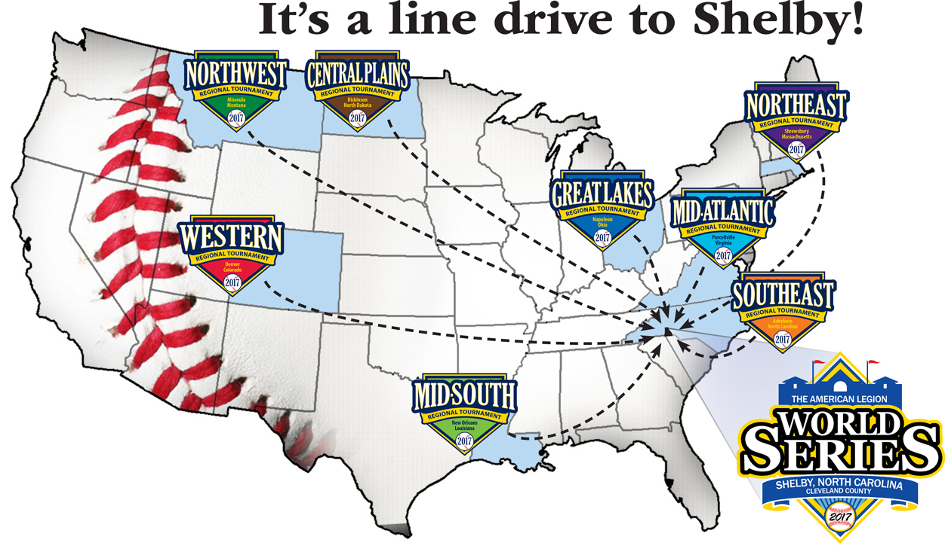
Shelby, North Carolina Home of The American Legion World Series
Played in Keeter Stadium since 2011
Attendance the last (3) years have been over 120,000 fans

Slide 4
Ohio American Legion Baseball Resume
Hall of Fame
Ohio in the World Series
Major League Baseball Hall of Fame is full of American Legion Baseball players from Ohio- Jim Bunning of Cincinnati and Phil Niekro of Bridgeport
Full list of all American Legion Baseball Alumni that became professional baseball players can be found at legion.org/baseball/alumni
Ohio has won (7) American Legion Baseball World Series
#2 on the list of teams who are series winners
Ohio has (24) World Series appearances
Ohio also has players who won the American Legion World Series “slugger” Award

Slide 5
How to Start a Baseball Team
Cost
Age
Rulebook
Roughly $3500.00 for equipment, uniforms, umpires, and miscellaneous costs
Ask the community to sponsor
Senior Team entry fee is $600.00 which includes Department and National Insurance
Junior Team entry fee is $500.00 which includes Department and National Insurance
Insurance is mandatory
Senior Players age 18 to 19 for the 2019 season
Players born in 2000 and 2001 must play in the Senior Division
If a player turns 20 ANYTIME this calendar year, he CANNOT play. His eligibility has expired
Junior Players age is 13 to 17 for the 2019 season
Players born in 2002 to 2006 must play in the Junior Division
2019 Department of Ohio American Legion Baseball Rulebook
2019 National American Legion Baseball Rulebook
Insurance website
Important team forms
All located on the Department website- ohiolegion.com/baseball

Slide 6
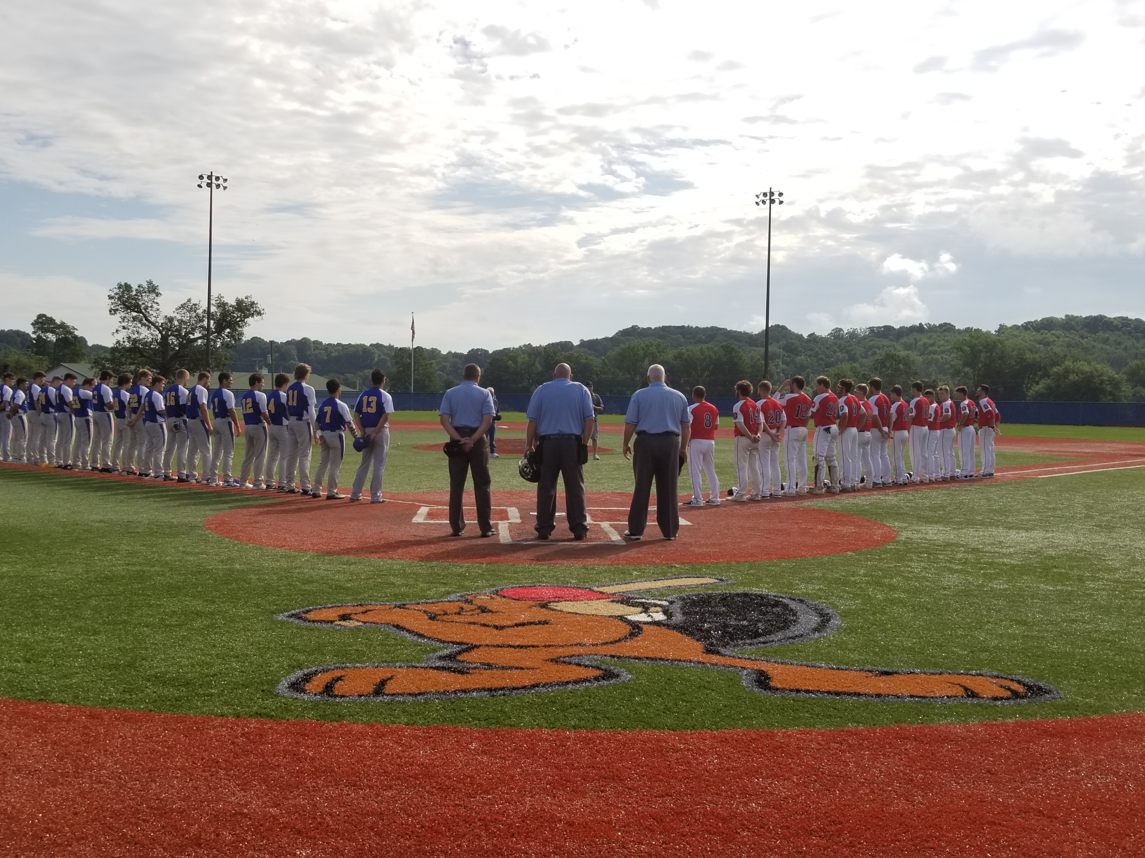
Tournament Dates
Junior Tournament
Senior Tournament
July 11th, 2019 – July 14th, 2019
Beavers Field
1651 Granville Pike
Lancaster, OH 43130
July 31st, 2019- August 4th, 2019
Beavers Field
1651 Granville Pike
Lancaster, OH 43130

Slide 7
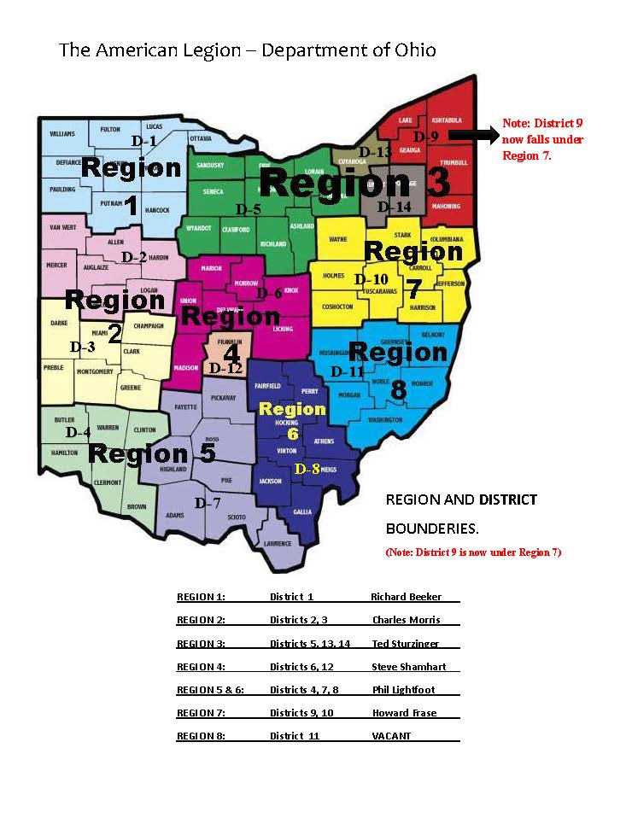
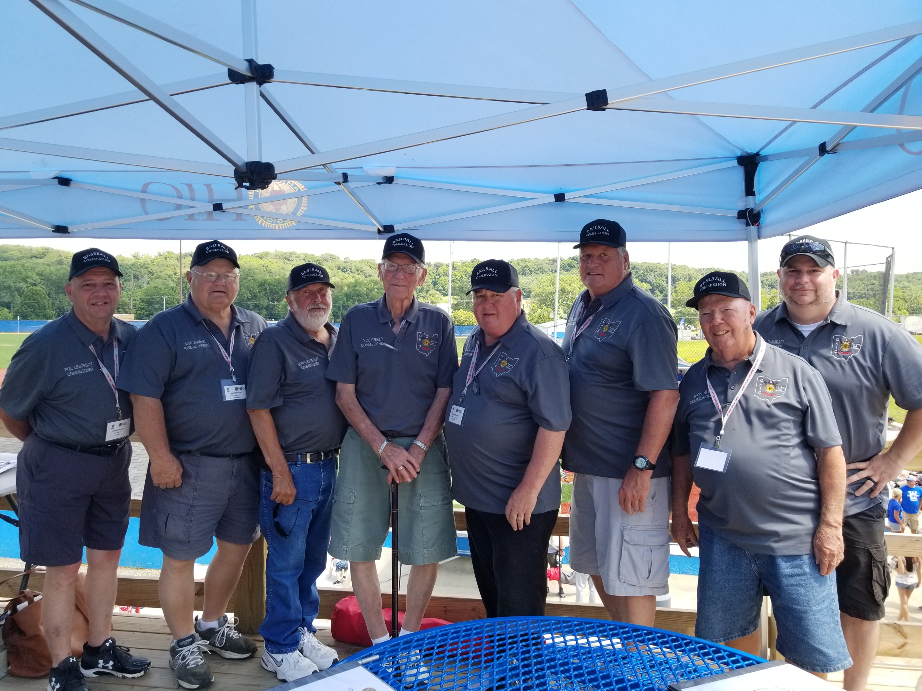
Department Commissioners
Commissioners handle any issues and help coordinate the Regional Tournament
Also determine the (8) teams that come to the State Baseball Tournament
Region Contacts
Region 1 – Richard Beeker
Region 2- Charles Morris
Region 3- Ted Sturzinger
Region 4- Steve Shamhart
Region 5 & 6- Phil Lightfoot
Region 7- Howard Frase
Region 8- Jack Hill

Slide 8
Upcoming Baseball Meeting
Meeting for American Legion Baseball Coaches and Managers
Sunday February 10th, 2019 at 1:00PM.
Department Headquarters, 60 Big Run Rd. Delaware, OH 43015
Department Americanism and Children & Youth Coordinator- Christie White Programs@ohiolegion.com 740-362-7478
Department Baseball Chairman- Marv Shamhart Shamhart@embarqmail.com 740-343-3012

