Slide 1


Burial Benefits
Will Brown
Senior Advocate / Department Service Officer, Cleveland VA Regional Office

Slide 2
5 Types of Burial Benefits
Based on Service-connected death
Based on non-service-connected death
Based on a Veteran who died while hospitalized by VA.
Burial plot or interment allowance
Reimbursement for transportation of remains.

Slide 3
Service-Connected Death
VA will pay $2,000 for the burial and funeral expenses of a veteran who dies from a service-connected disability. 38 C.F.R. § 3.1704(a).
VA will pay the $2,000 automatically if the veteran was rated 100% disabled for service-connected disabilities when he dies (this excludes TDIU).
In addition to the $2,000 VA may also pay the Following
Transportation expenses related to burial in a National Cemetery; and plot or interment allowance for burial in State Veterans cemeteries.

Slide 4
Non-Service-Connected Death
VA will pay up to $978 towards burial and funeral expenses for deaths on or after October 1, 2024
VA will pay an additional $978 plot-interment allowance (if not buried in a National Cemetery).
In addition to the $978 burial allowance, VA may also pay
Transportation expenses to burial in a National cemetery (but only if certain criteria are met); and Plot or interment allowance for burial in a State Veterans cemetery.

Slide 5
Burial Allowance for Veteran Who Died While Hospitalized by VA
VA will pay the non-service-connected death rate for burial and funeral expenses of a veteran who died while hospitalized by VA. 38 C.F.R. § 3.1076(a).
Generally, the veteran was admitted to a VA facility, nursing home, or in domiciliary care, or was admitted to such a facility under VA contract.
If admitted to a VA facility or under VA contract check the appropriate box on question 20B on the VA Form 21P-530EZ and explain to the VA where the veteran passed.

Slide 6
Burial Allowance for Veteran Who Died While Hospitalized by VA cont. by VA
In addition to the $978, VA may also pay:
Transportation expenses related to burial under certain circumstances; and Plot or interment allowance for burial in any cemetery under certain circumstances.

Slide 7
Plot or Interment Allowance for Burial
For a veteran who was eligible for burial in a National cemetery, but was not buried in a National cemetery, VA will pay the following allowances (38 C.F.R. § 3.1707):
VA will pay $700 for burial in a State Veterans cemetery. This is paid to and at the request of the State.
VA will pay $978 for burial in any other cemetery to a claimant who incurred such expenses AND the Veteran is either:
Eligible for burial allowance on non-service-connected death.
Eligible for burial allowance on death while hospitalized by VA.
Was discharged from active service for a disability incurred or aggravated in the line or duty; or was discharged from active service with a disability which would have justified a discharge for disability.

Slide 8
Transportation Expenses
VA will reimburse the costs of transportation of a veteran remains for burial in a National cemetery. 38 C.F.R. § 3.1709.
VA will reimburse transportation cost if:
The veteran died of a service-connected disability;
The veteran was receiving service-connected disability benefits on the date of death; or
The Secretary determines the veteran is eligible for a burial allowance because the remains are unclimed.

Slide 9
Who May Receive Burial Benefits
For claims received on or after July 7, 2014, VA will pay burial benefits to the first living person to file of the following:
His or Her surviving spouse ;
The survivor of a legal union between the deceased veteran and the survivor;
His or Her children, regardless of age;
His or Her parents, or surviving parent; or
The executor or administrator of the veteran’s estate.

Slide 10
When Claims must be filed
Generally, VA must receive a claim for non-service-connected burial allowance no later then two years after the burial of the veteran.
Otherwise, there are no other time limitations to file for burial benefits.

Slide 11
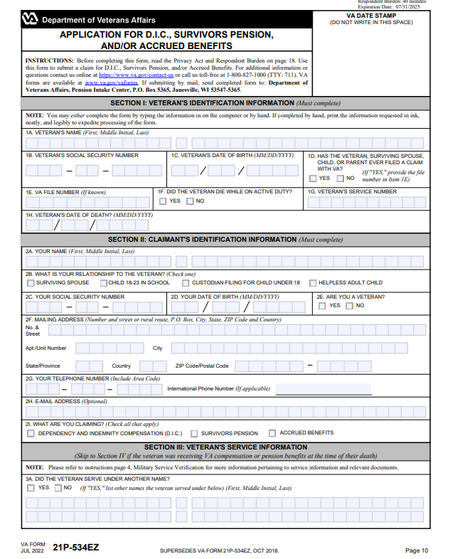
How to Apply for Burial Benefits
To apply for burial benefits, complete and submit VA Form 21P-534EZ. When filing a claim make sure to include:
Proof of veteran's death i.e. death certificate; a statement that the claimant incurred burial, plot or interment, or transportation cost of the deceased veteran; for transportation cost a receipt showing who paid the cost.

Slide 12

Automatic Payments to Surviving Spouse
On July 7, 2014 , VA may automatically pay a burial benefit to a surviving spouse when VA knows of the surviving spouse and is able to determine burial benefits eligibility based on the evidence of records.
Never assume that this has happened contact the surviving spouse to see if they have received a check or automatic deposit of $2,000 or $978.

Slide 13
Questions

