Slide 1
American Legion Department of Ohio Legislative Training
Suzette M. Heller, Past Department Adjutant, Legislative, VA&R, and National Security Director
Capital 12th District Commander & Department Legislative Chairwoman
Post 0001 Adjutant & Finance Officers
734-358-4404 zheller1105@gmail.com
Michael White, CSM, US ARMY (Ret.)
Thundering Third District 1st Vice Commander 937-999-9099 csmwhite@woh.rr.com

Slide 2
Learning Objectives
Be knowledgeable of Ohio Legislature website to access Legislators, Bills, and Resolutions.
Be knowledgeable of Congress.gov website to access Members of Congress, Bills, and Resolutions.
Be knowledgeable of the purpose of the American Legion Legislative and VA&R Division Office in Washington, D.C.
Be knowledgeable of interacting with State and Federal Elected Officials
Notes:
The learning objective for this lesson are….

Slide 3
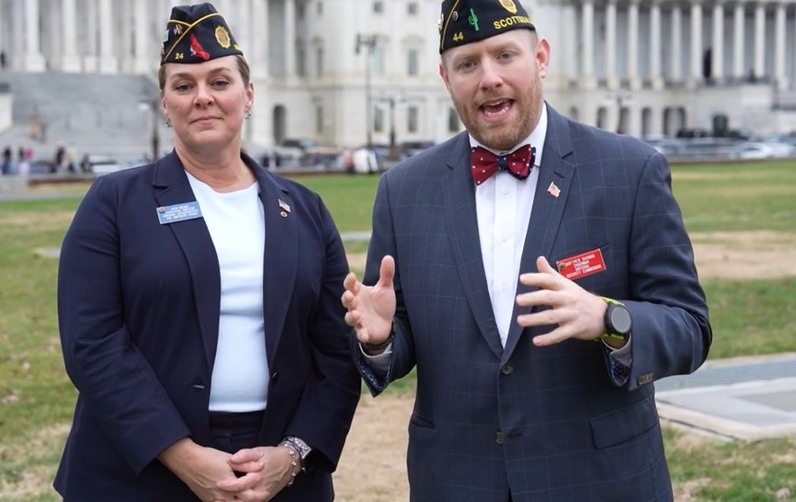
A Legionnaires Guide to Meeting with Lawmakers
https://www.youtube.com/watch?v=OSo3QT8mDDM

Slide 4

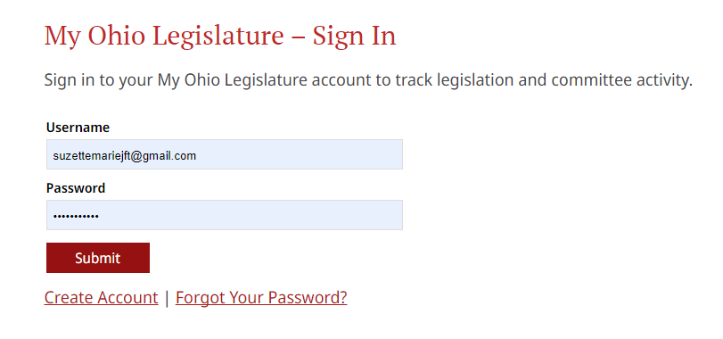
OHIO LEGISLATURE
https://www.legislature.ohio.gov/
“My Ohio Legislature”
Create Account
Notes:
Notes…

Slide 5
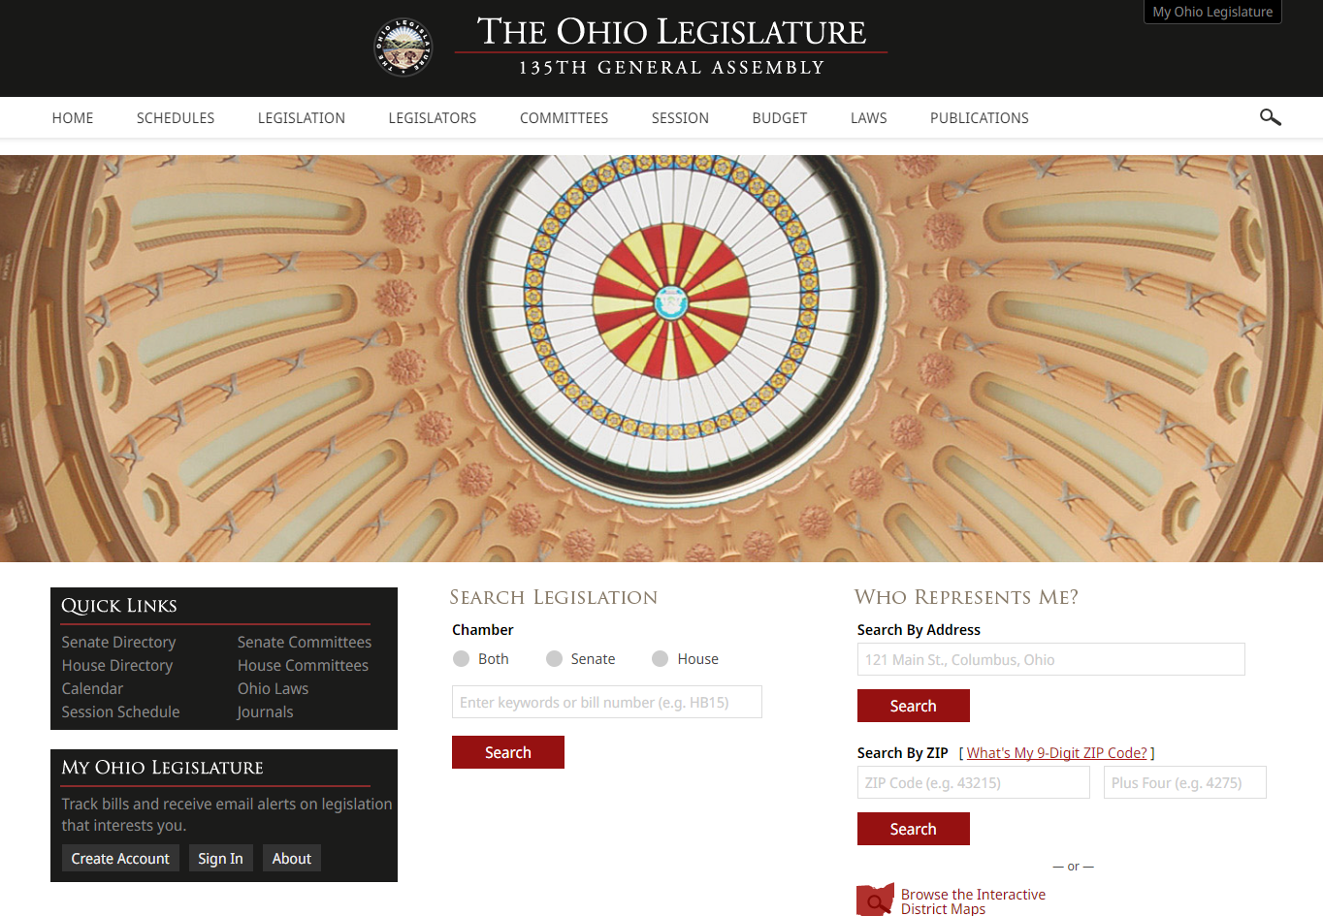
OHIO LEGISLATURE
Notes:
135th General Assembly is now closed.
136th General Assembly
.

Slide 6
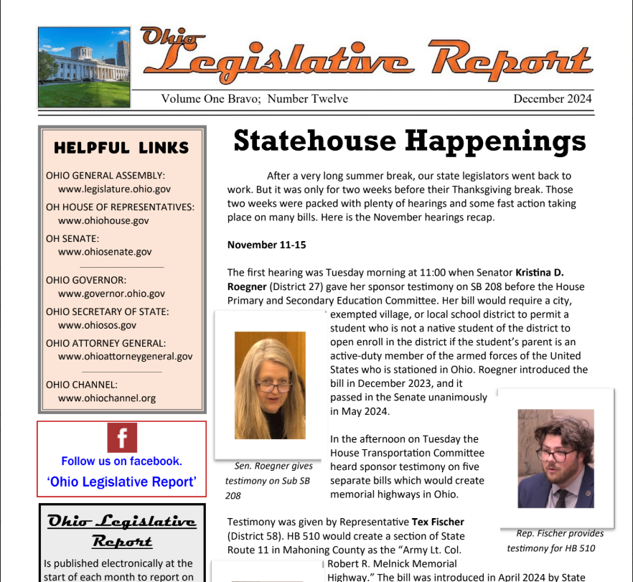
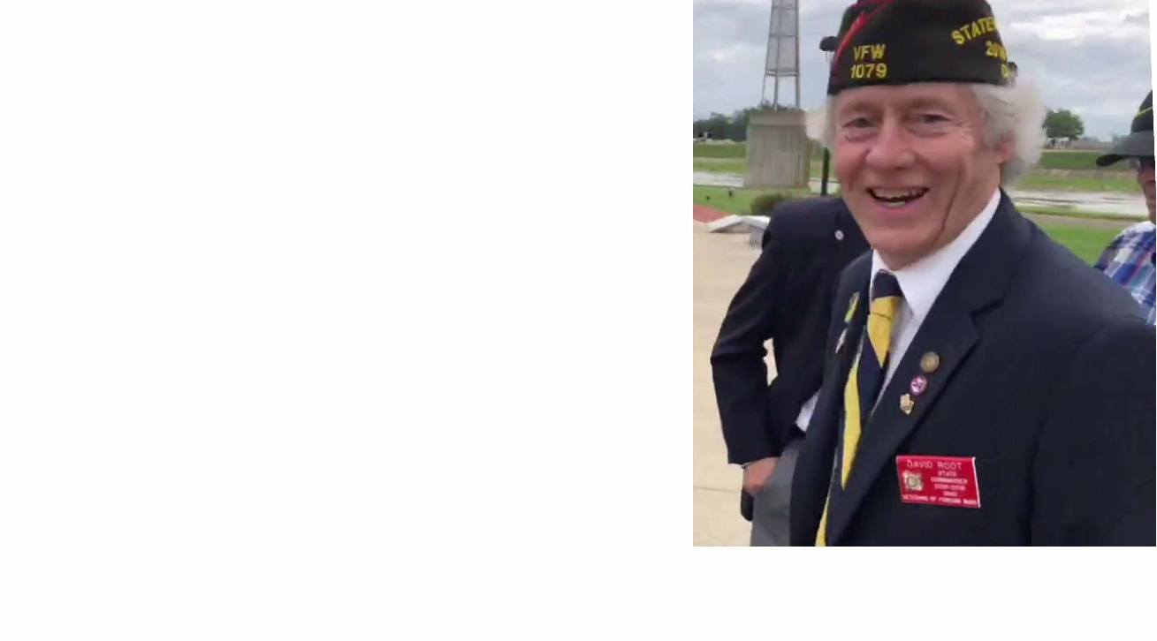
OHIO LEGISLATIVE REPORT
David K. Root, Member
Email: oh.leg.report@gmail.com
Notes:
Notes

Slide 7
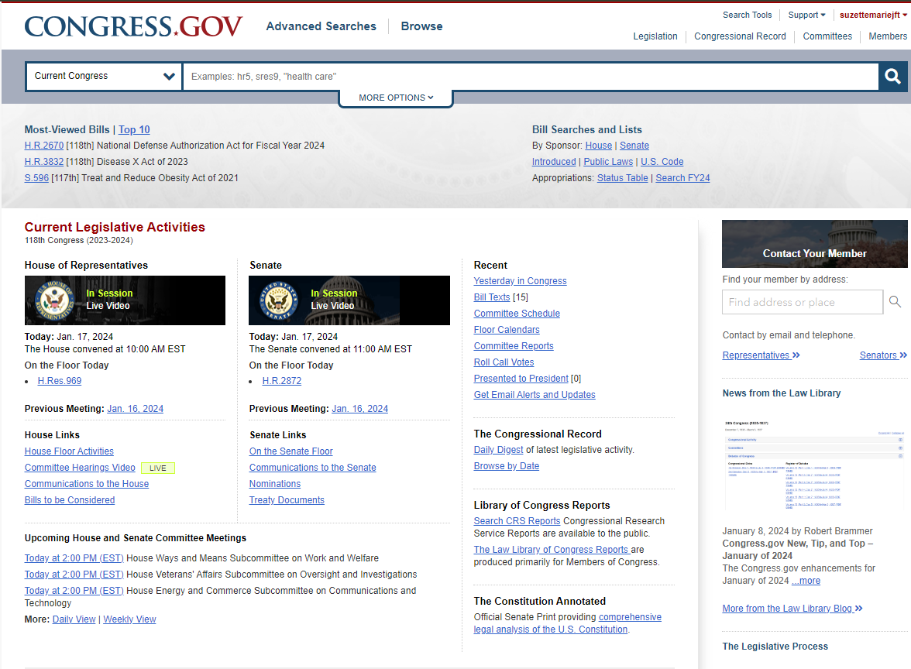
FEDERAL CONGRESSIONAL LEGISLATION
https://www.congress.gov/
Notes:
Notes

Slide 8
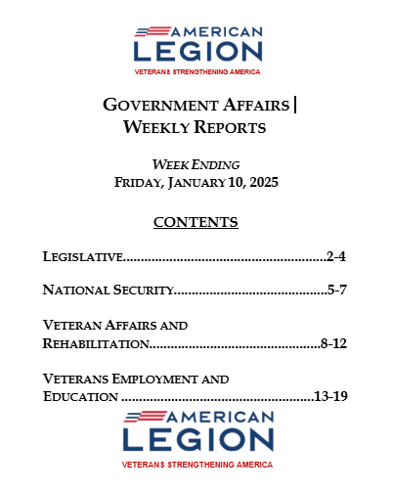
AMERICAN LEGION NATIONAL LEGISLATIVE DIVISION (NLD) WASHINGTON D.C.
Grassroots Action Updates
Julia Funari
jfunari@legion.org
Action of DC is Resolution Based
Washington DC Conference Annual – February
grassroots@legion.org
Notes:
Notes

Slide 9
INTERACTING WITH STATE LEGISLATORS AND MEMBERS OF CONGRESS
DO
RESEARCH YOUR LEGISLATOR
BE SPECIFIC – BE RESPECTFUL
ASK FOR ACTION - SOLUTION
KNOW THE ISSUE
BE CONSIDERATE OF THEIR TIME
PLAN OUT YOUR REMARKS
TELL THE TRUTH
ADDRESS PROPERLY
FORGE RELATIONSHIPS
VISIT LOCAL OFFICES AND WORK WITH STAFFERS
FOLLOW-UP: WRITE A THANK YOU NOTE
DON’T
DISMISS STAFF
MONOPOLIZE THE MEETING
TALK LOUDLY OR UNPROFESSIONALLY
CONFUSE THE LEGISLATIVE ISSUE
LACK BREVITY
BE AFRAID TO SAY “I DON’T KNOW” “I’LL GET BACK WITH YOU”
BE CONFRONTATIONSL OR ARGUMENTATIVE
USE INAPPROPRIATE LANGUAGE
PROVIDE FALSE INFORMATION
FAIL TO FOLLOW UP

Slide 10

Summary
Access to state and federal legislation
Resources for state and federal Legislation
Knowledge of the National Legislative Division
Do’s and Don'ts of interacting with a State
Legislator or Member of Congress (MOC)

Slide 11

Questions
SUZETTE HELLER
EMAIL: zheller1105@gmail.com
734-358-4404
MICHAEL WHITE
EMAIL:csmwhite@woh.rr.com
937-999-9099
Notes:
Notes

