Slide 1


Welcome to American Legion Baseball

Slide 2
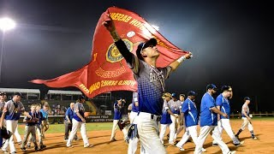
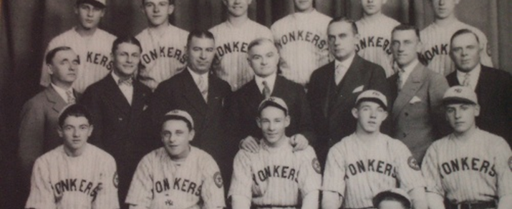

American Legion Baseball History
First AL World Series held in Philadelphia, Pennsylvania in 1926 at Yonkers Post 321
1927 was the only year not to have a World Series
2025 Marked 100 Years of ALB

Slide 3


Athletic Committee

Slide 4
Athletic Committee
Department of Ohio Athletic Committee –
  Program Coordinator – Christie White
  Department Athletic Committee (AC) Chairman-Chris Emmons
  Asst Department AC Chairman- Marv Shamhart
  Junior Baseball Director- Phil Lightfoot
  4 Region Directors – R1 Bryce Agner, R2 Mel Cantrell, R3 Bret Mavis, R4 Regis Kern Rr Asst Dir Jeff Vrabel Jr
  Sub Committee:
  State Tournament Site Liaison – Tyler Sisson Beavers Field
  District Baseball Chairman- appointed by District Commanders; will assist them in their regions with teams and Super Regional tournaments.
Authority: The Ohio Athletic Committee has tremendous authority and jurisdiction within the state. In ninety-nine percent of all problems and protests, the Athletic Committee is the final ruling authority. The Committee must comply with a National Appeals Board ruling, but it does have the authority to adopt more restrictive recruiting rules. The Committee is comprised of volunteer members, and they are responsible to protect the safety of the players and fans, as well as to ensure the integrity of the program. These volunteers are charged to ensure fair competition, set up tournament play, establish state rules, operating procedures, Team fees and handle interpretations and protests.
Meetings: The Athletic Committee normally meets two-three times each year.
October - Post season meeting. Meeting will be held at Department HQ. Athletic Committee and Sub Committee
January - in conjunction with the Dept. of Ohio Mid-year Conference. The Athletic Committee considers final rule changes for the upcoming season and selects tournament sites. .
February - Coaches meeting held on a Sunday at Department HQ to review Rules and Tournaments. Athletic Committee and Sub Committee. This will be the only meeting that mileage will be paid
July – Athletic Committee must attend Sr Tournament. Hotel rooms provided by Department of Ohio , Sub Committee by invite

Slide 5
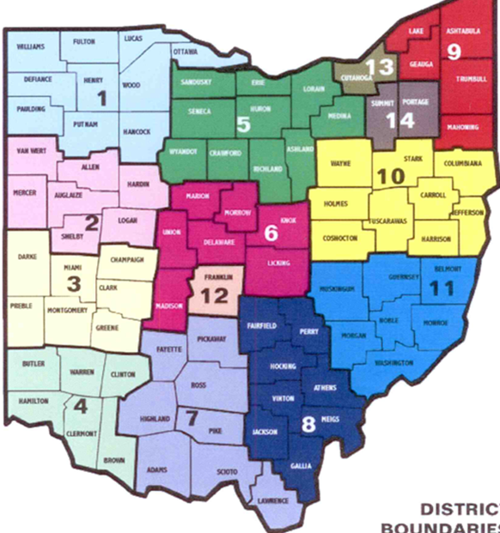

2025 Senior Baseball
2025 Season
NWO Region 1:
Districts 1,5
4 Teams
Napoleon, Ottawa, Pemberville, Findlay
WCO Region 2:
Districts 2,3,6,12
4 Teams
Sidney, Greenville, Utica, Columbus
SO Region 3:
Districts 4,7,8
6 Teams
Chillicothe, Waverly, Harrison, Portsmouth, Athens,
Lancaster
EO Region 4:
Districts 9,10,11,13,14
7 Teams
Marietta, Cambridge, Zanesville, St. Clairsville, Beverly-Lowell, Wayne County, New Philly
REGION 1
REGION 4
REGION 2
REGION 3

Slide 6

2025 Junior Baseball
Presented By The Sons of The American Legion Detachment of Ohio
2025 Season
NWO Region 1:
Districts 1,5
2 Teams
Bettsville, North Baltimore
WCO Region 2:
Districts 2,3,6,12
5 Teams
Sidney, Troy, Greenville, Utica, Columbus
SO Region 3:
Districts 4,7,8
5 Teams
Chillicothe, Waverly, Portsmouth, Athens,
Lancaster
EO Region 4:
Districts 9,10,11,13,14
5 Teams
Marietta, Cambridge, Zanesville, Beverly-Lowell, New Philly
REGION 1
REGION 2
REGION 4
REGION 3

Slide 7


Tentative Important Baseball Dates 2026
Thursday January 1st, 2026, Registration Opens
Sunday February 21st Commission Meeting 10am / Coaches Meeting 1pm
March 31st Deadline to establish players legal residence
June 1st Deadline for Team Registrations
June 5th Deadline to submit Transfer forms
June 25th Deadline for Rosters/insurance and Team Packets
Monday July 13th 6pm ALB Directors Teams Call to cover Regional Tournaments
  Junior Regionals must be completed by Saturday July 11, 2026
  Senior Regionals must be completed by Saturday July 18, 2026
July 16-19, 2026, Ohio Junior State Tournament
July 24-27, 2026, Ohio Senior State Tournament
TBD Mason-Dixon Junior National Regional Maryland
August 5-9, 2026, National Senior Regionals Location TBD
August 11-18, 2026, ALB World Series
September 1st, 2026, Official Close of the 2026 Season

Slide 8
2026 Tournaments
Ohio Regional Tournaments– Regions with less than 3 teams will schedule 3 game series. Home vs Home if game 3 is needed the team with the better run differential will be home team. Tiebreaker will be a coin flip
  All Tournament Sites will be determined at the Fall Meeting or Mid Winter at latest.
  Brackets will be seeded randomly by the Athletic Committee via Teams Meeting after June 1st registration Deadline.
  All Regional Tournaments will be played under Dept Tournament Rules. Double elimination , Department to Provide Winning Team and Runner up Trophies for each Region. Winners will advance to 6 Team Double Elimination State Tournament.
  Regional Runners Up will advance to State Tournament to be entered into Single elimination Play in Game- the 2 winners will complete the 6 Team bracket.
    Junior regionals will take place the week of July 6th, 2026, must be completed by July 11th
    Senior Super Regionals will take place the week of July 13th, 2026, must be completed by July 18th
State Tournaments–
  State Junior Tournament will be played under Dept Tournament Rules. Double Elimination, Dept will Provide winner and Runner up Team trophies, individual player awards. Dept will provide rooms for all teams outside of 60 Miles. Winner will advance to Regional tournament.
    State Junior Tournament will take place July 16-19th, 2026, Beavers Field Thursday – Sunday
  State Senior Tournaments will be played under Dept Tournament Rules. Double elimination , Department to Provide Winner and Runner up Trophies, and individual player awards. Dept will provide rooms for all teams outside of 60 miles. Winner will advance to Regional tournament.
    State Senior Tournament will take Place July 24-27th 2026 Beavers Field Friday-Monday

Slide 9
How to Start a Baseball Team
What will it Cost the Post?
Age
Rulebook
Registration estimate to include Department, and National fees Plus insurance $1,000.00
Roughly $3,500.00 for equipment, uniforms, umpires, and miscellaneous costs
Ask the community to sponsor
Have charitable gaming? ALB is a 4 Pillar Program and charitable $$ can be used!!
Senior Team Department fee is $600.00
Junior Team Department fee is $500.00
Insurance is mandatory through National Site- 2026 estimate is $250.00 for more in
1-800-441-3994.
Senior Players age is 18 to 19 for the 2025 season
If a player turns 20 ANYTIME this calendar year, he CANNOT play. His eligibility has expired
Junior Players age is 13 to 17 for the 2026 season
National Age Chart https://www.legion.org/get-involved/youth-programs/baseball/american-legion-baseball-resources
2026 Department of Ohio American Legion Baseball Rulebook Available February
2026 National American Legion Baseball Rulebook available in March 2026
Insurance website https://baseball.legion.org/
Important team forms
All located on the Department website https://www.ohiolegion.com/baseball/

Slide 10

How to Start a Baseball Team
Registration
Safety
Paperwork
All Teams must register their teams on the National ALB site. Registration opens Jan 1
All teams must purchase insurance and pay fees through Nat’l Site- opens Feb 15th
All Coaches must be entered into roster along with all players
Once rosters, BG’s and Abuse Awareness training has completed their roster can be approved by Dept Chair
All coaches, managers and assistant coaches, and Players over 18 years of age are required to do a background check and abuse awareness training through the National ALB site.
Each team must complete their Ohio Team Packet within the Packet must include
Team Picture
Official Team Roster from ALB Site
Form 2 – Each player must have signed by parents and notarized to play ALB.
Each player must have copy of driver's license or Birth cert for some Jr Players
No Patch / No Play
Uniforms must have ALB patch either on left sleeve or left breast

Slide 11

New Teams
With the extension of Ohio High School Baseball , American Legion Baseball is a shorter Summer season.
Most HS Students are not eligible to play until the 2nd week in June
We encourage ALB teams to schedule with other local ALB teams for regular season games, and travel to local tournaments to play.
Some Local and Regional Tournaments can be found at;
  https://www.beaversfield.com/
  https://troypost43baseball.com/
  https://www.legion.org/Tournaments/2025/July/crawfordsville-post-72-invitational
Tryouts for the following season are usually held in the fall right after the season ends.
Make sure to get the word out about your team and tryout information
https://www.legion.org/get-involved/youth-programs/baseball/how-to-participate
https://www.legion.org/get-involved/youth-programs/baseball/american-legion-baseball-resources

Slide 12
Registration and Forms
Form 2 – Player Agreement. All players must have a Form 2 – Notarized Signatures
Form 76 – Transfer Form. Read transfer Player rules for application

Slide 13
Read the Rulebook
American Legion Baseball plays by MLB rules and there are quite a few differences from NFHS –High School Rules
  For regular season play rules can be adjusted to get games in
  For all tournament play (Regional, State and Beyond) strict adherence to the National Rule Book wlll be followed https://www.ohiolegion.com/baseball/
    Some examples but not limited to:
        NO RE-ENTRY
        NO COURTESY RUNNERS
        DH FOR PITCHER ONLY - NO OHTANI RULE
        7 INNING GAMES
        MERCY RULE 10 AFTER 5, OR 4 ½ IF HOME TEAM IN THE LEAD
        COACHES MUST BE IN FULL UNIFORM TO MATCH PLAYERS, CAGE JACKETS ALLOWED, COACHES MUST WEAR HELMET OR SKULL CAP WHILE COACHING BASES
        https://www.legion.org/get-involved/youth-programs/baseball/american-legion-baseball-resources

Slide 14
Continued
American Legion Baseball recruiting rules
The Department of Ohio American Legion Baseball recruiting plan allows for selection of players who attend nearby high schools. Please note that National Recruiting Rule 4 - Player Recruiting was changed in 2020. As a result of the change. combined total enrollment of high schools cannot be 7.500 for grades 1-. 11. and 12. Reference Pages 14-16 of Ohio Rulebook
For High School enrollment numbers visit this site https://high-schools.com/
Rule 2 E. Players Per Team. No American Legion Baseball team may have more than 18 registered players once National Form #1 is registered with the department. Each team must register players on National Form #1 via online registration with their department by June 25 or the department closing date, whichever comes first. The department baseball chairman must certify teams to National Headquarters by June 30 to be eligible for national competition. A non-Legionnaire may serve as coach.
1. For those American Legion Baseball programs that have affiliated senior and junior teams, junior eligible players may participate on both teams during the regular season. However, senior eligible players may not participate on a junior team. Those eligible junior players may appear in an affiliated senior team game provided the total number of players in such senior game does not exceed 18 players. (Point of Emphasis- National deems regular season anything before June 25th Deadline… If you have a Junior Player that you want to play on both the Jr team and Sr team for tournaments they must be on BOTH ROSTERS!!!) National Form #1 refers to Online registration of a Player…

Slide 15
Pitching Rules
Rule 1. S. Pitching Rule. No player may pitch more than a total of 105 pitches per day. A pitcher will be allowed to finish a batter if he reaches or exceeds the maximum limit during an at-bat but must exit the position after that hitter.
No player may enter the game as a pitcher without having fulfilled the required rest days as mandated in the chart below. No player may make more than two appearances as a pitcher during any consecutive three-day period. PENALTY – The pitcher is removed from the pitcher’s position and head coach shall be ejected from the game and serve an additional game suspension.
1. Any player may be removed from the pitching position and remain in the game at another position. However, a pitcher will be automatically removed from the position when a coach makes a second trip to the mound in the same inning, and that player cannot return as a pitcher in that game. PENALTY – Forfeiture of the game if a protest is filed with the umpire-in-chief before the last out of the game.
2. If a player returns as a pitcher in the same game, he will be charged with another appearance.
3. If a team has multiple games on the same day, a pitcher who pitches more than 45 pitches in Game 1 may not pitch in a subsequent game that day and will be required to follow the rest protocol listed.
4. A day is defined as 8 a.m.to 8 a.m.
NO PLAYER MAY MAKE MORE THAN TWO (2)
APPEAREANCES AS A PITCHER DURING ANY
CONSECUTIVE THREE (3) DAY PERIOD

Slide 16


Welcome to American Legion Baseball

