Slide 1


How to interview a veteran to maximize their claim with the VA
Nicole Reese, Department Service Officer, Cleveland VA Regional Office

Slide 2
Interviewing the veteran
Start each interview by greeting the veteran and introducing yourself.
When talking with the veteran ask if he has filed a claim with the VA, he may even tell you directly (I have or Have not yet filed or what's the point they will deny me anyway.)
Encourage the veteran to file a claim with the VA. The American Legion has trained Post Service Officers and Department Service Officers here to assist them in the process.
Remind them that if they don’t apply, they are denied.

Slide 3
Basic Interviewing tips
The best way to learn how to help a veteran is to LISTEN
What brought the veteran to you today?
Watch their body language, tone, and emotion – those can clue you into other concerns for discussion
Be an active listener and ask clarifying questions
Provide brief but accurate descriptions of the next steps in the process
Is this a new claim? Is this a previously denied claim?
Never promise $, or service connection %, or state that the veteran “should be at ___ %” – this is the easiest way to lose a veteran’s trust with you.
However, after a denial if evidence proves the rating was not accurate – we can argue an appeal after the fact.

Slide 4
Where to start The Head
Start at the top and work your way to down:
Head: Headaches, Migraines TBI, Concussions, Lacerations to include painful scars.
Eyes:
Ears: Hearing loss and or Tinnitus (what was your Job)
Mouth and nose: Loss of taste smell, trauma to the teeth
Notes:
Headaches if migraines are they prostrating what do you have to do during a migraine or headache, have you missed work due to headaches or migraines.

Slide 5
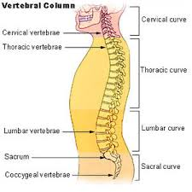
Neck, shoulder and back
Neck and Shoulder
Neck: Whiplash, trauma to the neck during work, of PT
Shoulders: Surgeries while in service, injury to the shoulder (sprain, dislocation, arthritis, tendonitis).
Back
Back: this includes the upper and lower back this is claimed as one issue but separate from the neck which can be rated separately.
Strains, bulging disk, arthritis, Sciatic, DDD, etc.)

Slide 6
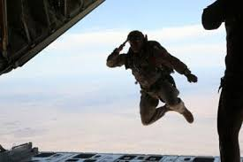
Hips
Hips
DJD, trauma to the hip
If the veteran make jumps while in the service
Dislocations of the hip

Slide 7
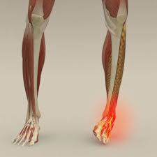
Legs and ankles
Legs
Trauma to the legs to include knee injuries.
Bursitis, arthritis, surgery, torn ligaments or tendons
Painful motion, limited motion
Ankles
Broken, twisted, dislocated
Arthritis
Painful motion, limited motion
Dislocation, surgery

Slide 8
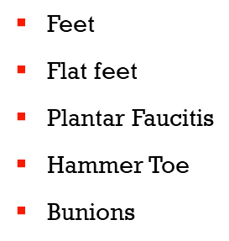
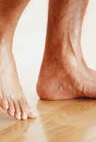
Feet

Slide 9
Remember
Three things are needed to service connect
An Event in Service
A Current Diagnosis
And a medical opinion linking the Event and Diagnosis to Service.
Things to ask
Did you seek treatment
Did you go to medical
Did you tell a friend or family member about the injury

Slide 10
Other conditions and Preexisting
Conditions
Mental disorders
Sleep Apnea
Gerd, Acid Reflux
ED
Diabetes
Preexisting conditions
Conditions that the veteran had at the time of enlistment and noted on the entrance exam can be service connected. If proof that the condition worsened beyond normal progression or if service aggravated the preexisting condition. A medical NEXUS statement will help justify the connection.

Slide 11
Secondary Conditions
Secondary conditions
These are a direct result of a service-connected disability. The veteran is SC for a back condition and is now having issues with his left hip.
In basic terms – the veteran wouldn’t have condition B if he didn’t have condition A
How to connect
The veteran would have to obtain medical opinion that the left hip is caused by the service connected back. Due to adjusted gait, restricted posture, etc.. The doctor should also state that it is as likely as not that the veteran's left hip is due to his SC back condition

Slide 12
What can not be service connected
Disease that are considered congenital
Definition of congenital
1a : existing at or dating from birth congenital deafness
b : constituting an essential characteristic : inherent congenital fear of snakes
c : acquired during development in the uterus and not through heredity congenital syphilis
38 CFR 3.303
Willful misconduct
3.301 Line of duty and misconduct.
(a)Line of duty. Direct service connection may be granted only when a disability or cause of death was incurred or aggravated in line of duty, and not the result of the veteran's own willful misconduct or, for claims filed after October 31, 1990, the result of his or her abuse of alcohol or drugs.
(Authority: 38 U.S.C. 105)
(b)Willful misconduct. Disability pension is not payable for any condition due to the veteran's own willful misconduct.
(Authority: 38 U.S.C. 1521)

Slide 13
Questions?????

