Slide 1
Veterans Affairs & Rehabilitation (VA&R)
“The natural spokesman for the disabled veteran, his first friend and advocate, is his veteran's organization.”
- Richard Seeyle Jones, “A History of The American Legion,” 1946
William Genochio, VA&R, VBA Coordinator

Slide 2
Learning Objectives
Mission and History of the VA&R Pillar of the American Legion
National Commissions operating under VA&R Pillar
Department of Ohio VA&R Programs
Department Service Officers
Post Service Officers
What to do when a Veteran transfers to Post Everlasting
Review

Slide 3
History of the VA&R Pillar
Founded by an Act of Congress after World War I, The American Legion fiercely advocates for the unique needs of every generation of veterans, service members, and their families who pledge to protect our nation. Today, we are committed to destigmatizing mental health support, offering peer-to-peer resources, and empowering everyone to Be The One in the fight to end veteran suicide.
The Legion has been the nation's leading advocate for proper health care and earned benefits for America's veterans. The Legion was instrumental in creating the Veterans Administration in 1930, and an ardent supporter of its rise to Cabinet status when it became the Department of Veterans Affairs (VA) in 1989.
As it has for decades, the Legion continues to aggressively lobby for adequate funding of the Veterans Health Administration (VHA), to provide timely access to quality health care. Additionally, the Legion seeks to ensure fair rulings on claims and other earned veterans benefits for those who have service-connected injuries and illnesses. American Legion accredited service officers and other professional staff works diligently to assist veterans in obtaining the benefits and care they have earned and deserve through VHA, the Veterans Benefits Administration (VBA) and the National Cemetery Administration.

Slide 4
Mission & Top Priorities
Protect VA from Budget Reductions
Boost VA Construction Projects
Improve access to health care in rural areas / Stop Denying VA Health Care
Address Environmental exposure issues
Increase staffing levels to reduce VA Claims backlog
Expand Veterans Treatment Courts
Increase funding for National Cemetery Administration
System Worth Saving Program
Research various treatments for treating Traumatic Brain Injury & Post-Traumatic Stress Disorder not currently being employed by DOD or VA.
Regional Office Action Review Program: Conducts site visits to VA regional offices to evaluate the quality of disability claims ..recommend strategies for improvement
Mains an extensive network of more than 2,500 professionally accredited department service officers, and National appeals representatives.
Reduce delays in Integrated Disability Evaluation System (IDES)

Slide 5
National Commissions & Committees
Purpose of VA&R Commission: formulates and recommends to the NEC policies, plans, and programs on direct assistance, outreach and support for veterans and their families with Department of Veterans Affairs (VA) claims and benefits, health care, memorial affairs, and women veterans' programs. To ensure they receive the highest quality of care from VA…coordinates the activities of the national organization…oversees the effectiveness of The American Legions programs of service to war veterans.
Purpose of Employment & Education Commission: to provide veterans with comprehensive education benefits, new employment & business opportunities, and to end homelessness among veterans.
National Veterans Employment & Education Commission
Health Administration Committee
National Cemetery Committee
Veteran Benefits Committee
Veteran Affairs & Rehabilitation Council
TBI/PTSD Committee
Veteran Affairs & Rehabilitation Commission
Employment & Veterans Preference & Education
Other Benefits & Homeless
VAVS National Advisory Committee

Slide 6
Department of Ohio VA&R Programs & Committees
Post Service Officers
VA Voluntary Services
Gifts for Yanks
Employment & Education
**These will be discussed further in the following slides

Slide 7
Department of Ohio VA&R Programs & Committees Post Service Officers
Post Service Officers: Volunteer position within an individual post. A PSO serves as a link between the veteran or dependent and a representative holding American Legion accreditation. PSO should be knowledgeable about local resources available to Veterans and their dependents. PSO are trained annually by the Department Service Officers on the basics of VA Forms, Presumptive conditions, Service Connection, Pension, widows' pension and burial benefits. Post Service Officers are not authorized to sign any forms nor give legal advice.
To Get involved see if your Post has an acting PSO. If they do not speak with the Commander and executive board for appointment. This is an appointed position not elected.
Guidance and training can be obtained by the VBA Coordinator William Genochio at genochio@ohiolegion.com or william.Genochio@va.gov

Slide 8
Post Service Officers
Post Service Officer Training is conducted annually at Department Headquarters
Basic Forms for Post Service Officers to know
VA Form 21-22, Selection of Service Organization (needed to rep the veteran)
VA Form 21-526EZ Application for Benefits
VA Form 21-534EZ Application for Death Benefits
VA Form 21-530 Application for Burial Benefits
VA Form 20-0995, 20-0996 (appeal forms for denied claims)
VA Form 10182 Appeal to the Board of Veterans Appeals (3 lanes)
Assistance with these forms can be obtained by contacting the DSO's or CVSO within your respected county.

Slide 9
Department of Ohio VA&R Programs & Committees VA Voluntary Services
The connecting link between the medical facility and the American Legion Post. VAVS Volunteer serves at the VA medical facility.
Is informed about the VA medical facility they represent, its policies, procedures, and patient treatment programs.
Is to inform the Post of VA Medical Facility's policies & programs
Is to inform the VA Medical Facility of the American Legion Programs.
Works with the Gifts for Yanks Program to support VAVS programs, events, or to provide resources that supports the Veteran.

Slide 10
Department of Ohio VA&R Programs & Committees Gifts for Yanks
Supports veterans in Ohio VA facilities and Veteran homes
Supports VAVS volunteers
Supports VA Homeless Veteran Shutdowns
Supports Military & Veterans Treatment Courts
Provides gifts to veterans at Ohio VAMCs and Veterans homes during the holiday Season
Being a Partner: The Gifts for Yanks program is completely dependent on the Legion Family fundraising efforts. All contributions to the Gifts for Yanks program directly impacts our Veterans’ receiving care in our VA facilities and Ohio Veterans Homes. For further information contact Holly Lewis, 10th District, Gifts For Yanks Commission Chairman, Gifts For Yanks Coordinator at.

Slide 11
Department of Ohio VA&R Programs & Committees Employment & Education
Recognizes Veteran friendly businesses in the State of Ohio. Promotes Career Readiness among the Veteran Community.
How to be involved
Notify department of Veteran owned businesses in your area / Districts
Engage veteran owned businesses and host career fair at Post. Put veterans in community looking for jobs in touch with these veteran owned businesses.

Slide 12
Department of Ohio VA&R Programs & Committees Temporary Financial Assistance
Through the American Veteran & Children Foundation, Veterans with minor children can apply for a one-time grant upwards of $1500. This grant is designed to prevent children of Veterans from experiencing homelessness and/or lack of utilities such as heat, water, and electric. Applicants must first exhaust all local and State resources.
General Eligibility Guidelines
•Applicant must possess an up-to-date membership in The American Legion OR
•Active-duty servicemember or serving on active-duty orders
•The application must be completed in its’ entirety and include the necessary documents including current statements, bills, leases, foreclosures, eviction notices to be considered
•Include a written narrative of your ask and your action plan that indicated your need is temporary in nature.
•All forms of possible assistance must be applied for, documented, and exhausted at the local level.
•Remember to apply for TFA at your local County Veterans Service Commission

Slide 13
Department Commander Visits VA Facilities
Each year, the Department Commander meets with the Executive Staff of every VA Medical Center in Ohio and Ohio Veterans Home to be presented with an update of current staffing, policies, lines of service, and programs that affect or are offered to local Veterans.
At the end of each meeting, the Commander asks, “How can the American Legion support you?”
VA Medical Locations in Ohio
Ohio Veteran Homes
Georgetown
Sandusky
Outpatient Clinic
Canton
Gallipolis
Toledo
Youngstown
VA Medical Centers
Chillicothe VAMC
Cincinnati VAMC
Louis Stokes Cleveland VAMC
Chalmers P. Wylie Ambulatory Care Center
Dayton VAMC
Community Base Outpatient Clinic
Akron CBOC
Ashtabula CBOC
Athens CBOC
East Liverpool CBOC
Cambridge CBOC
Defiance CBOC
Georgetown CBOC
Grove City CBOC
Hamilton CBOC
Lancaster CBOC
Lima CBOC
Mansfield CBOC
Marietta CBOC
Marion CBOC
Middletown CBOC
New Philadelphia CBOC
Newark CBOC
Parma CBOC
Portsmouth CBOC
Ravenna CBOC
Sandusky CBOC
Lorain County CBOC
Springfield CBOC
The Plains, Athens CBOC
Toledo CBOC
Warren CBOC
Lake County CBOC
Willoughby COC
Wilmington CBOC
Zanesville CBOC

Slide 14
Department Service Officer
The American Legion Department of Ohio Currently employees 7 full time DSO's and 1 part time DSO. They are located at the Cleveland Veterans Affairs Regional Office (VARO) (4) Cleveland Ohio, Chillicothe VA Medical Center (1) The Dayton VAMC (1), Cincinnati VAMC (Vacant) and the Cleveland Wade Park VAMC (1PT)
Appeals are conducted by 5 DSO's located at the Cleveland VARO and the Dayton VAMC office via in person hearings and video conference hearings
The purpose of the DSO is to provide expert knowledge in the field of veteran's benefits and benefits available to veteran’s, spouse, and dependents. DSOs are highly trained to handle applications for benefits, Predetermination hearings, Proposal to Reduce hearings, and Board of Veterans Appeals (BVA) Hearings. As well as other various needs pertaining to the veteran's needs
POC for the DSO's is William Genochio, VBA Coordinator William.genochio@va.gov / genochio@ohiolegion.com / 216-522-3504 or 740-816-7589

Slide 15
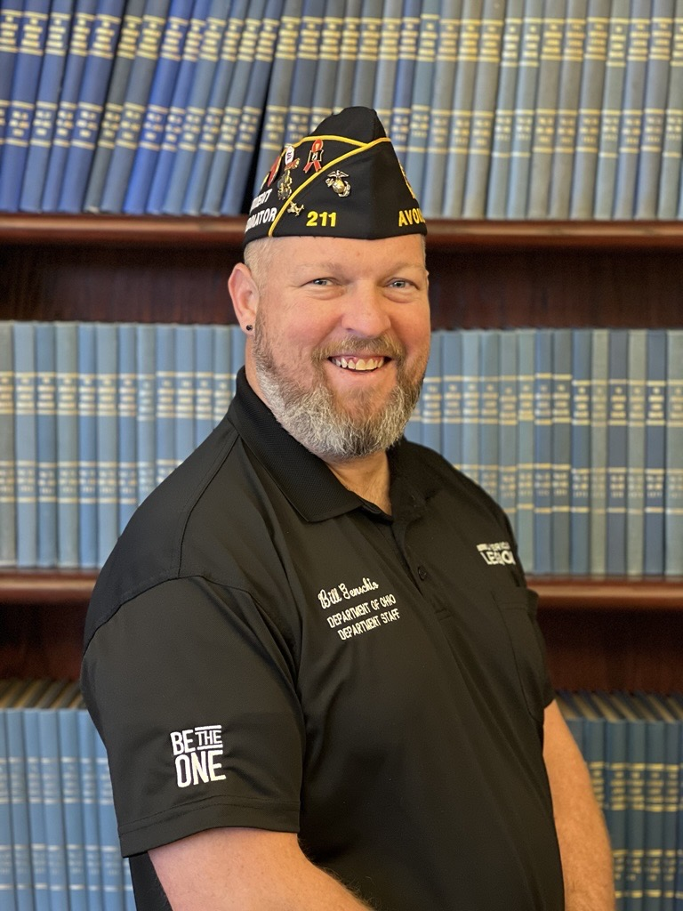
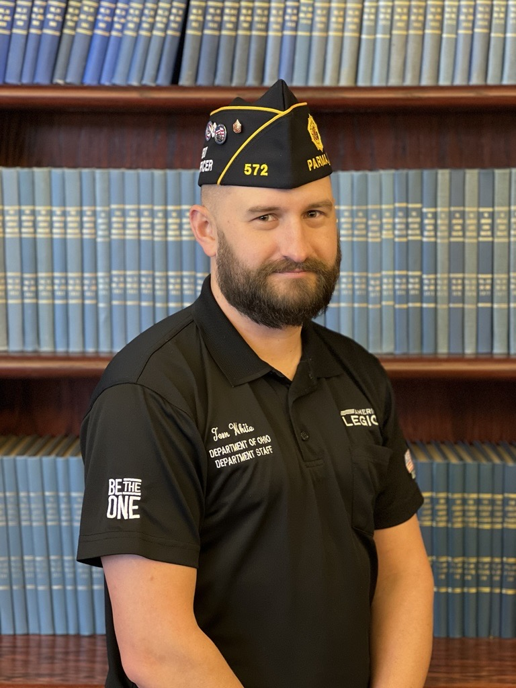
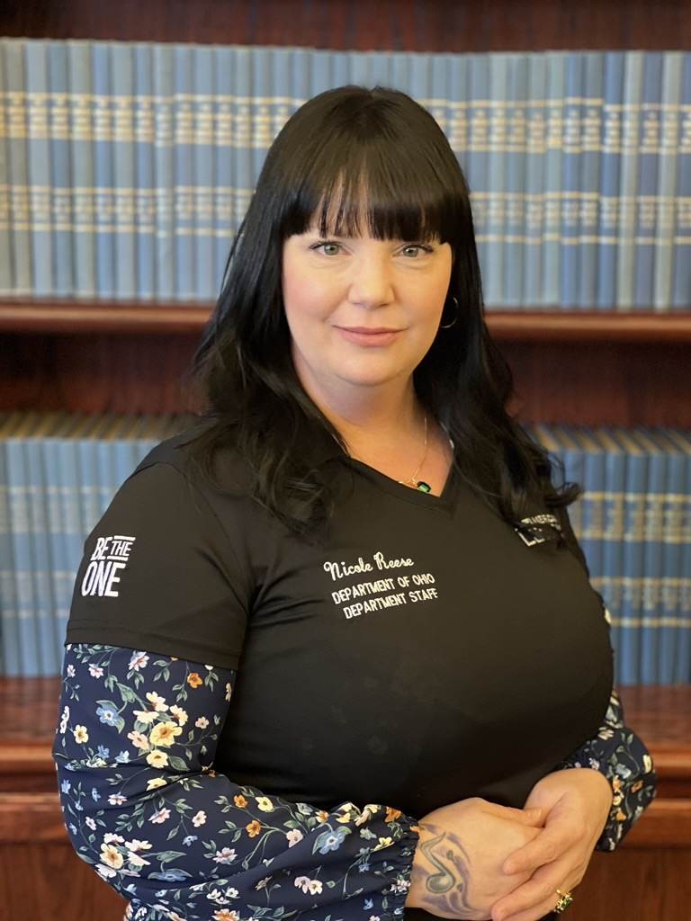
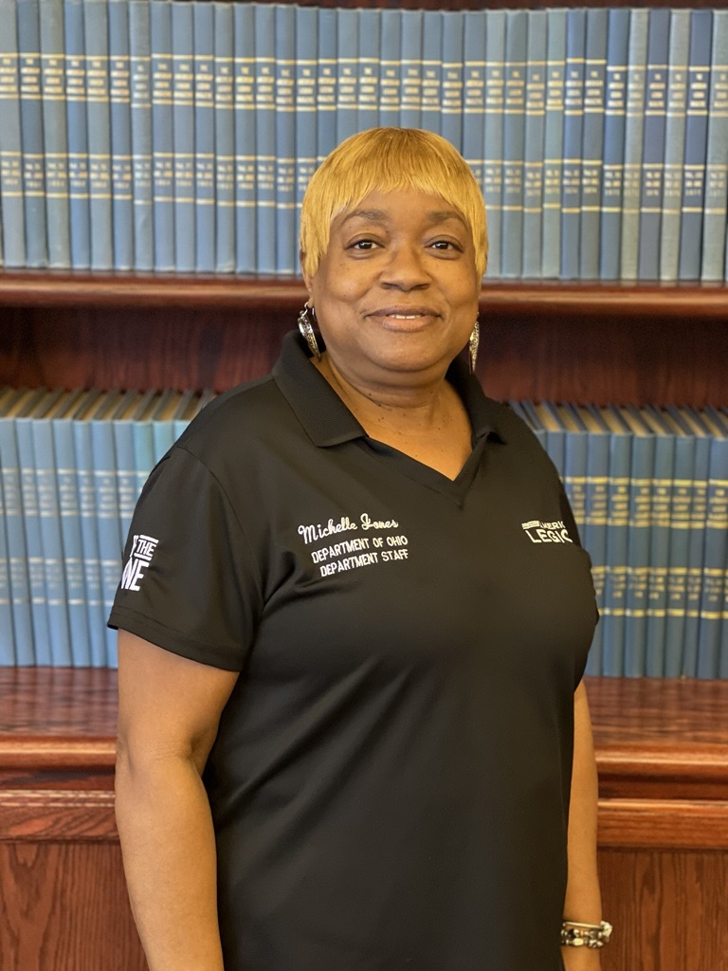
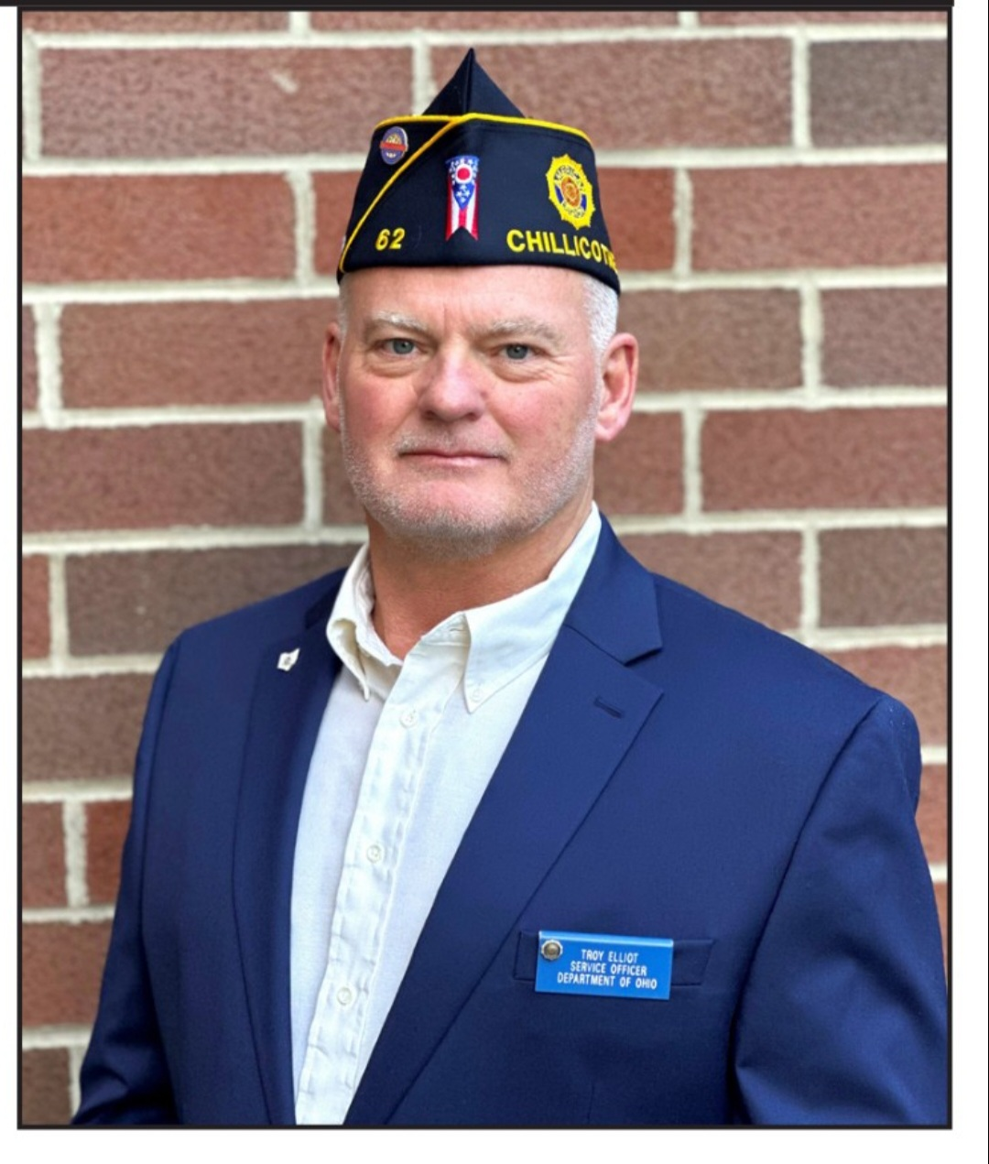
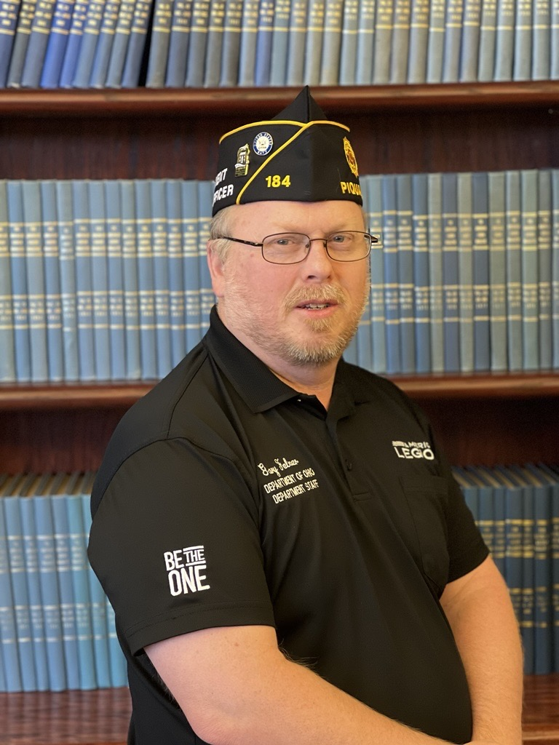
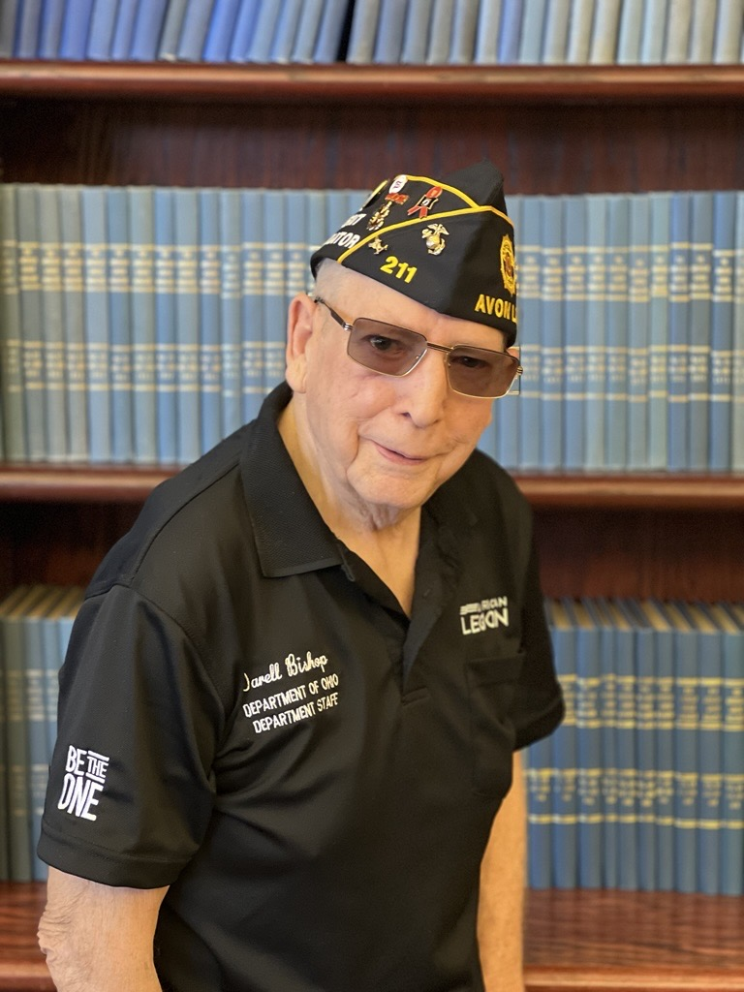
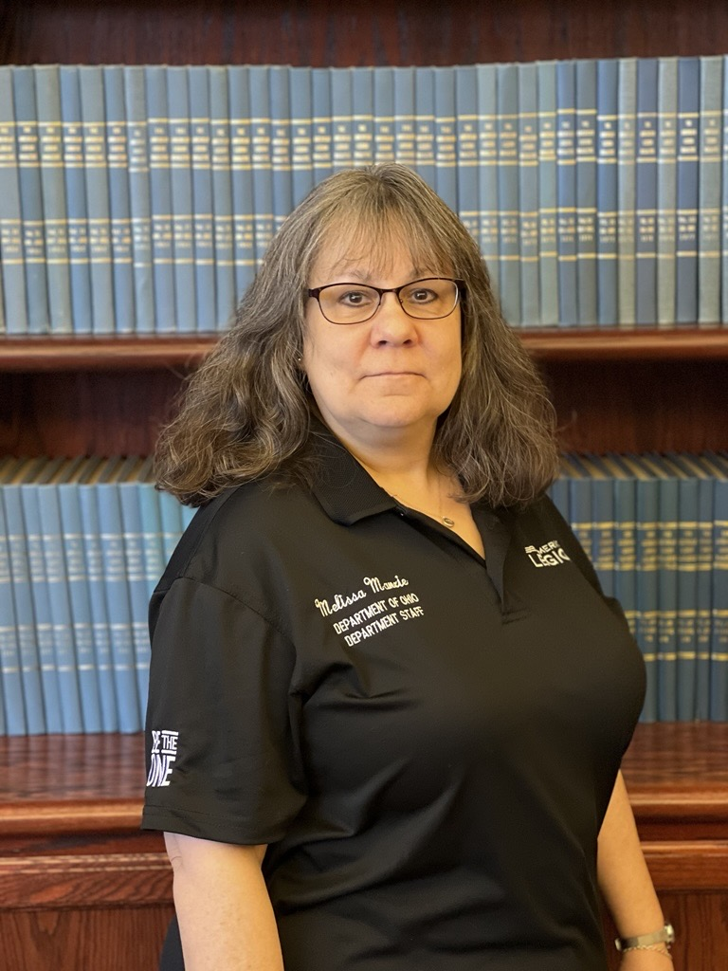
Your Department Service Officers
Cincinnati VAMC
Vacant
Will Brown
US Army
Cleveland VARO
Nicole Reese
US Navy
Cleveland VARO
William Genochio
USMC Retired
Cleveland VARO
Michelle Jones
Mother of Army
Cleveland VARO
William Genochio
USMC Retired
Cleveland VARO
Tom White
USMC Retired
Cleveland VARO
Nicole Reese
US Navy
Cleveland VARO
Darell Bishop
USMC, Army
Wade Park VAMC
Troy Elliott
US Army
Chillicothe VAMC
Gary Felver
US Navy
Dayton VAMC
Darell Bishop
US Army / USMC
Wade Park VAMC
Melissa Manzie
Administrative Asst.
Daughter US Army

Slide 16
Veteran Transfers to Post Everlasting
Family Preparation List
Location of DD-214 & VA Award Letter
When a Veteran transfers to Post Everlasting
Know the veterans POA (Service Organization that represents the claim or appeal).
Know the veterans Branch of Service, Service dates, and deployments.
Know if the veteran is service connected or have a claim filed with VA.
Notify VA of the veteran’s death by submitting a copy of the death certificate File a 21P-530 Application for Burial Benefits
File a 21-22 for the surviving spouse to elect a Service organization to represent surviving spouse or claimant on behalf of deceased veteran
If veteran has an existing claim or appeal with the VA, file a 21P-0847 within one year of death to allow the surviving spouse to continue the claim
File a 21-534EZ application for DIC, Death Pension, and/or Accrued benefits **Burial Benefit Guides are available online and A the DSO table**

Slide 17
Department Service Officer Contact Information
William Genochio, VBA Coordinator, Field Office Supervisor, DSO Cleveland VARO, OHALR Department Liaison P: 216-522-3504 ext. 53746 or option 2 E: Genochio@ohiolegion.com
Tom White, DSO Cleveland VARO P: 216-522-3504 ext. 53743 or option 5 E: twhite@ohiolegion.com
Nicole Reese, DSO Cleveland VARO P: 216-522-3504 ext. 53741 or option 4 E: jreese@ohiolegion.com
Michelle Jones, DSO Cleveland VARO P: 216-522-3504 ext. 53747 or option 3 E: jones@ohiolegion.com
Melissa Manzie, Admin Cleveland VARO P: 216-522-3504 ext. 53748 or option 6 E: mmanzie@ohiolegion.com
Darell Bishop, DSO Wade Park VAMC P: 216-791-3800 ext. 64154 E: dbishop@ohiolegion.com
Gary Felver, DSO Dayton VAMC P: 937-268-6511 ext. 2967 E: gfelver@ohiolegion.com
Troy Elliott: DSO Chillicothe VAMC P: 740-773-1141 ext. 16252 E: telliott@va.gov

Slide 18

Questions
William Genochio
EMAIL: genochio@ohiolegion.com

