Slide 1
Resolutions
Mike Blackwell, Commander – District 3

Slide 2
“Without the resolution process, our organization would not have guidance in developing programs, allocating funds to help veterans or targeting Congress with issues that affect you, me and the rest of this great country of ours.”
Past National Commander Ray G. Smith (NC), 2000-2001

Slide 3
Objectives
What is a resolution
Why are resolutions important
Who can submit a resolution
Where do resolutions originate
How do you write a proper resolution

Slide 4
What is a resolution?
Resolutions are written and introduced in many organizations and levels of government
A resolution is a motion submitted in writing

Slide 5
What is a resolution? (cont.)
A motion is often offered as a resolution either because of its importance or because of its length or complexity
It is a means of resolving a particular problem by stating very specifically what action is to take place

Slide 6
Why use the resolution process?
Resolutions tell our leaders (at all levels) what is important to the members
Resolutions are the only way to make changes to American Legion programs, policies, and positions

Slide 7
Who can submit a resolution?
Any legionnaire can submit a resolution to their Post
If adopted, the Post submits the resolution to their District and Their District then submits it to Department
The Department Adjutant determines whether or not the Department Executive Committee can deal with it or if it has to be sent to the Department Convention

Slide 8
Who can submit a resolution?
If adopted, the Department then forwards it to National
The National Adjutant then sends it to the appropriate National committee for review and action
The National Committee then sends it to NEC or National Convention for vote

Slide 9
Types of resolutions
A statement or position on veteran issues
To create and support The American Legion’s programs
To authorize change within the organization

Slide 10
Parts of the resolutions
A resolution consists of two parts
The Preamble
The Resolve Clause

Slide 11
The Preamble “WHEREAS”
The preamble is the description of the problem
It provides little known information where the merits of a resolution could be at risk of being misunderstood
The preamble is written in the form of a clause beginning with “WHEREAS”

Slide 12
WHEREAS, The proper display of the United States flag is a cornerstone of flag respect and etiquette; and
WHEREAS, The American Legion is recognized as one of the country’s foremost authorities on the proper display of the United States flag; and
WHEREAS, Title 4, Chapter 1, Section 8(k), United States: “The flag, when it is in such condition that it is no longer a fitting emblem for display, should be destroyed in a dignified way, preferably by burning”, and;
RESOLVED, That……………….

Slide 13
The Resolve Clause
The “RESOLVE” clause defines the solution, policy, action or outcome you are seeking
It may be necessary for more than one action to take place in order to complete the intent (Be it Further Resolved and Be it Finally Resolved)
It identifies the resolving authority (who)
It provides a clear unmistakable intent

Slide 14
Resources
National American Legion Resolutions Archives
https://archive.legion.org

Slide 15
RESOLVED, By The National Executive Committee of The American Legion in a regular meeting assembled in Indianapolis, Indiana, on May 4-5, 2011, That The American Legion at all levels encourage its membership, the general public, and all local, state and federal government agencies to display United States flags that are fitting emblems for display; and, be it finally
RESOLVED, That American Legion Posts are encouraged to promote and conduct a “Dignified Disposal of Unserviceable Flags Ceremony” as a part of their community service efforts.

Slide 16
How do you write a resolution?
First, make sure that there isn’t already a resolution or position available (legion.org/resolutions for National Resolutions) and that the resolution is applicable to the mission of the American Legion
Always draft your resolve clause first

Slide 17
How do you write a resolution? (cont.)
Use the Preamble (the “Whereas” clauses) to provide background information that builds the case for the resolution
Be concise
Go from broad to specific
Use facts, not assumptions – Do your research

Slide 18
How do you write a resolution? (cont.)
Proof read for grammar and spelling and then have it reviewed by someone else
Check the formatting, punctuation and structure
Provide any supporting documentation. Provide more than one set, if possible

Slide 19
How do you write a resolution? (cont.)
The whereas and resolved should always be capitalized
There should always be a comma after whereas and resolved
Always capitalize the first word after whereas and resolved

Slide 20
How do you write a resolution? (cont.)
Each whereas statement should end with a semicolon and then the word “and”
The entire resolve should be in bold
The only period in the resolution should be at the end of the final resolve

Slide 21
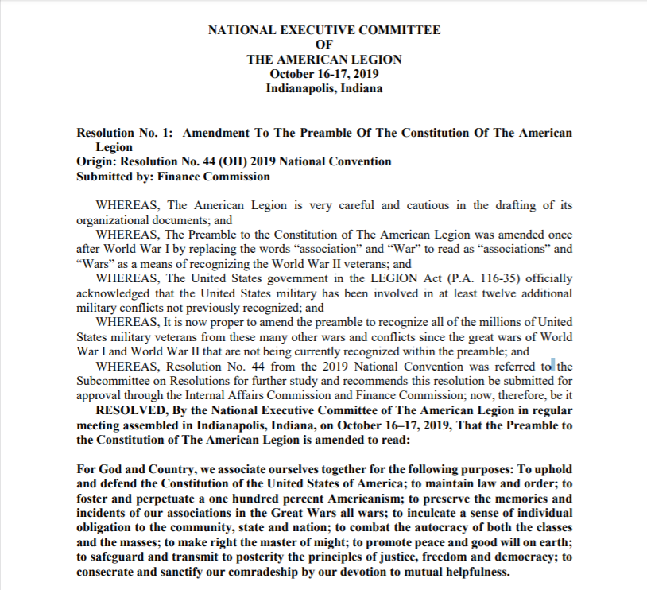

Slide 22
Why do resolutions fail?
Resolutions requiring financial support, already start with an uphill battle
Resolutions that are poorly written or lack proper formatting
Failure to advocate, network and negotiate the intent of the resolution with members and committees

Slide 23
Why do resolutions fall? (cont.)
Resolutions that are poorly researched, constructed, and fail to provide supporting documents
Resolutions with more than one subject
Resolutions that are politically sensitive

Slide 24
If you fail, don’t give up!
Listen to the feedback- Organize it- Incorporate it- Re- submit it
Ask for assistance and input from other districts or departments
Many Resolutions fail, multiple times- don’t give up, follow your passion

Slide 25
Additional information
Download the resolution booklet at legion.org/resolutions
Review resolutions in the Digital Archive for ideas at https://archive.legion.org
Reach out to others who have written resolutions for advice and direction
Don’t be intimidated

Slide 26
Thank you!
Kevin Motter
(419) 630-8767
Motter.kb@gmail.com

