Slide 1
HOW TO OBTAIN RECORDS
Nicole Reese

Slide 2
How to obtain your:
Discharge (DD-214)
Official Military Personnel Files (OMPFs)
Service Treatment Records (STRs)
The first way to get your records is to fill out a SF-180 form.
This form consists of 3 pages
Page 1-is the instruction sheet
Page 2-is the actual form
Page 3-is address chart as to where to send your SF-180
https://www.archives.gov/files/research/order/standard-form-180.pdf

Slide 3
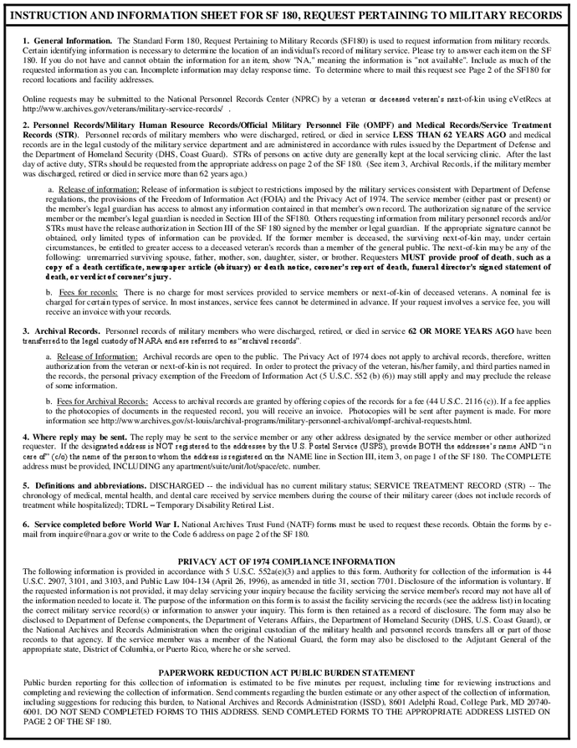
PAGE 1
OF THE SF-180

Slide 4
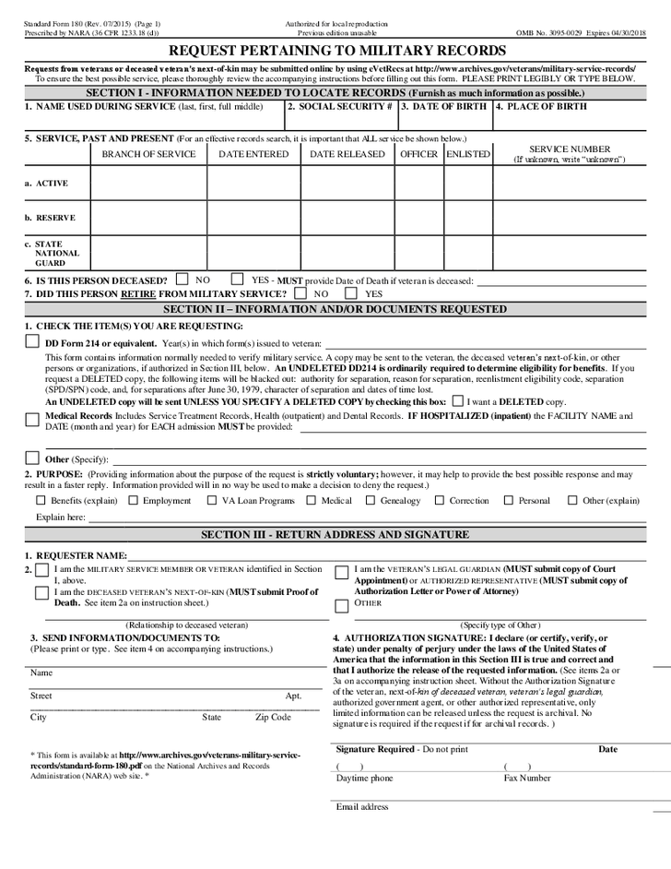
PAGE 2
OF THE SF-180

Slide 5
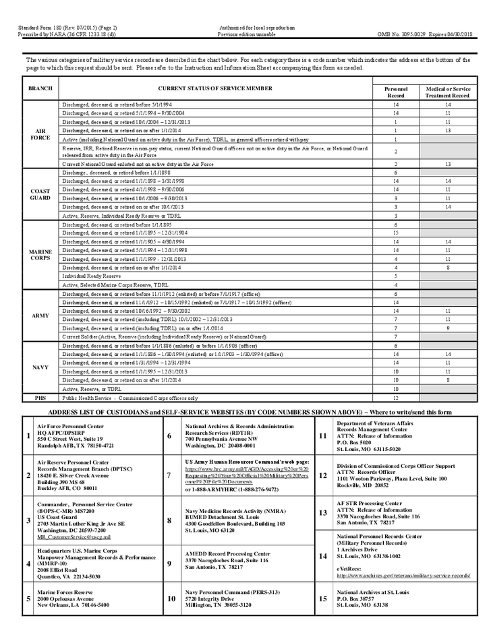
PAGE 3
OF THE SF-180

Slide 6
THE ADDRESS FOR ALL OHIO
ARMY AND AIR FORCE NATIONAL GUARD MAIL TO:
Adjutant General's Department 2825 West Dublin Granville Road Columbus, Ohio 43235-2789 614-336-7000

Slide 7
ANOTHER ALTERNATIVE METHOD TO RETRIEVE RECORDS
VA FORM 20-10206 Freedom of Information Act (FOIA) or Privacy Act (PA) Request
When to use this form?
Use VA Form 20-10206 to access your compensation, pension, benefit, or military records.
To obtain copies of your C-file, you must submit VA Form 20-10206, the Freedom of Information Act/Privacy Act Request, which is available on the VA website. You can submit the form online, by mail, or in person at a VA regional office. The form requires your personal information, including your name, address, and Social Security Number, and should clearly state your request for your complete C-file.
Monitor Your Request: Once submitted, you can check the status of your request through your VA.gov account.
Processing Time: Processing C-File requests can take several weeks to several months due to the volume of requests, so patience is advised. Your C-File may be delivered as a physical paper copy, a CD, or a digital download.

Slide 8
ANOTHER ALTERNATIVE METHOD TO RETRIEVE RECORDS
Fill out VA form 21-4138, Statement In Support of Claims
In Section II, the remarks section, please state that you respectfully
request a copy of your entire C-file sent to the address on file.
Make sure you put ‘US’ in the block for country.
The VA will reject
Forms that are not filled out in entirety

Slide 9
NATIONAL ARCHIVES PHONE NUMBER
Please call us toll free at:
1-866-272-6272

Slide 10
OBTAINING REPLACEMENT MEDALS
You must fill out and request medals on the SF-180 form and Send to:
National Personnel Records Center
1 Archives Drive
St. Louis, MO 63138

Slide 11
Replace Veterans' Medals, Awards, and Decorations
Veterans are entitled to ONE REPLACEMENT set of their medals earned. To obtain replacement medals, submit a filled out Standard Form 180 (SF-180). It is recommended that you include a copy of your DD-214, however if that is not available you should include pertinent information in your request (e.g. full name, service number, social security number, date of birth, and as much additional information as possilble). DO NOT mail the SF-180 to the address listed on the form. Requests for replacement medals should be directed to the specific branch of the military in which you (or the veteran for whom you are applying if request is being made by next of kin) served
The National Personnel Records Center (NPRC) does not issue service medals; that is a function of each military service department. Requests for the issuance or replacement of military service medals, decorations and awards should be directed to the specific branch of the military in which the veteran served. However, for cases involving Air Force and Army personnel (click here for exceptions), the NPRC will verify the awards to which a veteran is entitled and forward the request along with the records verification to the appropriate service department for issuance of the medals. Use the addresses listed below, and mail your request accordingly.

Slide 12
How Do I Request Military Awards and Decorations?
For the Veteran: in general, the military services will work replacement medal requests for the veteran at no cost. This includes family members with the signed authorization of the veteran.
For the Next-of-Kin: the process (and cost) for replacement medals requests differs among the service branches and is dependent upon who is requesting the medal, particularly if the request involves an archival record. Click here for details.
For the General Public: if the service member separated from military service before 1955, the public may purchase a copy of the veteran's Official Military Personnel File (OMPF) to determine the awards due and obtain the medals from a commercial source. If the service member separated after 1954, the public may request such information from the OMPF via the Freedom of Information Act ( see Access to OMPFs by the General Public).

Slide 14
QUESTIONS?

