Slide 1

TOTAL DISABILITY INDIVIDUAL UNEMPLOYABILITY (TDIU)
Tom White
Department service officer

Slide 2
VA and Total Disability
“Total disability will be considered to exist when
there is present any impairment of mind or
body which is sufficient to render it impossible
for the average person to follow a substantially
gainful occupation; provided…(that) the
impairment is reasonably certain to continue
throughout the life of the disabled person.”
38 C.F.R. § 4.15.

Slide 3

Total Disability Based on Individual Unemployability
• If a Veteran’s combined schedular rating is less
than 100%, BUT
•Their service-connected disabilities render the
Veteran unemployable,
•Then VA may assign a total disability rating for
compensation purposes. 38 C.F.R. § 4.16.
**The VA will only consider service-connected disabilities.

Slide 4
TDIU Eligibility: Schedular
“Schedular” TDIU threshold eligibility requirements at 38 C.F.R. § 4.16(a):
•One service-connected disability rated at 60% disabling or more, or.
•Multiple service-connected disabilities combining to 70% or greater level of impairment, with at least one disability rated at 40% or more.

Slide 5
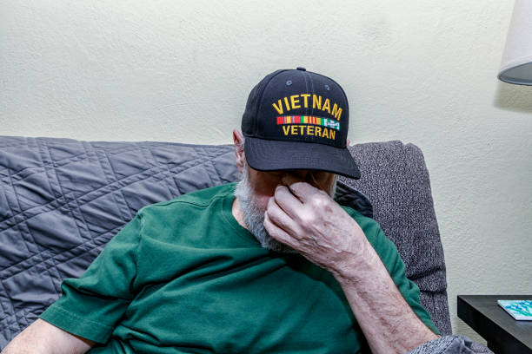
TDIU Eligibility: Schedular, cont.
Multiple service-connected disabilities resulting from one common cause, or one single accident would be considered as one disability for meeting the 60% or 40% thresholds.
• Example: service-connected diabetes and secondary conditions (nephropathy, diabetic retinopathy, etc.)
• Example: multiple disabilities resulting from an in-service combat injury or motor vehicle accident.

Slide 6

TDIU Eligibility: Extraschedular
“Extra schedular” TDIU is available for Veterans who do not satisfy the schedular criteria. See 38 C.F.R. §4.16(b).
• It is VA policy to rate a Veteran 100% whenever a Veteran is unemployable.
• If the Veteran is unemployable due to service-connected disabilities, but the Veteran is not rated high enough, then
• The Veteran’s case must be referred to the Director, Compensation Service, in Washington, D.C. (VA Central Office) for extra schedular consideration.

Slide 7

Unemployability vs. Unemployment
Unemployability and unemployment are
NOT the same thing.
The veteran must be found unable to do substantially gainful employment due solely to Service-Connected disabilities. Not because they do not want to work or unable to find work.

Slide 8

What is Unemployability?
1. Can the Veteran “secure or follow” a job?
•The Veteran cannot get hired.
•The Veteran cannot keep a job once hired.
2. Does the Veteran have “substantially gainful” employment.
•Was there competitive hiring?
• Is the work full-time or equivalent?
•Can the Veteran make a living?

Slide 9

TDIU Eligibility Cont.
There is a Economic Component: | There is a Noneconomic Component:
“Substantially gainful occupation”: Occupation results in more than marginal income (earning over the poverty level for one person, as set by the government). | Veteran’s history, education, skill, and training. Whether Veteran has physical ability to perform the type of activities required by the occupation. Whether Veteran has mental ability to perform the type of activities required by the occupation.

Slide 10

Determining Unemployability
• Unemployability is NOT a medical determination and doctors should not give an opinion if a Veteran is employable.
• Instead, Doctors should describe the Veteran’s limitations and how they impact the ability to work.
• Example: Pain from the Veteran’s back disability prevents him from standing for more than one hour at a time.

Slide 11
Applying for TDIU
Gather Documentation
  Medical records
  VA disability ratings
  Employment history
Complete VA Form 21-8940
  Application for Increased Compensation Based on Unemployability
Submit Application
  Online via VA.gov
  By mail or in person at CVSO or Accredited American Legion DSO

Slide 12

TDIU Risk
TDIU is a huge benefit for veterans that results in a substantial jump in monthly compensation. But there are risks to applying for TDIU as with all things is the “Risk worth the Reward”.
Under TDIU, veterans are not allowed to work or earn more than what the federal poverty level, which defines substantially gainful employment.
A Claim for TDIU is considered a claim for increase. Meaning anything the veteran claims that prevents them from substantial gainful employment will be reviewed by the VA. Often requiring a new Compensation and Pension Exam to be completed.
  This may result in the Examiner or Rater finding that the condition improved. This would trigger the VA to issue a Proposal to Reduce. This happens more often than you would think.
  The veteran only has 30 days from the notice of proposed rating to request a Predetermination hearing regarding the proposed reduction and or 60 days to provide evidence that the condition has not improved.

Slide 13

QUESTIONS

