Slide 1
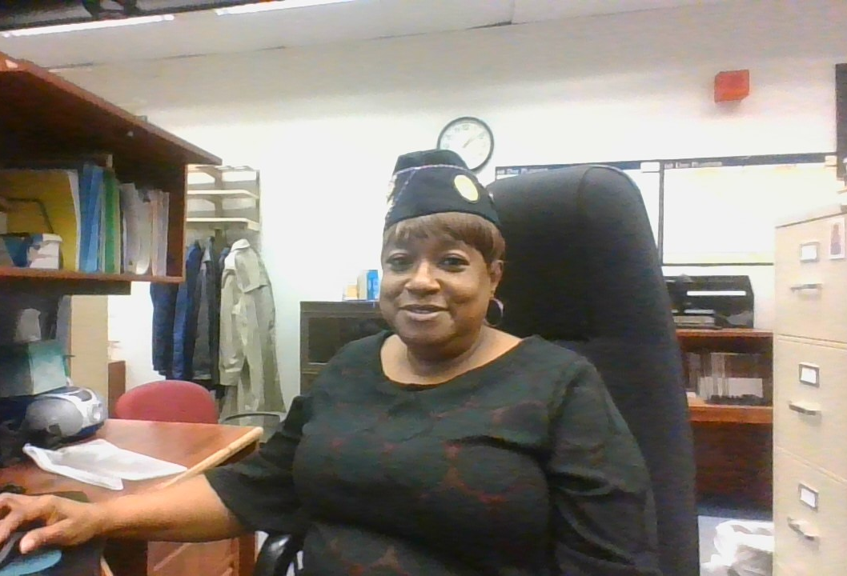
How to interview a veteran to maximize their claim with the VA
MICHELLE JONES
AMERICAN LEGION DEPT. SERVICE OFFICER

Slide 2
Interviewing the veteran
Start each interview by greeting the veteran and introducing yourself.
When talking with the veteran ask if he has filed a claim with the VA he may even tell you directly (I have or Have not yet filed or what's the point they will deny me anyway.)
Encourage the veteran that you can help him file a claim with the VA and the American Legion has trained Post Service Officers and Department Service Officers here to assist them in the process
If you don’t apply you are denied.

Slide 3
Where to start The Head
Start at the top and work your way to down:
Head: Headaches, Migraines TBI, Concussions, Lacerations to include painful scars.
Eyes:
Ears: Hearing loss and or Tinnitus (what was your Job)
Mouth and nose: Loss of taste smell, trauma to the teeth
Notes:
Headaches if migraines are they prostrating what do you have to do during a migraine or headache, have you missed work due to headaches or migraines.

Slide 4
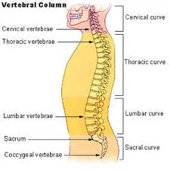
Neck, shoulder and back
Neck and Shoulder
Neck: Whiplash, trauma to the neck during work, of PT
Shoulders: Surgeries while in service, injury to the shoulder (sprain, dislocation, arthritis, tendonitis).
Back
Back: this includes the upper and lower back this is claimed as one issue, but separate from the neck which can be rated seperatly.
Strains, bulging disk, arthritis, Sciatic, DDD, ect)

Slide 5
Hips
Hips
DJD, trauma to the hip
If the veteran make jumps while in the service
Dislocations of the hip

Slide 6
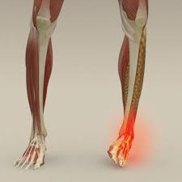
Legs and ankles
Legs
Trauma to the legs to include knee injuries.
Bursitis, arthritis, surgery, torn ligaments or tendons
Painful motion, limited motion
Ankles
Broken, twisted, dislocated
Arthritis
Painful motion, limited motion
Dislocation, surgery

Slide 7
Feet

Slide 8
Remember
Three things are needed to service connect
An Event in Service
A Current Diagnosis
And a medical opinion linking the Event and Diagnosis to Service.
Things to ask
Did you seek treatment
Did you go to medical
Did you tell a friend or family member about the injury

Slide 9
Other conditions and Pre exisiting
Conditions
Mental disorders
Sleep Apnea
Gerd, Acid Reflux
ED
Diabetes
Pre existing conditions
Conditions that the veteran had at the time of enlistment and noted on the entrance exam can be service connected. If proof that the condition worsened beyond normal progression or if service aggravated the preexisting condition. A medical NEXUS statement will help justify the connection.

Slide 10
Secondary Conditions
Secondary conditions
These are a direct result of a service connected disability. The veteran is SC for a back condition and is now having issues with his left hip.
How to connect
The veteran would have to obtain medical opinion that the left hip is caused by the service connected back. Due to adjusted gait, restricted posture, ect. The doctor should also state that it is as likely as not that the veterans left hip is due to his SC back condition

Slide 11
What can not be service connected
Disease that are considered congenital
Definition of congenital
1a : existing at or dating from birth congenital deafness
b : constituting an essential characteristic : inherent congenital fear of snakes
c : acquired during development in the uterus and not through heredity congenital syphilis
38 CFR 3.303
Willful misconduct
3.301 Line of duty and misconduct.
(a)Line of duty. Direct service connection may be granted only when a disability or cause of death was incurred or aggravatedin line of duty, and not the result of the veteran's own willful misconduct or, for claims filed after October 31, 1990, the result of his or her abuse of alcohol or drugs.
(Authority: 38 U.S.C. 105)
(b)Willful misconduct. Disability pension is not payable for any condition due to the veteran's own willful misconduct.
(Authority: 38 U.S.C. 1521)

Slide 12
Questions?????

