Slide 1
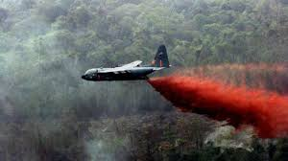
Agent Orange & Presumptive Conditions

Slide 2
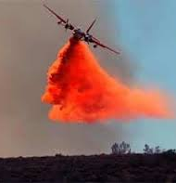
What is agent orange
A tactical herbicide used by the U.S. military for control of vegetation. It was named for the orange band around the storage barrel. The military sprayed Agent Orange and other tactical herbicides during the Vietnam War. Veterans who may have been exposed to Agent Orange include Veterans who served in different locations, including Vietnam, the Korean Demilitarized Zone, on Thai Air Force bases, at other locations, and who flew on or worked on C-123 Aircraft.

Slide 3
History of Agent Orange
Created by Dow and Monsanto
Monsanto was also responsible for the production of DDT and PCBs
Monsanto has been acquired by Bayer
First created Agent Orange in the 1940s to be used along power lines and railroads.
The government has been aware of its dangers since the 1950s
AO is 2 chemicals. 2,4-dichlorophenoxyacetic acid and 2,4,5-Trichlorophenoxyacetic acid.
Tetrachlorodibenzo-p-dioxin is the biproduct of 2,4,5-Trichlorophenoxyacetic acid. The creation was unintentional and by far the worst of the 3 chemicals

Slide 4

Agent Orange and VA Benefits
VA offers eligible Veterans a free Agent Orange Registry health exam for possible long-term health problems related to exposure. VA also offers health care, disability compensation, and other benefits to eligible Veterans for certain disease conditions, as well as benefits for children of Vietnam Veterans who have spina bifida. Dependents and survivors may also be eligible for other benefits.

Slide 5
Agent Orange Registry Health Exam
This is a free health exam for Veterans who meet any of the above service requirements for presumption of contact. Even if you don’t have a known illness, the exam could alert you to illnesses that may be related to contact with herbicides. By being part of this registry, you’re also helping your fellow Veterans by giving us information so we can better understand and serve those affected by Agent Orange–related illnesses.
This exam isn’t a VA claim exam (also known as a compensation and pension, or C&P, exam). And you don’t need to have this exam to get other VA benefits. To get disability benefits, you’ll need to file a claim.
To schedule your exam: Contact your local VA environmental health coordinator Vapublichealth.gov

Slide 6

The U.S. Congress enacted Public Law 102-4, referred to as the "Agent Orange Act of 1991," on February 6, 1991. This legislation directed the Secretary of Veterans Affairs to request that the National Academy of Sciences conduct a comprehensive review and evaluation of scientific and medical information regarding the health effects of exposure to Agent Orange, other herbicides used in Vietnam, and their components, including dioxin.
The first report, Veterans and Agent Orange: Health Effects of Herbicide Used in Vietnam (1994), determined the first presumptive conditions related to herbicide exposure.
Agent Orange new Legislation H.R. 3052 Agent Orange Relief Act of 2025, was introduced (ONLY) to the House. The Act is seeking to provide more coverage for children affected by Agent Orange https://www.congress.gov/bill/119th-congress/house-bill/3052/text

Slide 7
Diseases associated with Agent Orange 1991
Chloracne (or similar acneiform disease)
A skin condition that occurs soon after exposure to chemicals and looks like common forms of acne seen in teenagers. Under VA's rating regulations, it must be at least 10 percent disabling within one year of exposure to herbicides.
Non-Hodgkin's Lymphoma
A group of cancers that affect the lymph glands and other lymphatic tissue
Soft Tissue Sarcomas (other than osteosarcoma, chondrosarcoma, Kaposi's sarcoma, or mesothelioma)
A group of different types of cancers in body tissues such as muscle, fat, blood and lymph vessels, and connective tissues

Slide 8
Diseases associated with Agent Orange 1994
Hodgkin's Disease
A malignant lymphoma (cancer) characterized by progressive enlargement of the lymph nodes, liver, and spleen, and by progressive anemia
Multiple Myeloma
A cancer of plasma cells, a type of white blood cell in bone marrow
Porphyria Cutanea Tarda
A disorder characterized by liver dysfunction and by thinning and blistering of the skin in sun-exposed areas. Under VA's rating regulations, it must be at least 10 percent disabling within one year of exposure to herbicides.
Respiratory Cancers (includes lung cancer)
Cancers of the lung, larynx, trachea, and bronchus

Slide 9
Diseases associated with Agent Orange 1996-2009
Diabetes Mellitus Type 2 (2001)
A disease characterized by high blood sugar levels resulting from the body’s inability to respond properly to the hormone insulin
AL Amyloidosis (2009)
A rare disease caused when an abnormal protein, amyloid, enters tissues or organs
Prostate Cancer (1996)
Cancer of the prostate; one of the most common cancers among men

Slide 10
Diseases associated with Agent Orange 2010-2013
Chronic B-cell Leukemias (2010)
A type of cancer which affects white blood cells
Ischemic Heart Disease (2010)
A disease characterized by a reduced supply of blood to the heart, that leads to chest pain
Parkinson's Disease (2010)
A progressive disorder of the nervous system that affects muscle movement
Peripheral Neuropathy, Early-Onset (2013)
A nervous system condition that causes numbness, tingling, and motor weakness. Under VA's rating regulations, it must be at least 10 percent disabling within one year of herbicide exposure.

Slide 11
New Presumptive Diseases due to Agent Orange
Bladder cancer: A type of cancer that affects the bladder where urine is stored before it leaves the body. The most common type of bladder cancer starts in the cells that line the inside of the bladder. This is called urothelial or transitional cell carcinoma.
Hypothyroidism: A condition that causes the thyroid gland to not produce enough of certain important hormones. Hypothyroidism can cause health problems like obesity, joint pain, infertility, and heart disease.
Parkinsonism: Any condition that causes a combination of abnormal movements. These include slow movements, trouble speaking, stiff muscles, or tremors. Tremors are rhythmic shaking movements in a part of the body caused by muscle contractions that you can't control.
2021

Slide 12
New Presumptive Diseases due to Agent Orange
Hypertension: High blood pressure (systolic reading greater than 160 mmHg, diastolic reading greater than 100 mmHg)
Monoclonal gammopathy of undetermined significance (MGUS): non-cancerous condition where the body makes an abnormal protein, called a paraprotein.
2022
Pact Act

Slide 13
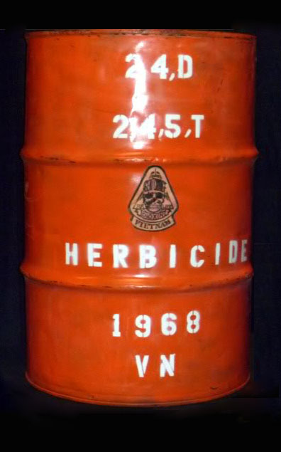
Eligibility for Presumptive Exposure
Between January 9, 1962, and May 7, 1975, you must have served for any length of time in at least one of these locations:
In the Republic of Vietnam, or
Aboard a U.S. military vessel that operated in the inland waterways of Vietnam (Brown Water Navy), or
On a vessel operating not more than 12 nautical miles seaward from the demarcation line of the waters of Vietnam and Cambodia (Blue Water Navy), or
Prior to August 10, 2022 when the Pact Act was enacted, must be on regular perimeter duty on the fenced-in perimeters of a U.S. Army installation in Thailand or a Royal Thai Air Force base. These bases include U-Tapao, Ubon, Nakhon Phanom, Udorn, Takhli, Korat, or Don Muang.
AO is hydrophobic. It will not dissolve or break down in water. If it gets into the ground, it could persist for decades

Slide 14
Eligibility for Presumptive Exposure
Or at least one of these must be true. You:
Served in or near the Korean DMZ for any length of time between September 1, 1967 (previously April 1, 1968), and August 31, 1971, or
Served on active duty in a regular Air Force unit location where a C-123 aircraft with traces of Agent Orange was assigned, and had repeated contact with this aircraft due to your flight, ground, or medical duties, or
Were involved in transporting, testing, storing, or other uses of Agent Orange during your military service, or
Were assigned as a Reservist to certain flight, ground, or medical crew duties at one of the below locations.
  Lockbourne/Rickenbacker Air Force Base in Ohio, 1969 to 1986 (906th and 907th Tactical Air Groups or 355th and 356th Tactical Airlift Squadrons)
  Westover Air Force Base in Massachusetts, 1972 to 1982 (731st Tactical Air Squadron and 74th Aeromedical Evacuation Squadron, or 901st Organizational Maintenance Squadron)
  Pittsburgh International Airport in Pennsylvania, 1972 to 1982 (758th Airlift Squadron)

Slide 15

Blue Water Veterans and the CAVC
Procopio v. Wilkie, 913 F. 3rd 1371 (Fed. Cir. 2019): In the Procopio decision, the Federal Circuit said that Congress intended in 1991 to include naval personnel who served in the territorial seas of the Republic of Vietnam within the presumption of herbicide exposure. (“Territorial seas” extend up to 12 nautical miles from the shore.)
Nehmer v. U.S. Dep’t of Veteran Affairs No. C 96-06160 WHA, 2020 U.S. Dist. LEXIS 207458 (N.D. Cal. Nov. 5, 2020) The bottom line: The order by the U.S. District Court, Northern District of California (District Court), in Nehmer (2020) requires that VA must automatically readjudicate all claims of Blue Water Navy Vietnam Veterans and survivors that were previously denied for failure to show exposure to an herbicide such as Agent Orange. If VA grants a claim under the Blue Water Navy Vietnam Veterans Act of 2019, then VA must assign an effective date back to the date of the Veteran’s original claim for benefits for that disease. This District Court order is a tremendous win for Veterans and survivors. Please note that unless and until mandate issues, this decision should be considered non-final as VA may appeal it.

Slide 16
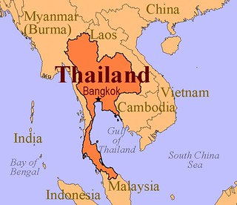
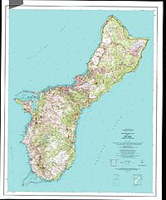
Pact Act 2022
Guam
Adds 5 new areas of service to the list of presumptive locations:
Any U.S. or Royal Thai military base in Thailand from January 9, 1962, through June 30, 1976
Laos from December 1, 1965, through September 30, 1969
Cambodia at Memot or Krek, Kampong Cham Province from April 16, 1969, through April 30, 1969
Guam or American Samoa or in the territorial waters off of Guam or American Samoa from January 9, 1962, through July 30, 1980
Johnston Atoll or on a ship that called at Johnston Atoll from January 1, 1972, through September 30, 1977

Slide 17
Pact Act 2022
Guam
Effective Date of Claims:
Claims submitted between August 10, 2022 and August 14, 2023 will have an effective date of August 10, 2022. This includes “intent to file”
Claims submitted after August 14, 2023 will be effective the day the claim is received by the VA.
Conditions added under the Pact Act are not subject to Nehmer. Therefore, claims that were submitted prior to August 10, 2022 must prove direct service connection to get an earlier effective date if they served in the areas added by the Pact Act.

Slide 18
Agent Orange is not a Disease or condition
It is important to know that Agent Orange is not a service-connected condition.
The earlier discussed conditions are caused by being exposed to Agent Orange.
It is important for veterans that served in these areas of operations to have the Agent Orange Registry exam done.

Slide 19
New Presumptive Diseases due to Agent Orange
If the VA denied your claim for any of these conditions in the past, they are supposed to automatically review your case again. The VA claims you don't need to file another claim and that they will send you a letter to let you know they are reviewing your case.
Best Practice is to have the veteran contact the Department Service Officer team to verify that this is in fact the case.
A refile on VA Form 20-0995 may be warranted and or beneficial to the veteran.

Slide 20
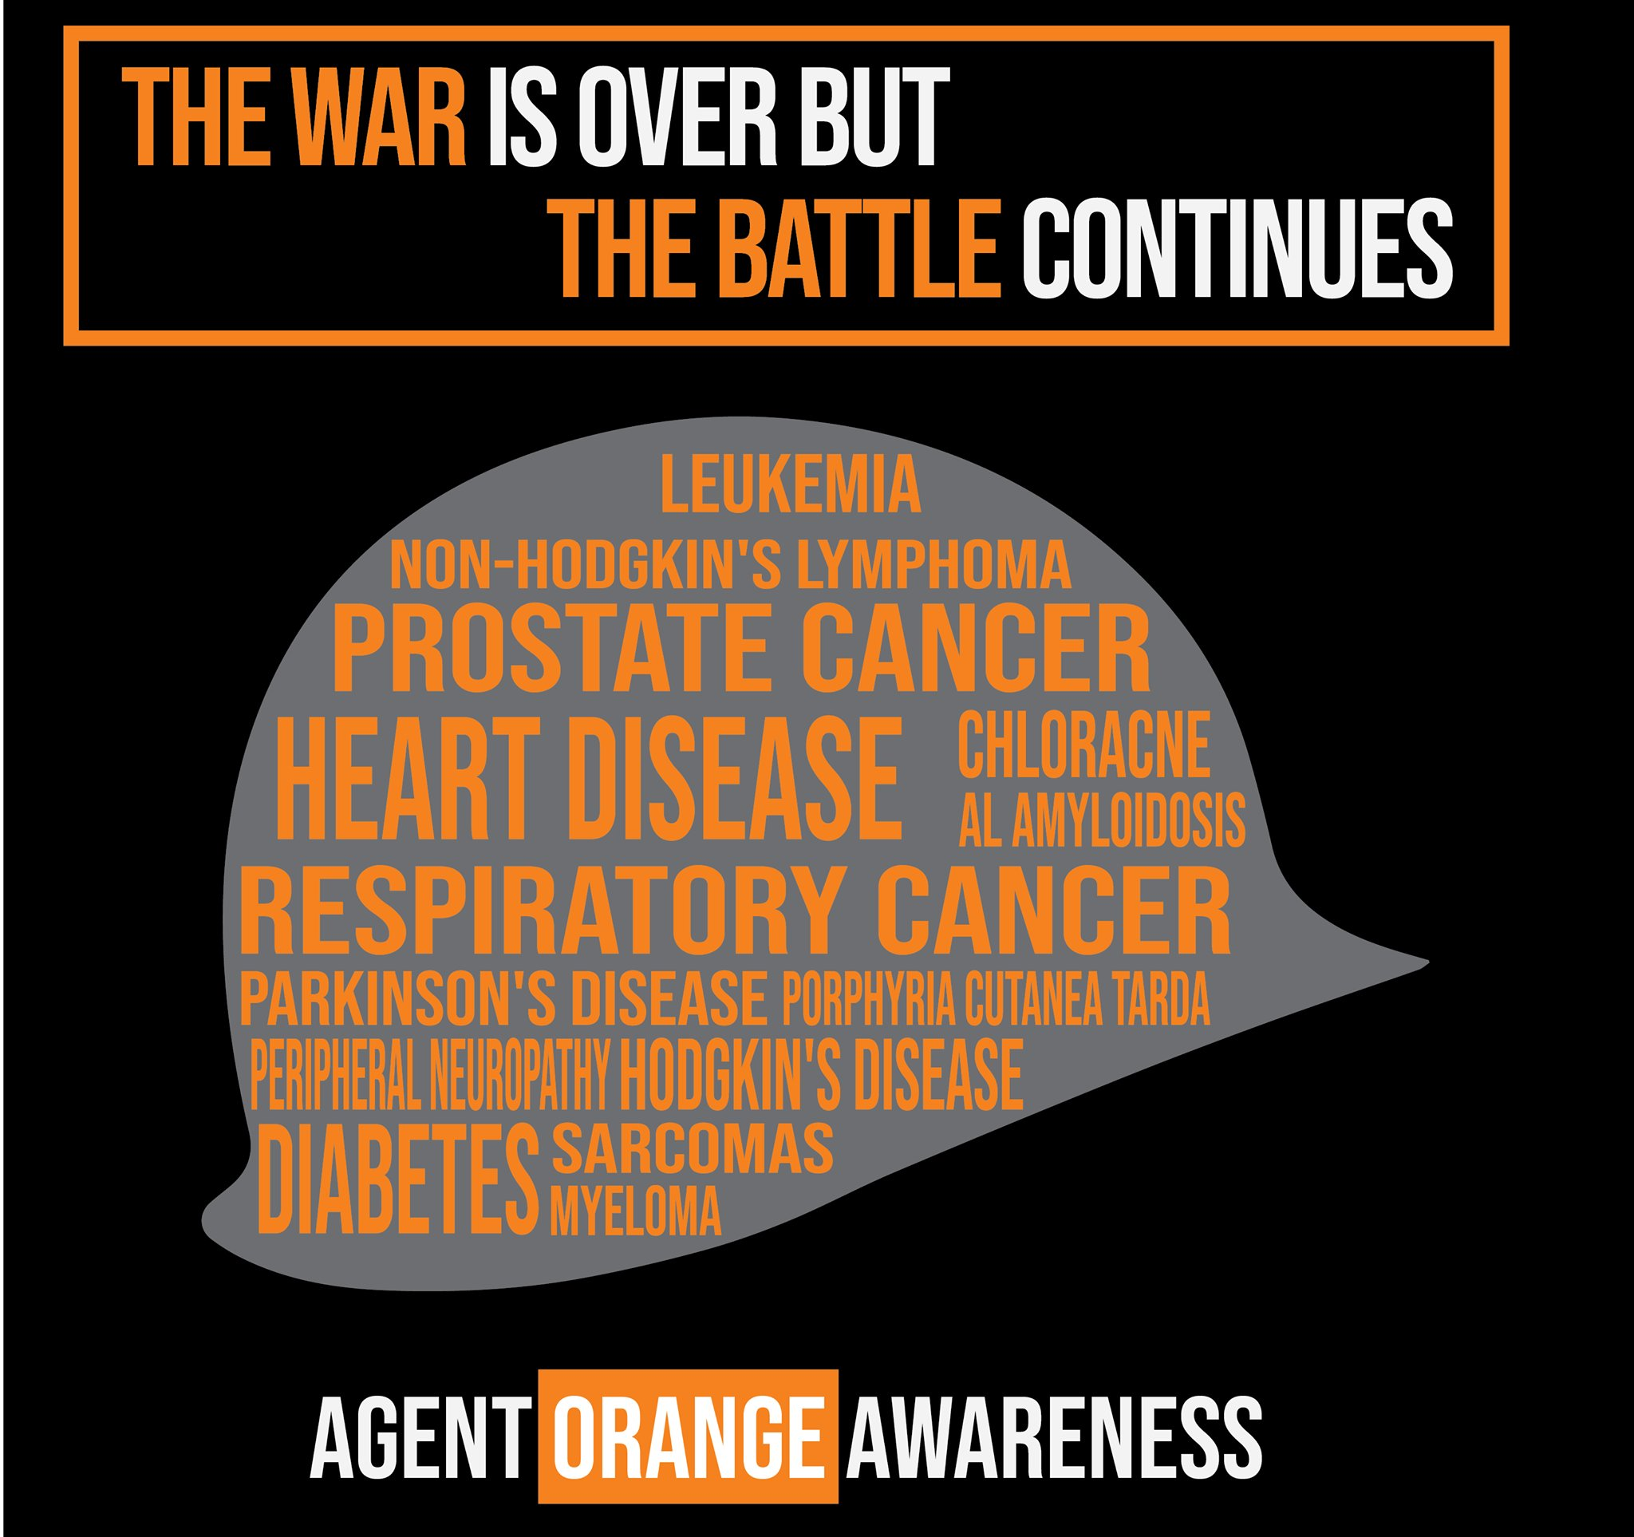
Questions?

