Slide 1

VA Correspondence and Internal Documents
Gary Felver, DSO Dayton VAMC

Slide 2

VA Correspondence to the Veteran

Slide 3
VA Correspondence to the Veteran
Development Letter with 5103 Notice
Dependent Verification
Notification Letter for Rating Decision
Notification Letter for Proposal to Reduce
BVA Decision Letter
Debt Management Letter

Slide 4
Development Letter with 5103 Notice
30 day response

Slide 5
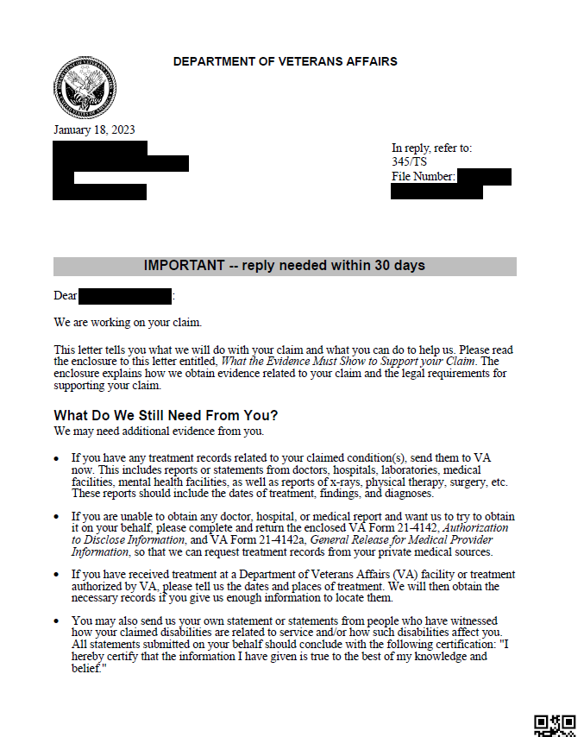
These letters are normally generic requesting any private medical evidence or lay statements.
They may also request information on toxin, asbestos, and/or radiation exposure.

Slide 6
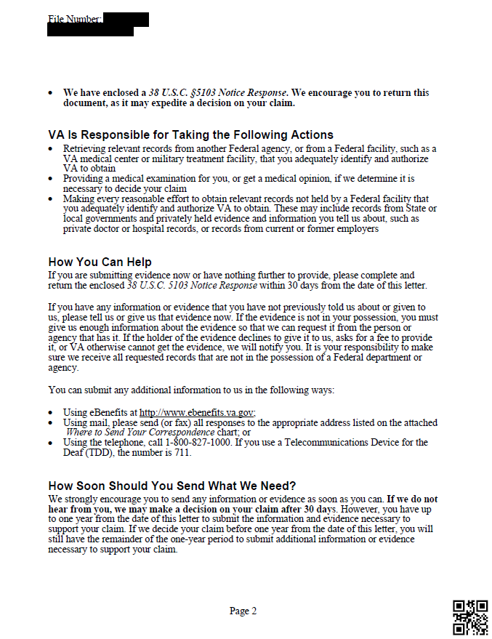
Duty to Assist
Claim on HOLD for 30 days or until 5103 Notice is received

Slide 7
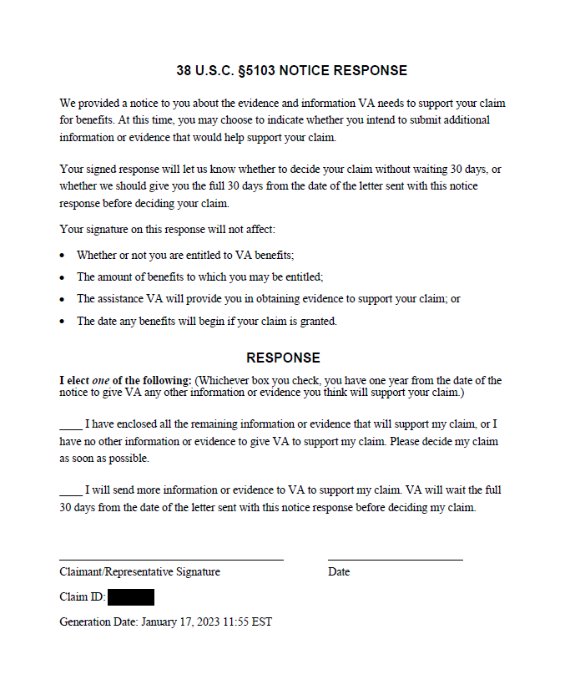
Mark the appropriate box, sign, and submit to the VA immediately

Slide 8
Dependent Verification
60 day response

Slide 9
OVERPAYMENT!
Failing to respond to a dependent verification letter is one of the biggest reasons a debt is incurred by the veteran.
But once the veteran receives a Debt Management Letter then they are quick to respond.

Slide 10
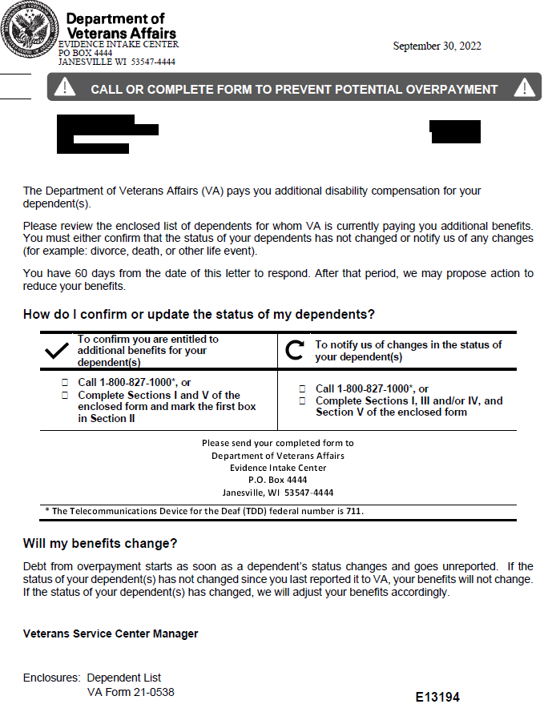

Slide 11
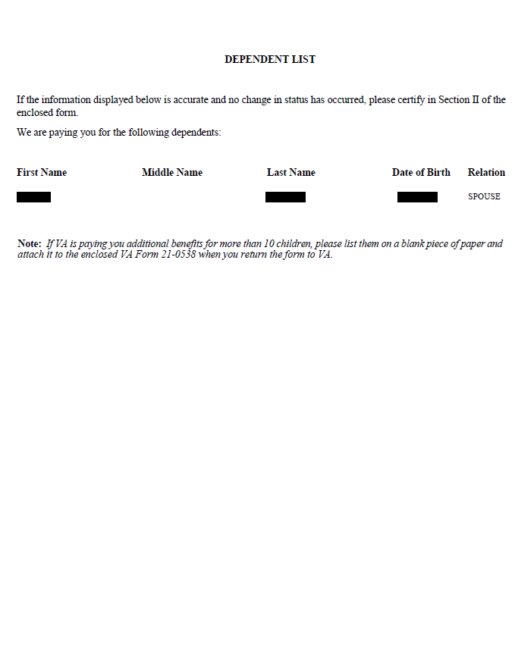
Verify dependents listed are correct

Slide 12
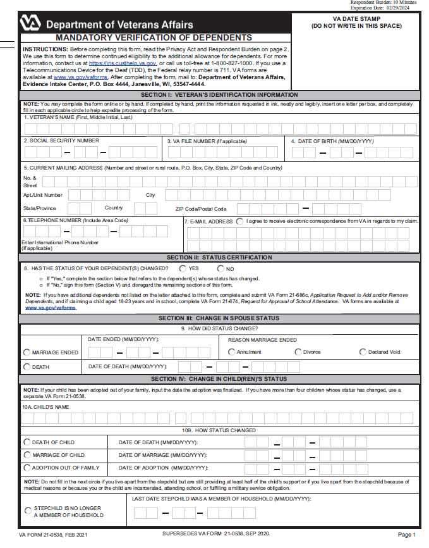
Complete box 1-7
Box 8: no changes mark “NO” and sign box 17
If there are changes then mark “YES” and complete the applicable section(s)

Slide 13
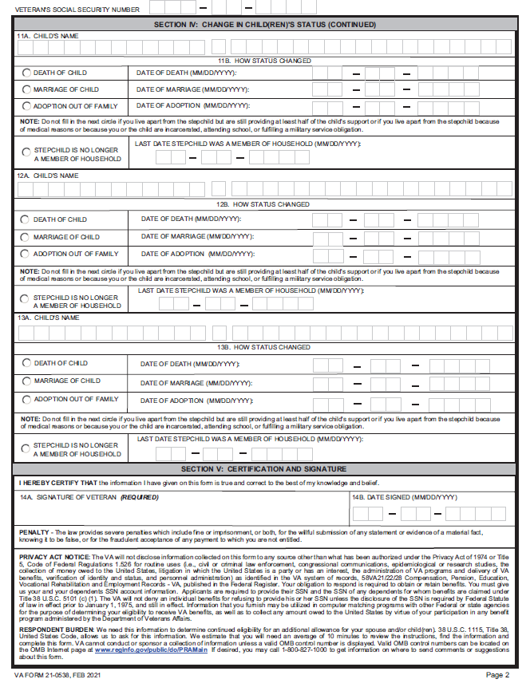

Slide 14
Notification Letter for Rating Decision
365 day response to maintain effective date of claim

Slide 15
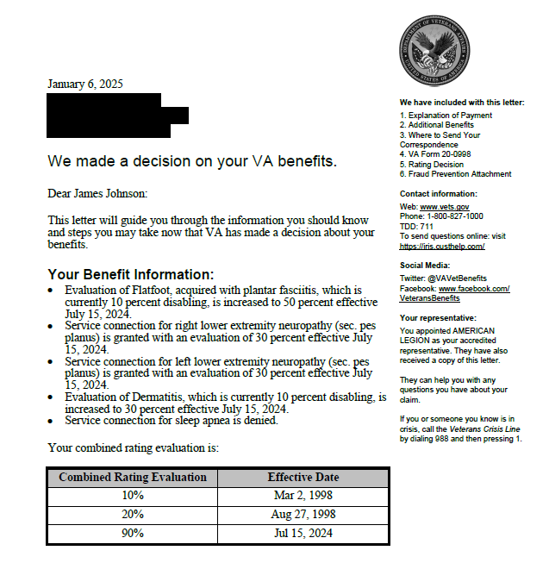
Overview of rating decision
Change in combined ratings over the years

Slide 16
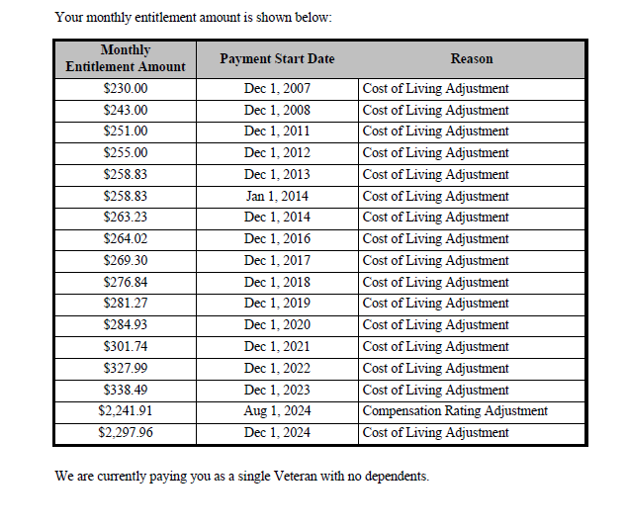
Change in disability pay over the years
This area is often missed; veteran needs to ensure it is correct.

Slide 17
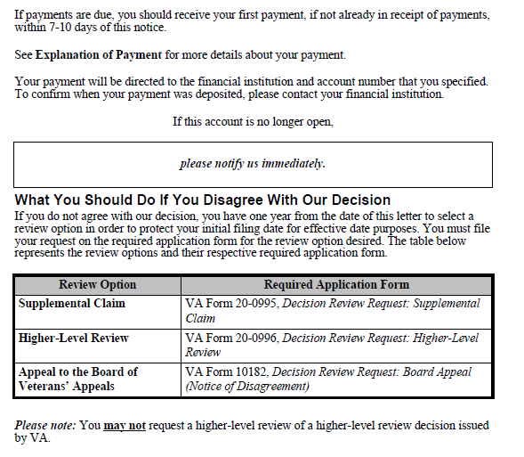
Direct deposit
Seek help of service officer

Slide 18
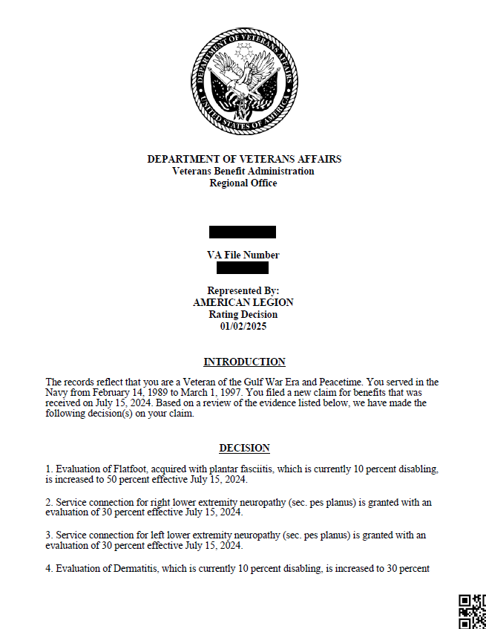

Slide 19
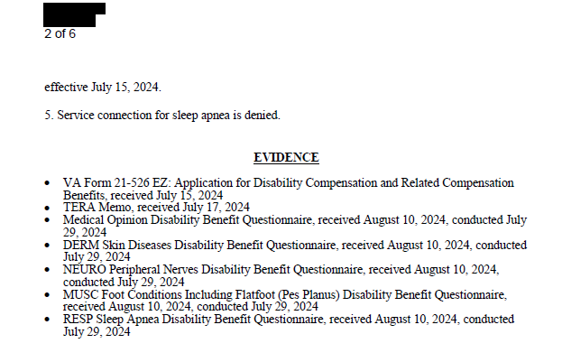
Ensure ALL the evidence that was submitted with the claim is listed

Slide 20
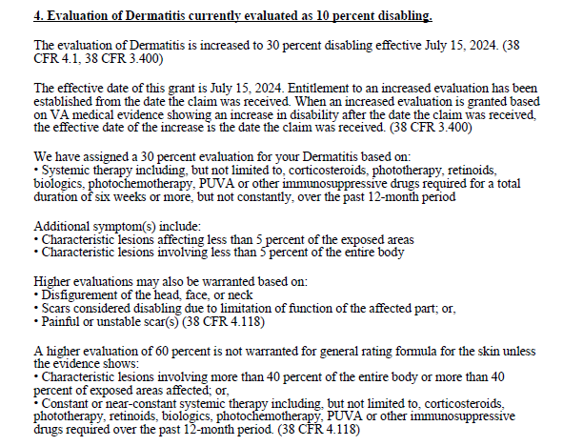
Why an increased evaluation was granted
What is need to meet the next higher evaluation

Slide 21
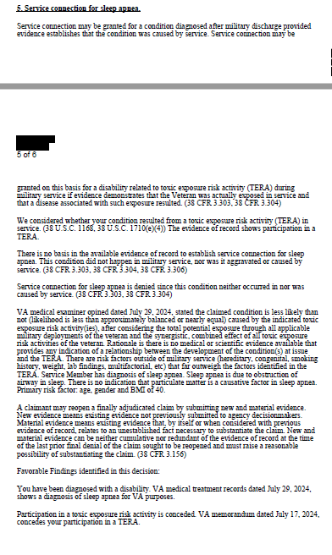
Favorable findings lists which of the three criteria for Service Connection have been met
(In-service event, current diagnosis, and/or nexus)

Slide 22
Notification Letter for Proposal to Reduce
30 days for hearing / 60 days for evidence

Slide 23
What may trigger an exam that will lead to a reduction
Cancer going into remission / surgically removed
Heart bypass / stent placement
Veteran submits a claim for increase
Veteran submits a claim for secondary condition (primary condition will be re-evaluated)

Slide 24
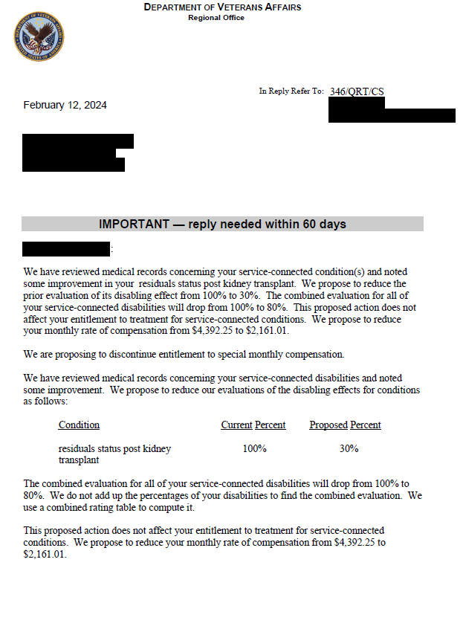

Slide 25
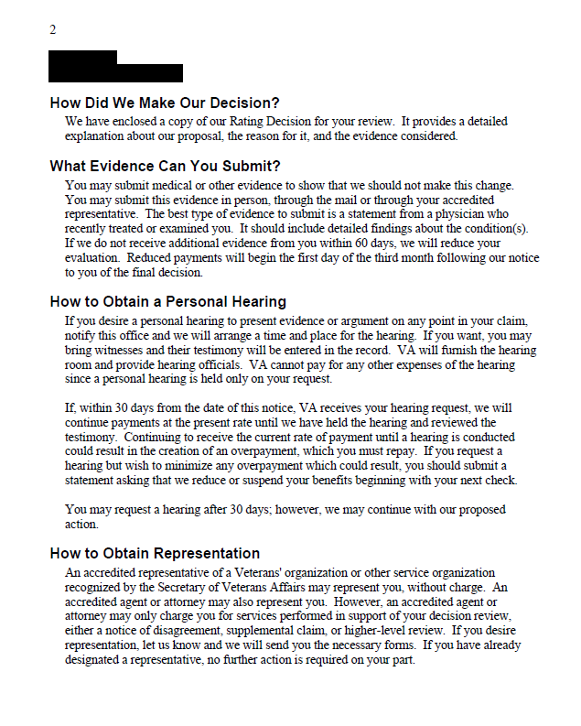







Additional evidence can be
submitted for 60 days
Request hearing within 30 days, reduction will not start until after hearing, could cause overpayment

Slide 26
BVA Decision Letter
365 day response to maintain effective date of claim

Slide 27
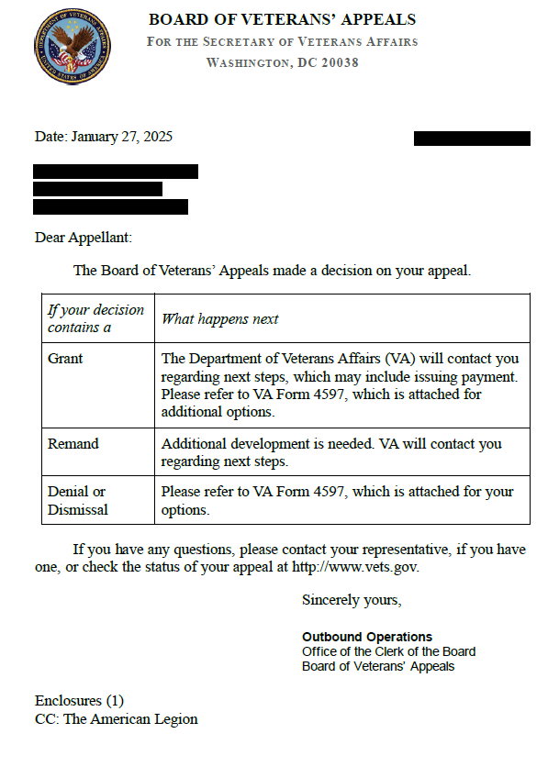

Slide 28
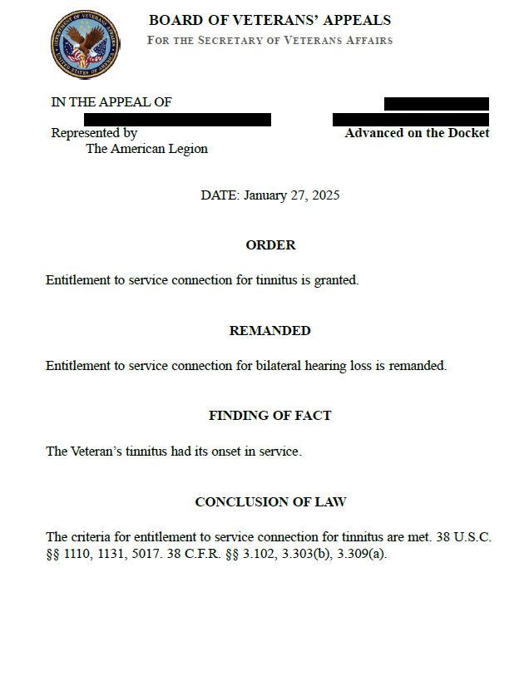
Grant – returned to VARO
for a rating decision
Remand – returned to VARO
to correct an error
(DTA, new exam, new opinion)
and to get a rating decision

Slide 29
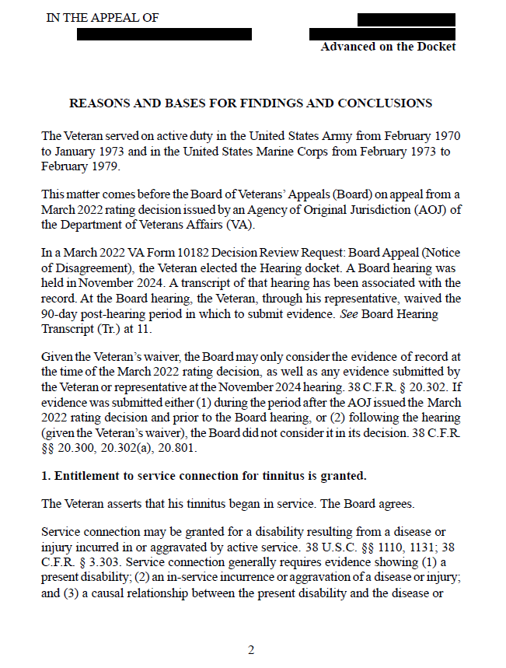

Slide 30
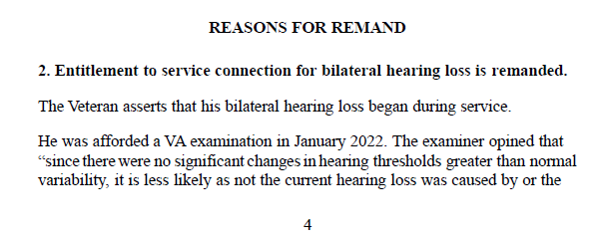

Slide 31
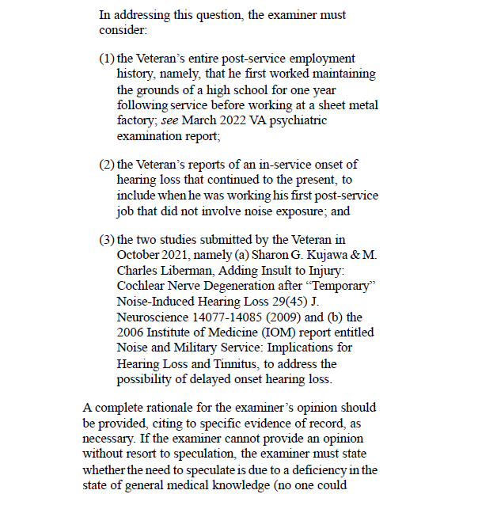
Board tells the VARO specifically
what they must do before rendering
a new decision

Slide 32
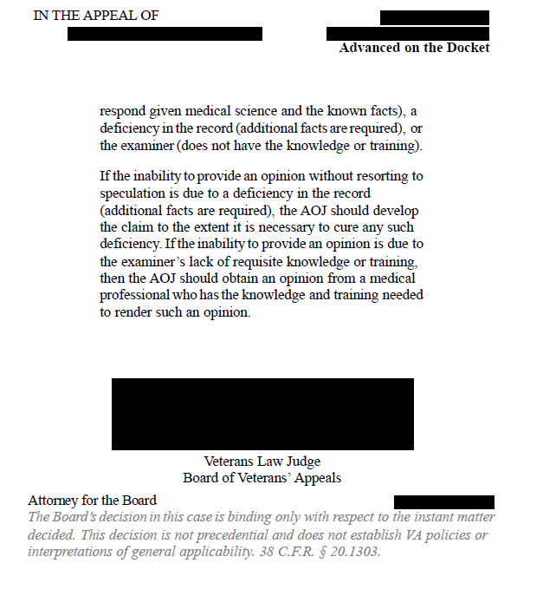

Slide 33
Debt Management Letter
30 days

Slide 34
Causes of Debt
Dependency change (ex: spouse dies / divorce)
Incarceration / Fugitive Felon
NSC Pension (ex: social security starts after NSC granted)
Reduction in Service-Connected disability.

Slide 35
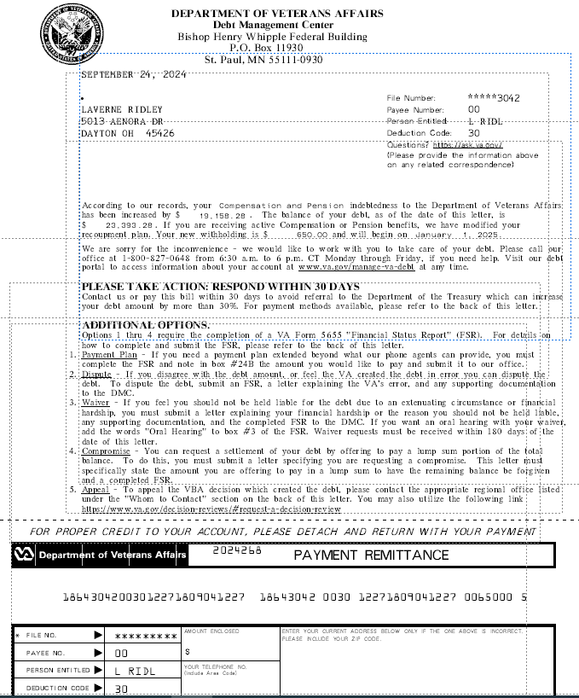









Debt must be paid back within 36 months
VAF 5655, Financial Status Report (Income minus expenses)
Financial hardship
Lump sum payment

Slide 36
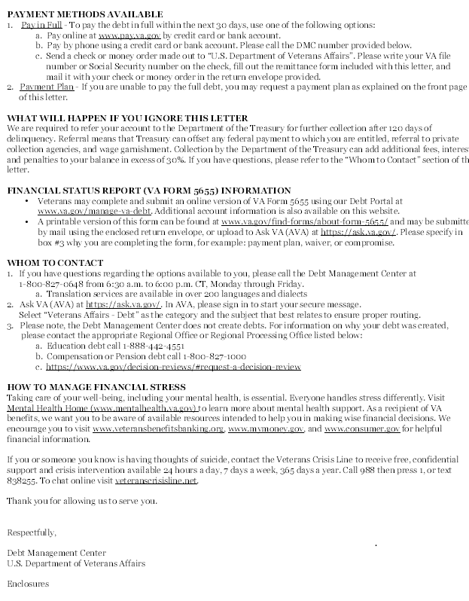

If veteran does not respond the VA will send the debt to the Department of Treasury.
Any Federal Payment can be offset (social security, federal retirement)

Slide 37
VA Internal Documents

Slide 38
VA Internal Documents
Code Sheet
ILER – Individual Longitudinal Exposure Record
TERA – Toxic Exposure Risk Activity

Slide 39
Code Sheet

Slide 40
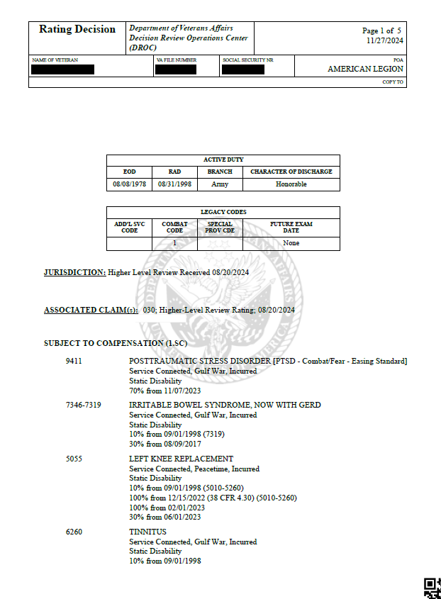
Active duty periods
Date the claim was received
Disabilities listed highest to lowest
Change in rating over the years

Slide 41
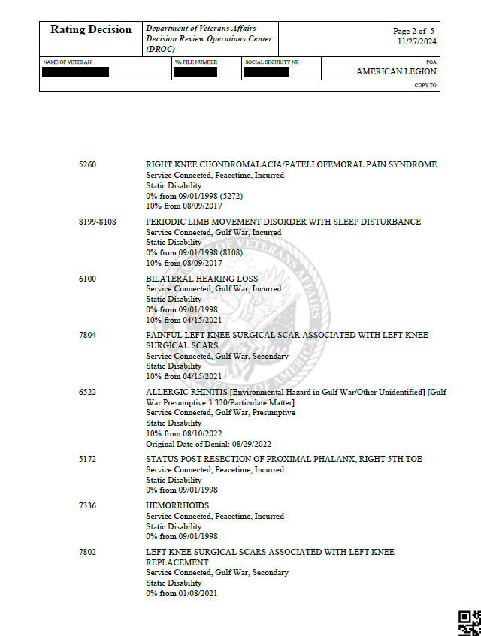

Slide 42
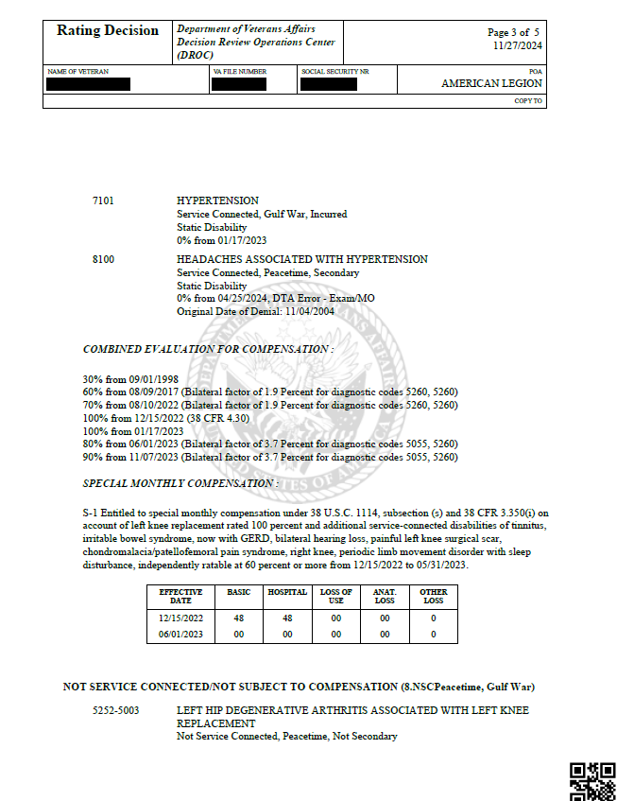
Combined Rating %
Denied issues and original
date of denial

Slide 43
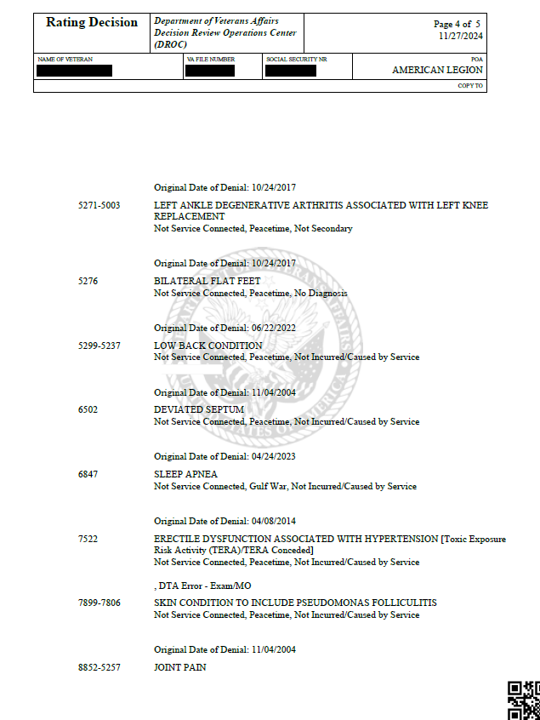
Any issues that are deferred
would be listed next

Slide 44
Individual Longitudinal Exposure Record

Slide 45
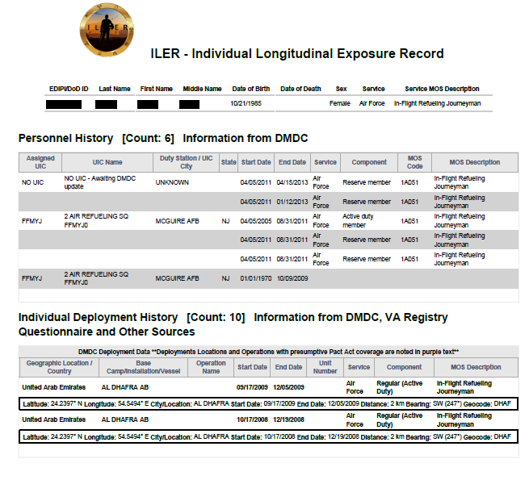
State Side:
Duty station
Time frame
MOS
Deployments:
Country/duty station
Time frame
MOS

Slide 46
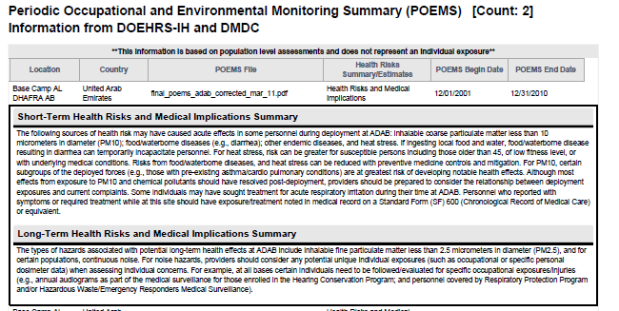
All exposures
listed individually

Slide 47
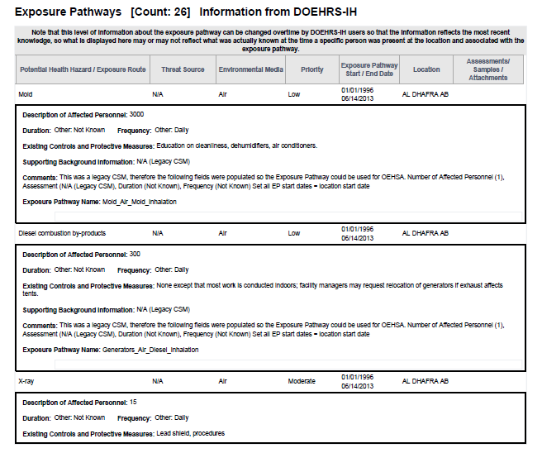

Slide 48
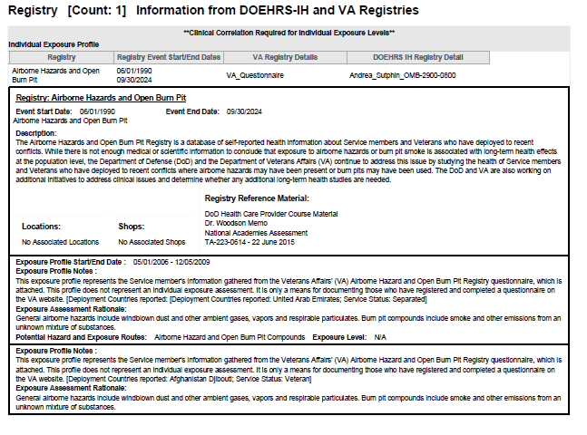

Slide 49
Total Exposure Risk Activity

Slide 50
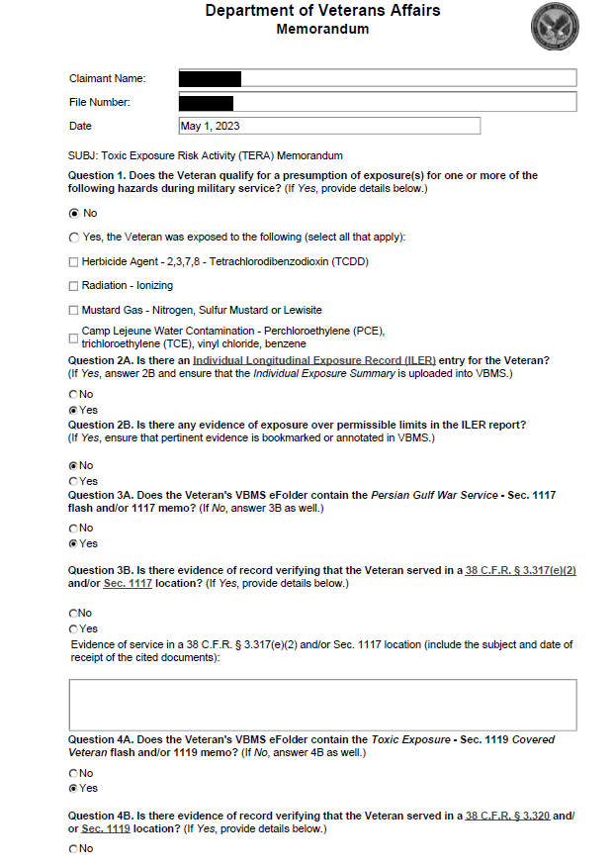
Pact Act
Sect 1119:
August 2, 1990
(i) Bahrain;
(ii) Iraq;
(iii) Kuwait;
(iv) Oman;
(v) Qatar;
(vi) Saudi Arabia;
(vii) Somalia; or
(viii) United Arab Emirates
September 11, 2001
(i) Afghanistan;
(ii) Djibouti;
(iii) Egypt;
(iv) Jordan;
(v) Lebanon;
(vi) Syria;
(vii) Yemen;
(viii) Uzbekistan; or
(ix) any other country determined
relevant by the Secretary.
Persian Gulf War
Sect 1117:
(i) Bahrain;
(ii) Iraq;
(iii) Kuwait;
(iv) Oman;
(v) Qatar;
(vi) Saudi Arabia; or
(vii) United Arab Emirates

Slide 51
