Slide 1

Understanding the Appeal Process

Slide 2
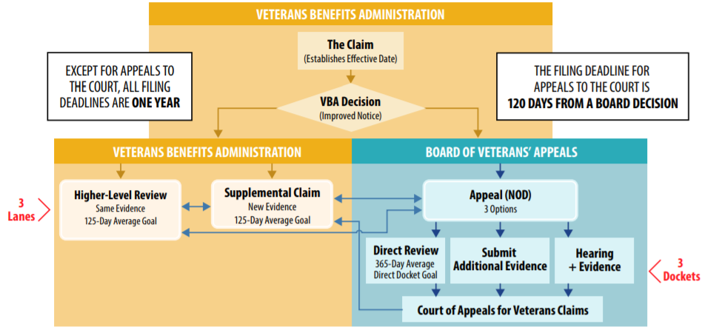
Decision Review Process for AMA

Slide 3

Supplemental Lane
Is used to reopen any previously denied claim over a year old. (formerly called reconsideration)
Also used to appeal a denial and provide new and relevant evidence to the VA for consideration to grant the claim.
Under this lane the VA Duty to assist still applies for claimants.

Slide 4
Higher Level Review Lane
Used when no new evidence is needed to prove the claim and the veteran feels the VA missed something in the record.
This is the fastest decision process for appeals.
The VA Duty to assist does not apply in this lane, if an error is found the claim will be kicked to the Supplemental lane.
Veteran can not send in any additional evidence to support the claim.
Advocates can submit a VA Form 21-4138 pointing out the veteran's record, and errors found. This is helpful to guide the Senior Rater to the discrepancies with the denial.

Slide 5
Board of Veterans Appeals Lane
Under the BVA Lane veterans and advocates have three lanes to choose from:
  Higher level Review:
    Same evidence, veteran can not submit anything new to the records. A Judge will review the record and render his/her decision. This is the fastest BVA Appeal lane approximately 125 days.
  Evidence submission NO HEARING:
    The veteran and advocate can submit additional relevant evidence to the claims file to be review in conjunction with all other evidence in the record. The veteran will not have a hearing with the BVA Judge.

Slide 6

Board of Veterans Appeals Lane
Evidence plus Hearing Lane:
  This is the slowest route at the BVA. Veterans and advocates can submit additional evidence at the hearing or up to 90 days after the hearing. Do not submit additional evidence prior to the BVA hearing with the Judge.
  Hearings are currently being scheduled as Virtual hearings, veterans must have laptop or computer with camera and microphone to conduct these virtual hearings. An Apple product can also be used i.e., iPhone, iPad. Further Google Chrome is the web browser that must be used to access the Hearing room.

Slide 7
Board of Veterans Appeals Hearings
BVA is conducting hearings via Virtual hearing option.
Veteran must have iPhone, iPad or computer with a working microphone and web camera to have virtual hearing.
Veterans can schedule to come to the Cleveland VA Regional Office to access the hearing with the DSO by appointment. The veteran can also seek assistance at the CVSC for help with computer access

Slide 8


US Court of Appeals for Veterans Claims (CAVC)
This is the final stop for appealing a denied decision. American Legion Department Service Officer can not represent veterans at this level of Appeal.
The American Legion partners with Bergmann and Moore, who specialize in Veterans law and will represent American Legion represented veterans at the CAVC free of charge to the veteran. https://www.vetlawyers.com/

Slide 9
Questions

